Slide 1
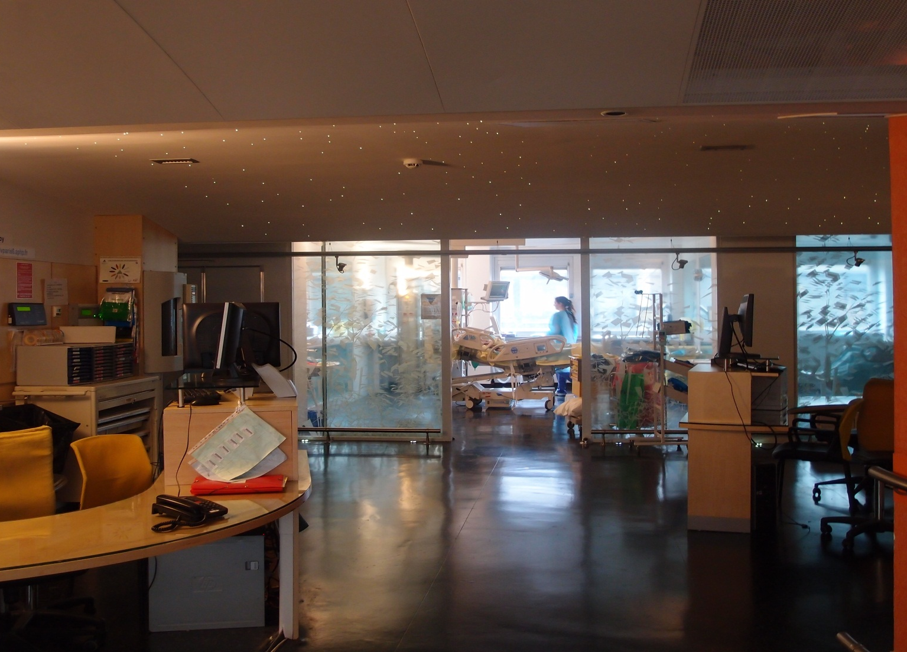
Basic skills in transthoracic lung ultrasound
Antoine Monsel, MD, PhD, Charlotte Arbelot, MD, Helene Brisson, MD, and Jean-Jacques Rouby, MD, PhD
Multidisciplinary ICU Department of Anesthesiology and Critical Care,
Pitié Salpêtrière Hospital, School of Medecine Sorbonne University, Paris, France
La Pitié-Salpêtrière
08 06 2012
Multisiciplinary ICU, Department of Anesthesiology, La Pitié-Salpêtrière Hospital, Sorbonne University, Paris France
JJR January 2020

Slide 2
Lung ultrasound: Image formation
Normally, ultrasounds are not transmitted through anatomical structures filled with gas and the lung parenchyma is not visible beyond the pleura.
.
Multisiciplinary ICU, Department of Anesthesiology, La Pitié-Salpêtrière Hospital, Sorbonne University, Paris France
JJR January 2020

Slide 3
Lung Ultrasound : normal aeration
0
Subcutaneous tissue
Pleural line
Pleural line
A line
A line
Lung sliding +
Horizontal «A» lines arising from pleural line.
A line
Multisiciplinary ICU, Department of Anesthesiology, La Pitié-Salpêtrière Hospital, Sorbonne University, Paris France
JJR January 2020

Slide 4
Lung Ultrasound : normal aeration
0
Pleural line and lung sliding
Pleural line
In 30 % of healthy volunters, 1 or 2 vertical B lines can be found, particularly in dependent lung regions
B line
B line
Normal aeration is defined as the presence of A lines and/or ≤ three B lines
B line
Multisiciplinary ICU, Department of Anesthesiology, La Pitié-Salpêtrière Hospital, Sorbonne University, Paris France
JJR January 2020

Slide 5
Interstitial syndrome
Lung Ultrasound : moderate loss of aeration
1
Interstitial pulmonary syndrome (edema, fibrosis) is characterized by accumulation of extravascular wa-ter within the interstitial space and the interface gas/tissue produces vertical artefacts which are detected as multiple spaced B lines.
.
Multisiciplinary ICU, Department of Anesthesiology, La Pitié-Salpêtrière Hospital, Sorbonne University, Paris France
JJR January 2020

Slide 6
Ultrasound characteristics of B lines
Arising from the pleural line or subpleural consolidations
Well defined
Reaching the edge of the screen
Moving with pleural line
Erasing horizontal A lines
Multisiciplinary ICU, Department of Anesthesiology, La Pitié-Salpêtrière Hospital, Sorbonne University, Paris France
JJR January 2020

Slide 7
False B lines E lines for subcutaneous Emphysema
Not arising from the pleural line
Well defined
Non synchronous with lung sliding
Erasing horizontal A lines
Transthoracic lung ultrasound cannot be performed in presence of subcutaneous emphysema
Lichtenstein Critical Care Medicine 35 (suppl 5): S250-S261, 2007
Multisiciplinary ICU, Department of Anesthesiology, La Pitié-Salpêtrière Hospital, Sorbonne University, Paris France
JJR January 2020

Slide 8
False B lines Z lines detected in more than 80% of patients with normal lungs
Arising from the pleural line
Not well defined
Non-synchronous with lung sliding
Do not erase horizontal A lines
When starting lung ultrasound practice, trainees overestimate the number of B lines because they mistake Z lines with B lines
Lichtenstein Critical Care Medicine 35 (suppl 5): S250-S261, 2007
Multisiciplinary ICU, Department of Anesthesiology, La Pitié-Salpêtrière Hospital, Sorbonne University, Paris France
JJR January 2020

Slide 9
Multiple B lines regularly spaced and arising from pleural line (1r)
Lung Ultrasound : moderate loss of aeration
1
Hemodynamic interstitial edema
7 mm-apart B lines issued from pleural line thickening of interlobular septa
B1 line
B1 line
B1 line
B1 line
Lichtenstein et al AJRCCM 156 : 1640-1646 , 1997
Multisiciplinary ICU, Department of Anesthesiology, La Pitié-Salpêtrière Hospital, Sorbonne University, Paris France
JJR January 2020

Slide 10
Multiple B lines, irregularly spaced and arising from the pleural line with limited lung sliding (1ir)
Lung Ultrasound : moderate loss of aeration
1
Interstitial pneumonia
Impaired lung sliding
B1 line
B1 line
B1 line
Multisiciplinary ICU, Department of Anesthesiology, La Pitié-Salpêtrière Hospital, Sorbonne University, Paris France
JJR January 2020

Slide 11
Small foci of bronchopneumonia
Lung Ultrasound : moderate loss of aeration
1
Multiple B lines, irregularly spaced and arising from small subpleural consolidations (1p)
B1 line
B1 line
B1 line
A Reissig et al Respiration 74 : 537 , 2007
B Bouhemad, JJ Rouby Critical Care Medicine 2009
JJR 05 12 2012
JJR January 2020
Multisiciplinary ICU, Department of Anesthesiology, La Pitié-Salpêtrière Hospital, Sorbonne University, Paris France

