Slide 1
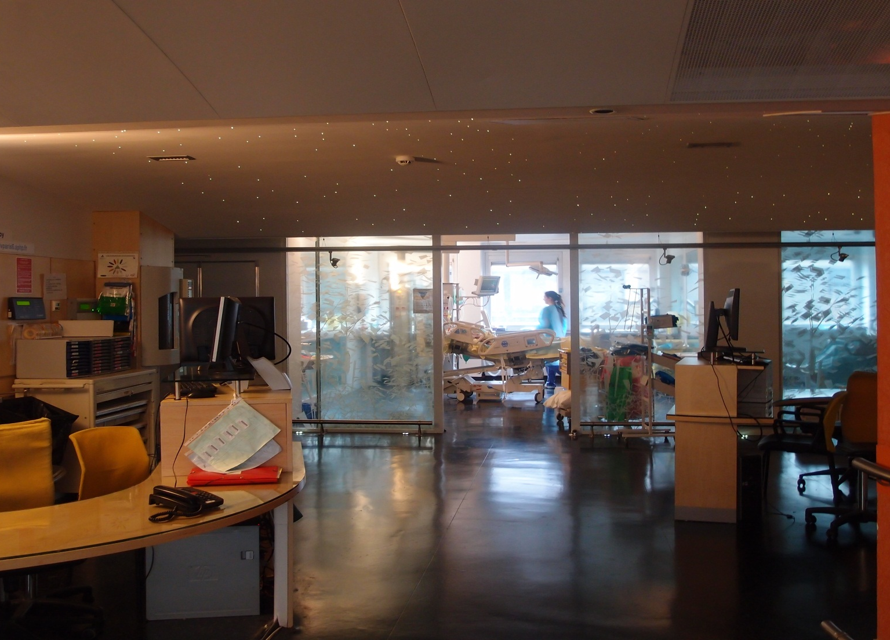

Basic skills in transthoracic lung ultrasound
Antoine Monsel, MD, PhD, Charlotte Arbelot, MD, Helene Brisson, MD, and Jean-Jacques Rouby, MD, PhD
Multidisciplinary ICU Department of Anesthesiology and Critical Care,
Pitié Salpêtrière Hospital, School of Medecine Sorbonne University, Paris, France
La Pitié-Salpêtrière
08 06 2012
Multisiciplinary ICU, Department of Anesthesiology, La Pitié-Salpêtrière Hospital, Sorbonne University, Paris France
JJR January 2020

Slide 2
Lung ultrasound: pleural effusion
  Pleural effusion is detected by lung ultrasound as a liquid accumulation between the diaphragm and the visceral pleura
Multisiciplinary ICU, Department of Anesthesiology, La Pitié-Salpêtrière Hospital, Sorbonne University, Paris France
JJR January 2020

Slide 3
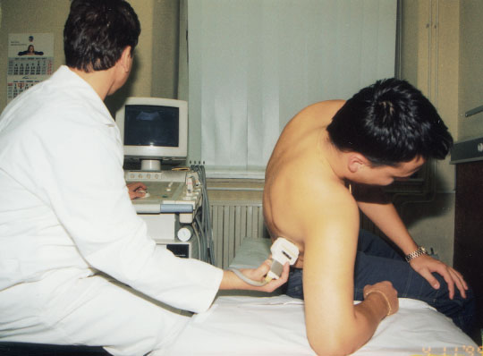
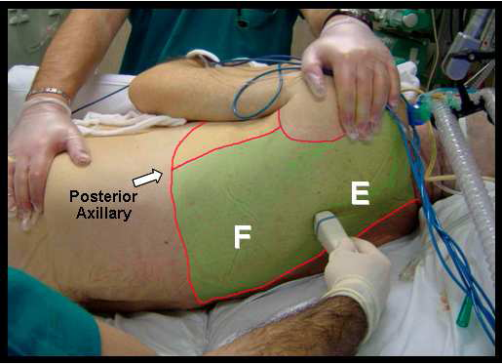
Ultrasound diagnosis of pleural effusion
  Pleural effusion is detected by lung ultrasound as a posterior fluid accumulation between the chest wall and the lung .
In medical patients
In critically ill patients
Kocijancic et al ., J Clin Ultrasound 31: 69-74, 2003
Via et al ., Int Care Med (in press), 2010
Multisiciplinary ICU, Department of Anesthesiology, La Pitié-Salpêtrière Hospital, Sorbonne University, Paris France
JJR January 2020

Slide 4
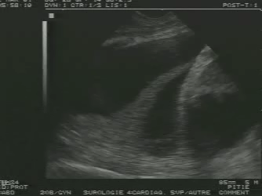
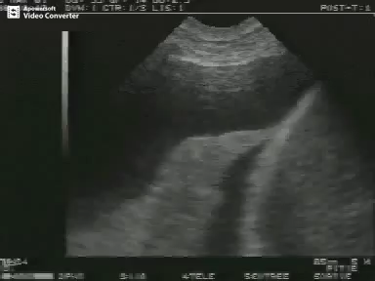
Fluid accumulation indicative of pleural effusion
A liquid collection
the thickness of which increases at inspiration
Pleural effusion
diaphragm
Abundant pleural effusion:
the nonaerated lower lobe « swims » within the pleural effusion
spleen
Lower lobe
BD Doust et al, Radiology 114 : 135-140 1975
Multisiciplinary ICU, Department of Anesthesiology, La Pitié-Salpêtrière Hospital, Sorbonne University, Paris France
JJR January 2020

Slide 5
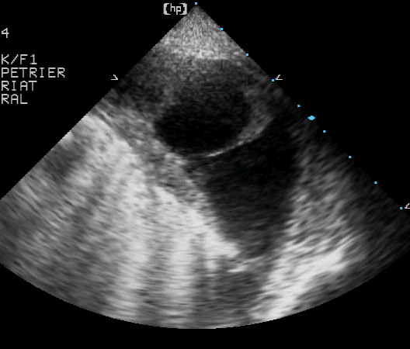
Pleural effusion with pleural adhesions
Multisiciplinary ICU, Department of Anesthesiology, La Pitié-Salpêtrière Hospital, Sorbonne University, Paris France
JJR January 2020

Slide 6
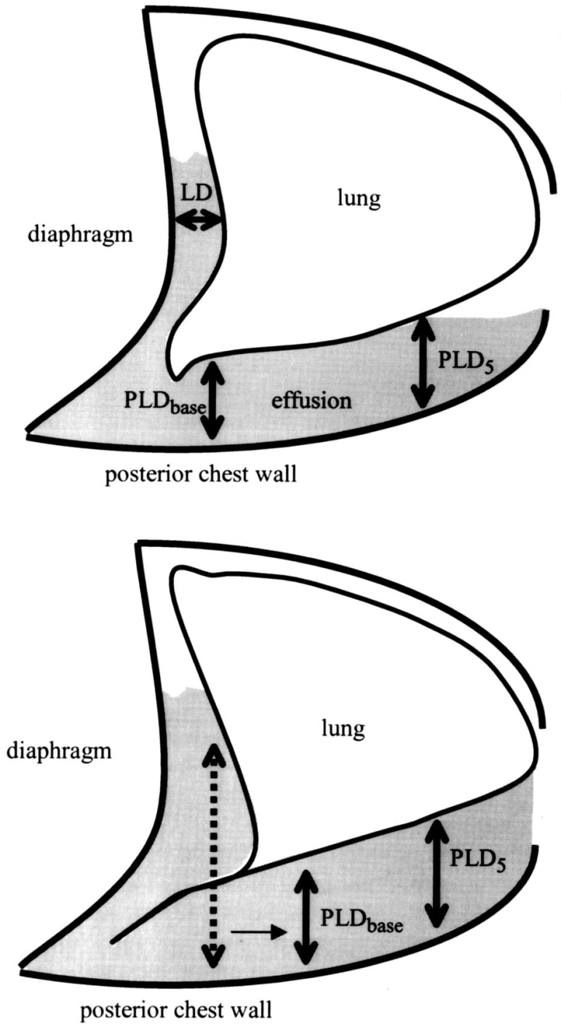
Quantification of pleural effusion ≥ 500 ml
Distance between the lung and the chest wall at the lung base (PLD_{base})
Between 3 et 5 cms, uncertainty
Roch A et al Chest 2005; 127:224–232
JJR 05 12 2012
JJR January 2020
Multisiciplinary ICU, Department of Anesthesiology, La Pitié-Salpêtrière Hospital, Sorbonne University, Paris France

Slide 7
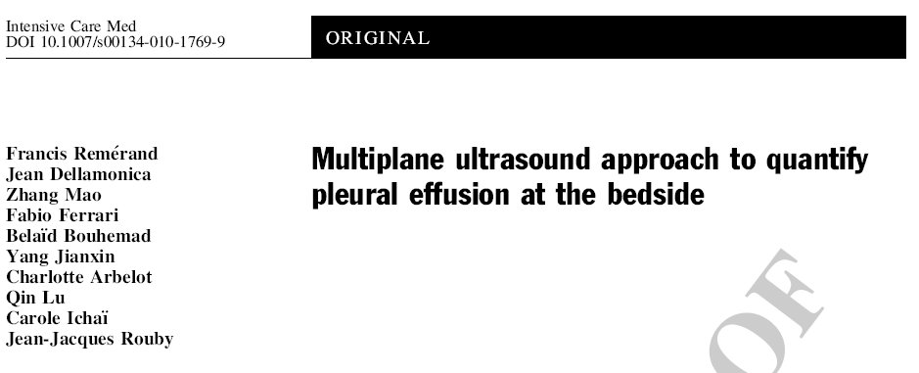
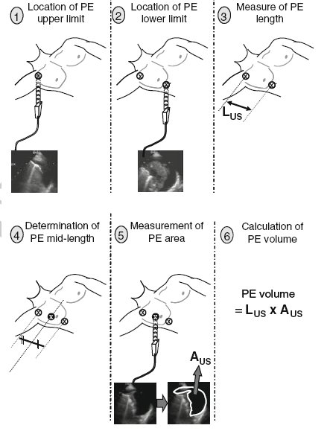
Quantification of pleural effusion ≥ 500 ml
2010 36: 656
PE volume_{US} = PE area_{midlength} x PE axial length
Multisiciplinary ICU, Department of Anesthesiology, La Pitié-Salpêtrière Hospital, Sorbonne University, Paris France
JJR January 2020

Slide 8
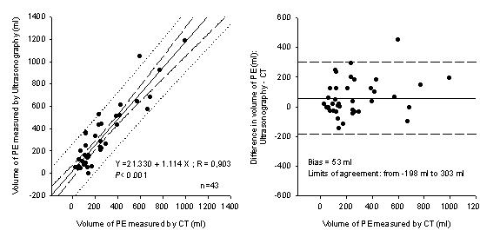
Validation of the formula - PE vol_{US} = PE area_{midlength} x PE axial length - for quantifying pleural effusion volume
Rémérand F et al Intensive Care Medicine 2010 36: 656-664
30 11 2011
JJR January 2020
Multisiciplinary ICU, Department of Anesthesiology, La Pitié-Salpêtrière Hospital, Sorbonne University, Paris France

Slide 9
Lung Ultrasound: pneumothorax
  Pneumothorax is detected by lung ultrasound as the abolition of lung sliding and can be ruled out in presence of « B lines».
Multisiciplinary ICU, Department of Anesthesiology, La Pitié-Salpêtrière Hospital, Sorbonne University, Paris France
JJR January 2020

Slide 10
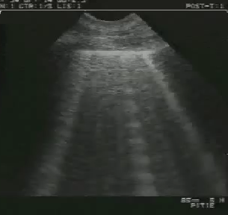
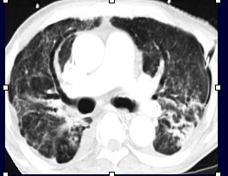
The presence of B lines arising from the pleural line rules out pneumothorax
Lichtenstein et al Intensive Care Medicine 25 : 383-388 , 1999
Multisiciplinary ICU, Department of Anesthesiology, La Pitié-Salpêtrière Hospital, Sorbonne University, Paris France
JJR January 2020

Slide 11
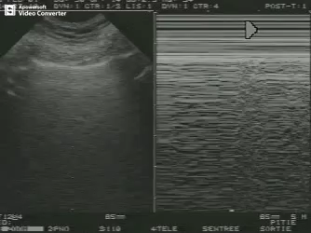
Without B lines, the absence of lung sliding is highly evocative of pneumothorax
Lichtenstein et al Intensive Care Medicine 25 : 383-388 , 1999
2D
MD
Using a high emission frequency (>10mHz) facilitates assessment of lung sliding
When using a 4 MHz microconvex probe, the use of monodimentional view is very usefull for assessing pneumothorax: the “seashore” sign
Intermittent pneumothorax following clamping and declamping of a chest tube
Multisiciplinary ICU, Department of Anesthesiology, La Pitié-Salpêtrière Hospital, Sorbonne University, Paris France
JJR January 2020

Slide 12
  Lung ultrasound is very accurate for detecting partial pneumothorax.
Multisiciplinary ICU, Department of Anesthesiology, La Pitié-Salpêtrière Hospital, Sorbonne University, Paris France
JJR January 2020

Slide 13
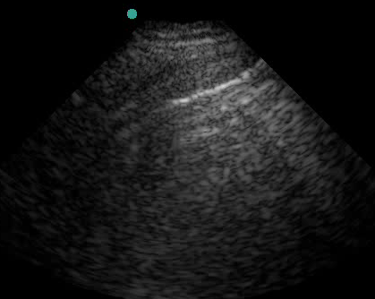
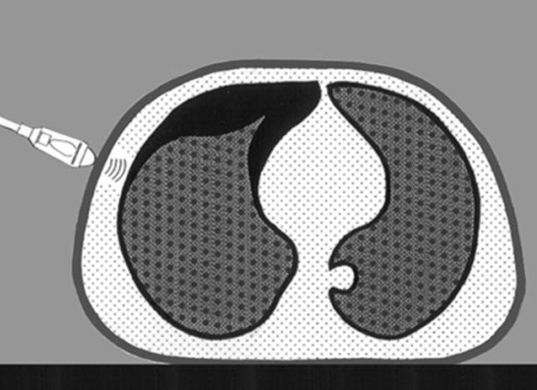
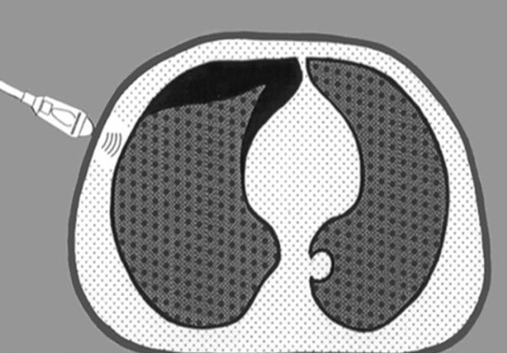
Partial pneumothorax is detected as the presence of «lung point»
Lichtenstein Critical Care Medicine 33 : 1231 , 2006
Zhang Mao et al Critical Care : 10 R112, 2006
Multisiciplinary ICU, Department of Anesthesiology, La Pitié-Salpêtrière Hospital, Sorbonne University, Paris France
JJR January 2020

Slide 14
Lung Ultrasound: anterior pneumothorax
  By checking carefully the lateral and anterior parts of each intercostal space, anterior pneumothorax can be exactly delineated.
Multisiciplinary ICU, Department of Anesthesiology, La Pitié-Salpêtrière Hospital, Sorbonne University, Paris France
JJR January 2020

