Slide 1
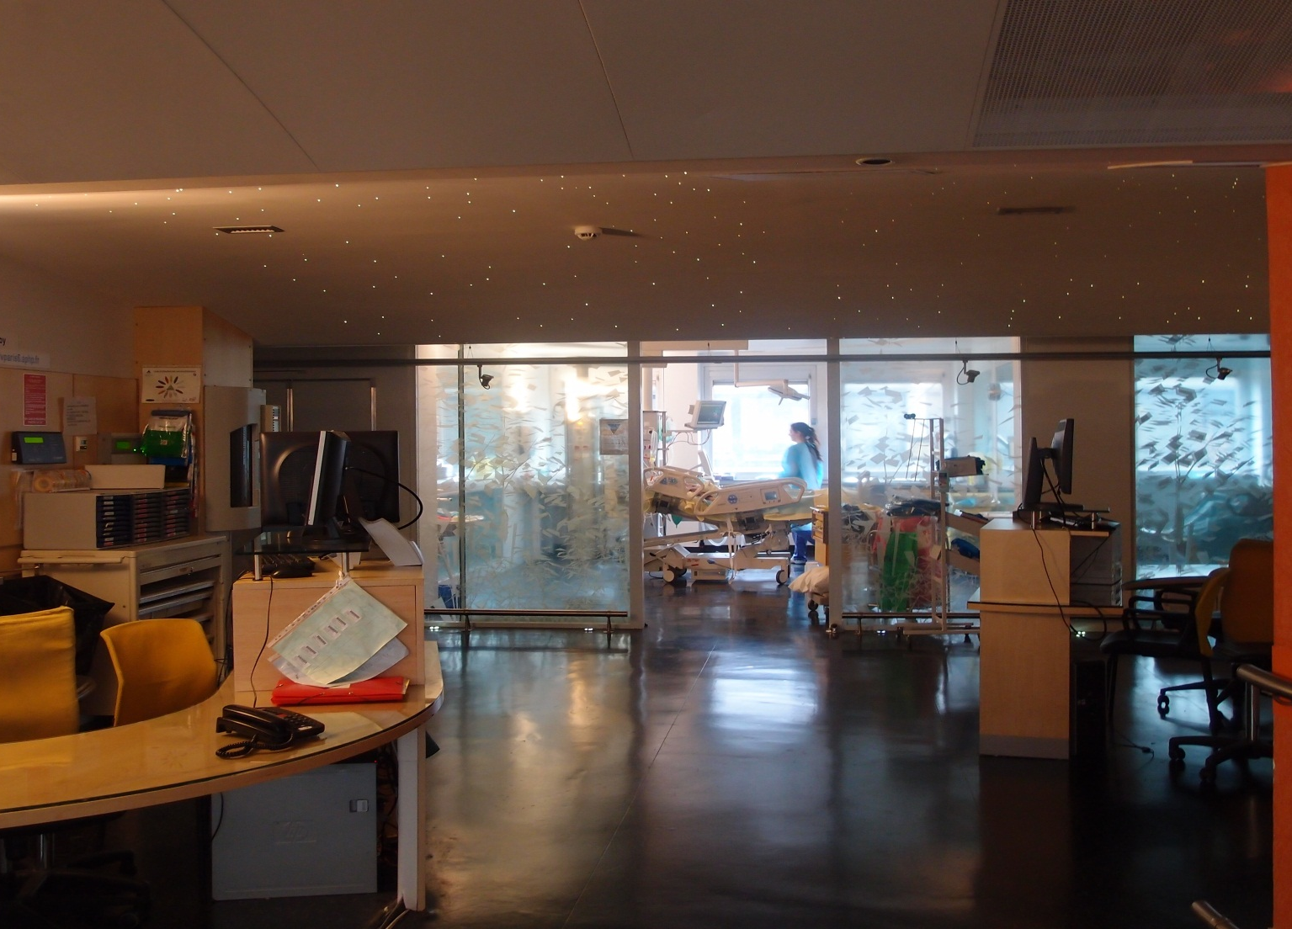
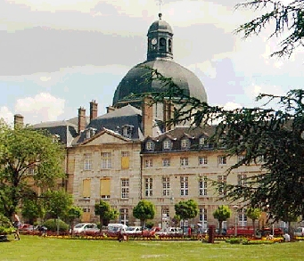
Basic skills in transthoracic lung ultrasound
Antoine Monsel, MD, PhD, Charlotte Arbelot, MD, Helene Brisson, MD, and Jean-Jacques Rouby, MD, PhD
Multidisciplinary ICU Department of Anesthesiology and Critical Care,
Pitié Salpêtrière Hospital, School of Medecine Sorbonne University, Paris, France
La Pitié-Salpêtrière
08 06 2012
Multisiciplinary ICU, Department of Anesthesiology, La Pitié-Salpêtrière Hospital, Sorbonne University, Paris France
JJR January 2020

Slide 2
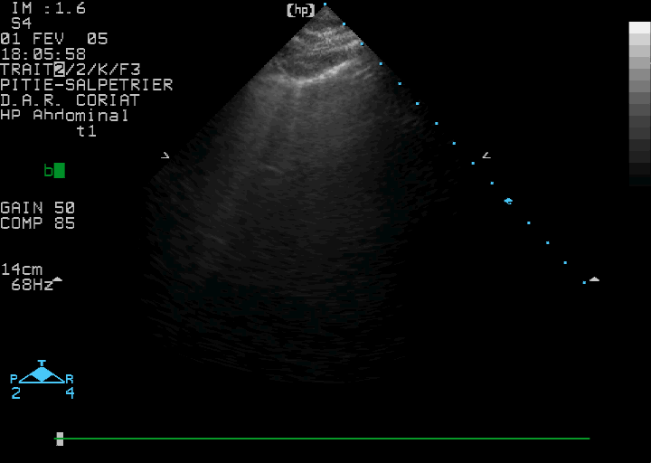
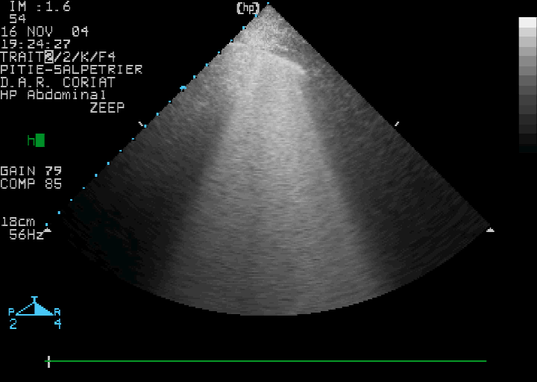
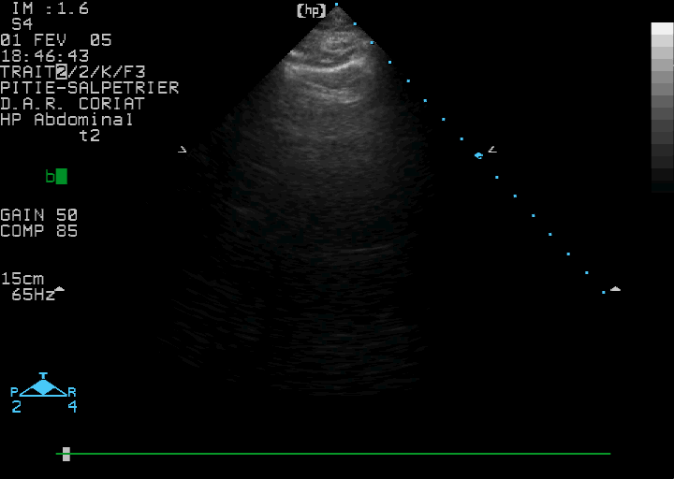
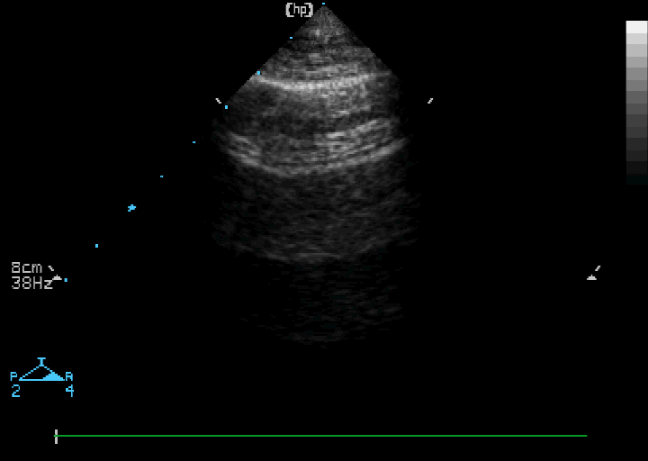
Reaeration score is calculated for each of the 12 examined regions
Interstitial syndrome (Before)
Alveolar edema (Before)
Normal ((After)
Normal (After)
1
3
Bouhemad B and Rouby JJ Critical Care Medicine 39: 84-92, 2010
Multisiciplinary ICU, Department of Anesthesiology, La Pitié-Salpêtrière Hospital, Sorbonne University, Paris France
JJR January 2020

Slide 3
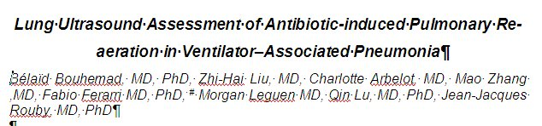
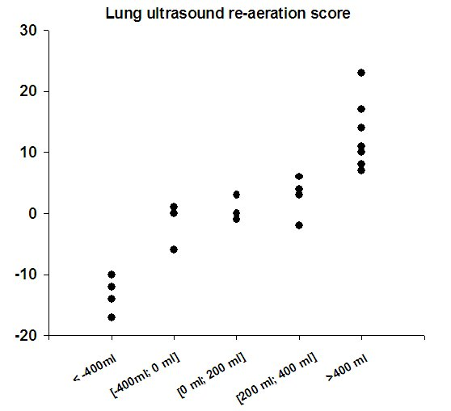
Bouhemad B and Rouby JJ Critical Care Medicine 39: 84-92, 2010
Lung Ultrasound vs Lung Computed Tomography
Multisiciplinary ICU, Department of Anesthesiology, La Pitié-Salpêtrière Hospital, Sorbonne University, Paris France
JJR January 2020

Slide 4
Transthoracic Lung Ultrasound allows the detection of reaeration resulting from efficient antibiotic treatment
Bouhemad B and Rouby JJ Critical Care Medicine 39: 84-92, 2010
30 patients avec pneumonie acquise sous ventilation mécanique
Multisiciplinary ICU, Department of Anesthesiology, La Pitié-Salpêtrière Hospital, Sorbonne University, Paris France
JJR January 2020

Slide 5
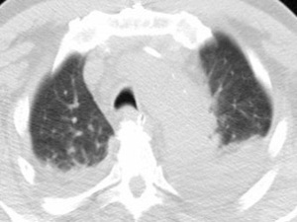
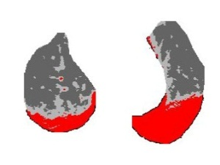
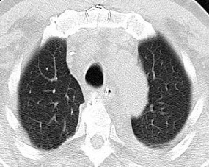
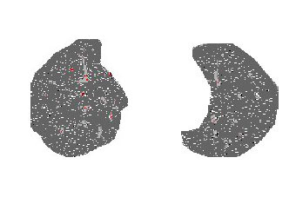
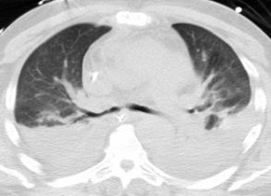
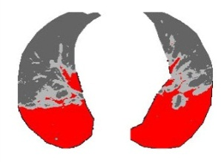
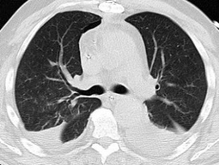
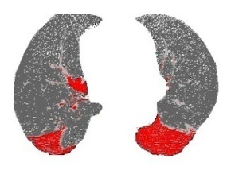
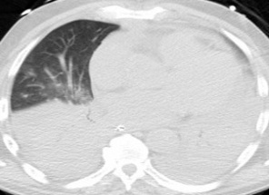
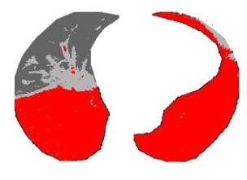
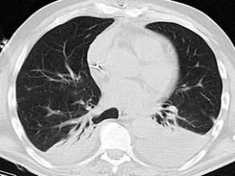
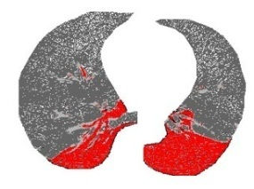
Exemple: a 60-year patient with VAP caused by Pseudomonas aeruginosa
Bouhemad B and Rouby JJ Critical Care Medicine 39: 84-92, 2010
30 patients with VAP
Before antibiotics (D₀ )
After antibiotics (D₉ )
Multisiciplinary ICU, Department of Anesthesiology, La Pitié-Salpêtrière Hospital, Sorbonne University, Paris France
JJR January 2020

Slide 6
Transthoracic Lung Ultrasound allows the detection of aeration loss resulting from failure of antibiotic treatment
Bouhemad B and Rouby JJ Critical Care Medicine 39: 84-92, 2010
30 patients with ventilator-associated pneumonia
Multisiciplinary ICU, Department of Anesthesiology, La Pitié-Salpêtrière Hospital, Sorbonne University, Paris France
JJR January 2020

Slide 7
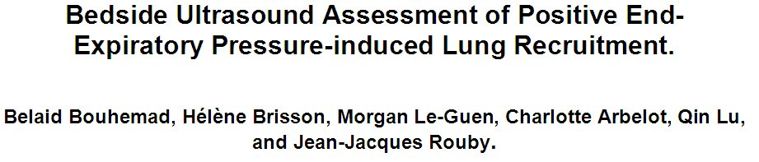
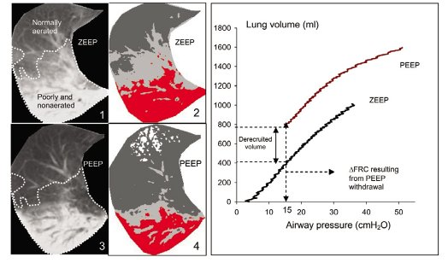
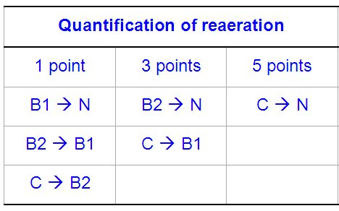
AJRCCM 183: 341-347, 2011
30 patients with Acute Respiratory Distress Syndrome
PV Curves
Score og lung reaeration
vs
Multisiciplinary ICU, Department of Anesthesiology, La Pitié-Salpêtrière Hospital, Sorbonne University, Paris France
JJR January 2020

Slide 8
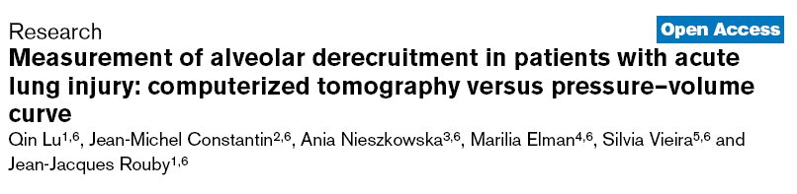
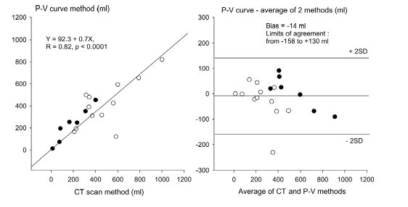
CRITICAL CARE 10: R95, 2006
Multisiciplinary ICU, Department of Anesthesiology, La Pitié-Salpêtrière Hospital, Sorbonne University, Paris France
JJR January 2020

Slide 9
Lung ultrasound allows semi-quantitative assessment of PEEP-induced alveolar recrutement in 40 patients with ARDS/ALI
AJRCCM 183: 341-347, 2011
Lung ultrasound vs PV curve method
Multisiciplinary ICU, Department of Anesthesiology, La Pitié-Salpêtrière Hospital, Sorbonne University, Paris France
JJR January 2020

