Slide 1
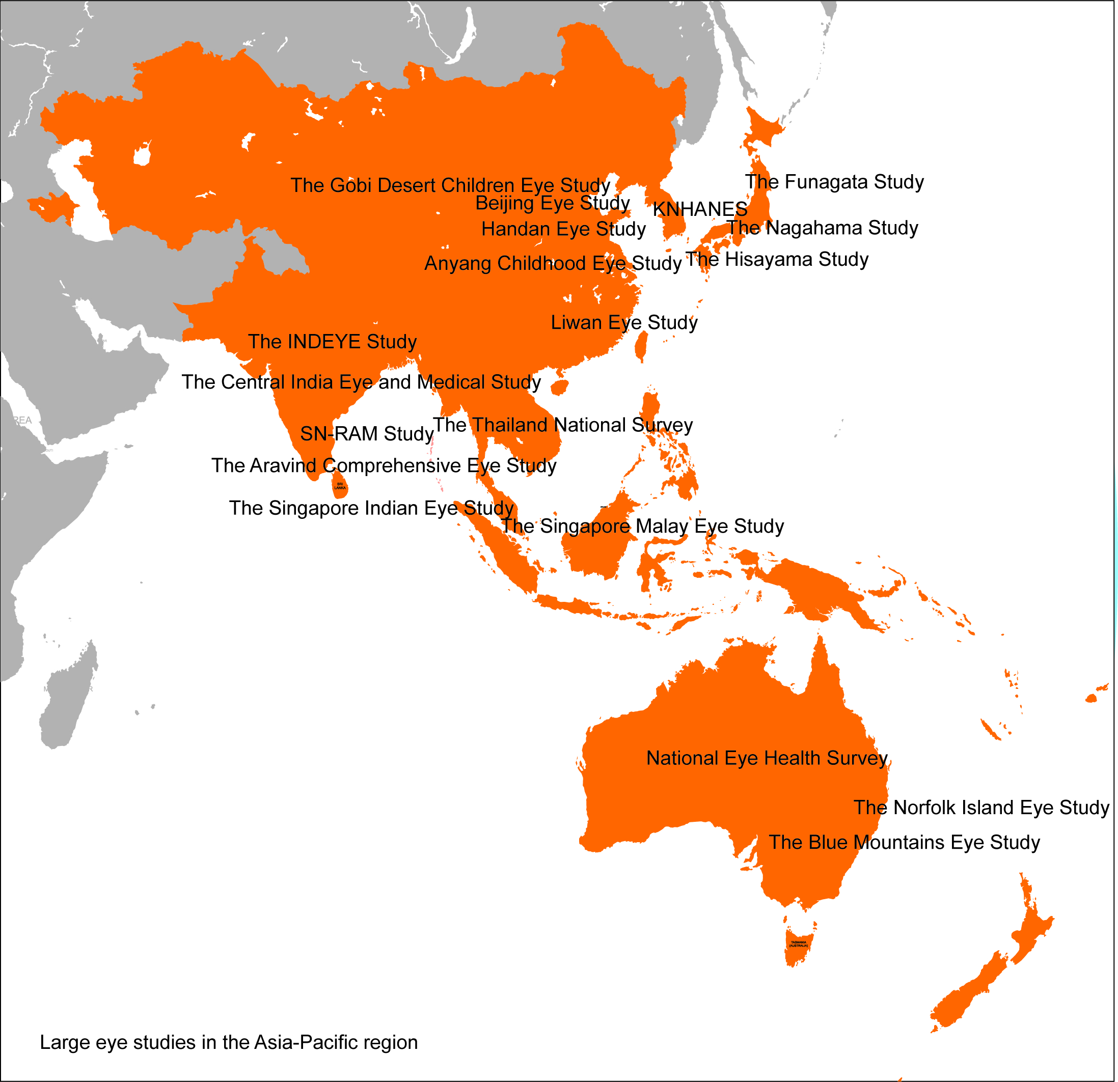
SDC, Figure 3:
Large eye studies in the Asia-Pacific region

