Slide 1
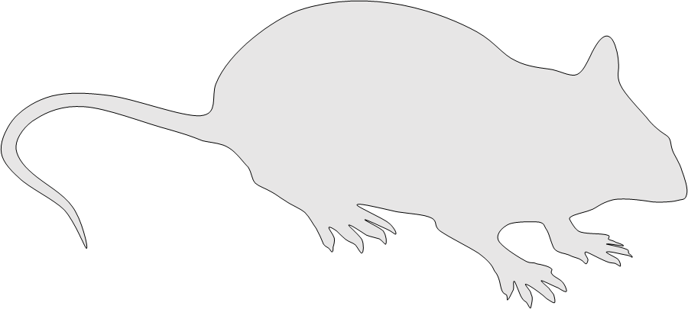
Supplemental Digital Content 6
A
Open field
Line crossing
2
1
Yes
No
Model of a open-field line-crossing test (A).

