Slide 1
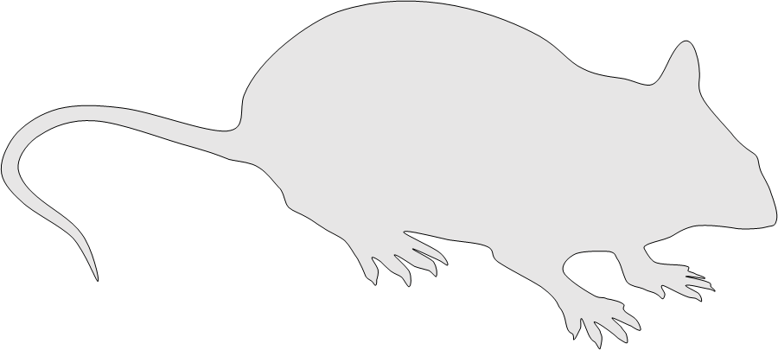
Supplemental Digital Content 8
A
Open field
Novel object
recognition
2
1
Yes
No
Model of a novel-object-recognition test (A).

