Slide 1
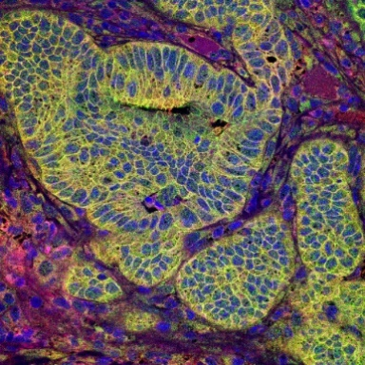
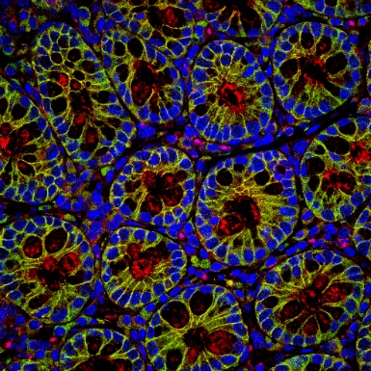
A
RTS*-Cy5.5
B
CLDN1
C
ρ=0.66
l
l
l
lp
g
lp
g
lp
g
C
C
C
adenoma
25 μm
adenoma
25 μm
adenoma
25 μm
D
RTS*-Cy5.5
E
CLDN1
F
ρ=0.60
lp
g
lp
g
lp
g
l
l
l
C
C
C
normal
25 μm
normal
25 μm
normal
25 μm

