Slide 1
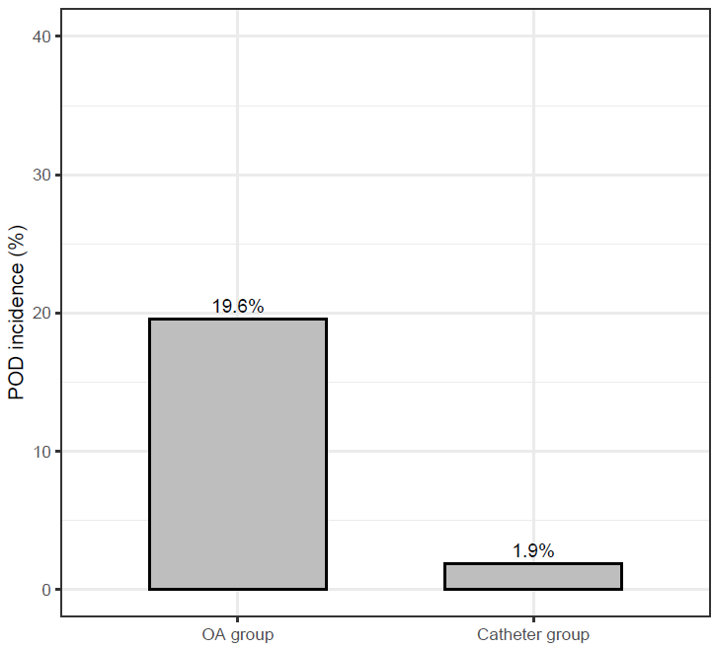
Effect of regional anaesthesia via preoperatively inserted parasternal catheters on postoperative delirium after cardiac surgery: the ORACAT study
Study population
Postoperative delirium (POD) incidence (%)
* P-value = 0,005
Adults ≥ 18 years
Cardiac surgery involving sternotomy and cardiopulmonary bypass
*
N = 100
Catheter group
Opioid Anaesthesia group
N = 54
N = 46
After cardiac surgery involving sternotomy, regional anaesthesia via parasternal catheters inserted pre-sternotomy reduced POD incidence without major adverse events.
Elhadjene et al. Eur J Anaesthesiol. August 2023
@EJA_Journal Copyright © 2021 Copyright © European Society of Anaesthesiology and Intensive Care. Unauthorized reproduction of this abstract is prohibited.

