Slide 1
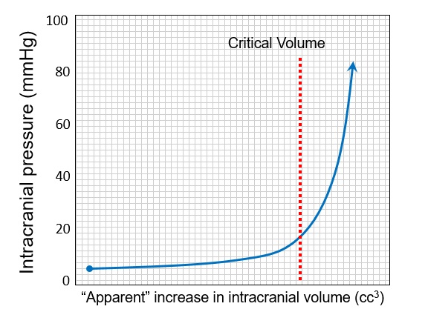
SDC 2. Intracranial Compliance Curve. For a given change in intracranial volume at lower intracranial pressure, the brain is compliant and only minimal increase in ICP arises. However, eventually capacitive mechanisms are exhausted and each small apparent increment in volume produces a correspondingly much larger increment in ICP. A non-linear, apparently exponential relationship is evident.
Notably, proper physiological terminology refers to this figure as an elastance curve but we use the conventional nomenclature here. Also, given that intracranial volume is an unchanging constant, the change in intracranial volume noted in this figure is somewhat of a misnomer, as “apparent added volume” displaces CSF or blood until such adaptations are exhausted whereupon ICP increases dramatically. ICP-intracranial pressure; CSF-cerebrospinal fluid

