Slide 1
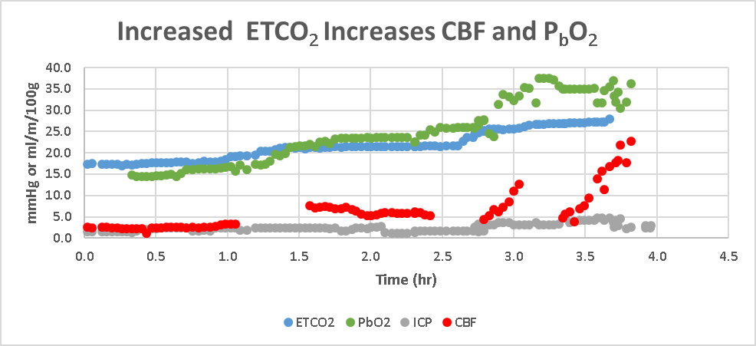
SDC 9. Increase in CBF and P_{b}O₂ with increased CO₂. This graph is from a UPenn NeuroICU patient illustrating the impact of decreasing minute ventilation to increase CBF (CBF by invasive thermodilution—data gaps arose with auto recalibration), reflecting the potential for PCO₂ increases to produce a hyperemic intracranial hypertension subset. In this patient brain compliance was normal such that a large ICP increment was not observed with CBF increase. P_{b}O₂ – brain O2 tension(mmHg); EtCO2-end-tidal CO₂(mmHg₎; ICP-intracranial pressure(mmHg), CBF-cerebral blood flow (ml/min/100g)

