Slide 1
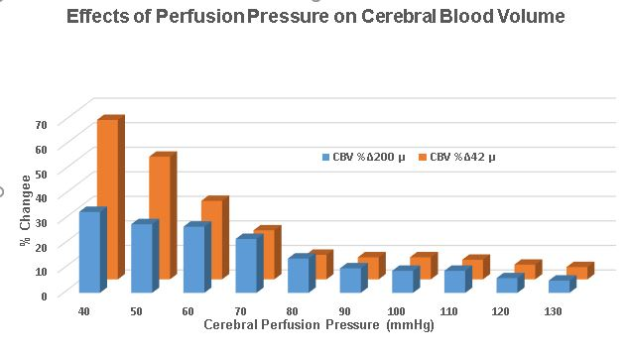
Effects of Perfusion Pressure on Cerebral Blood Volume
% Change
Cerebral Perfusion Pressure (mmHg)
SDC 15. Non-linear relationship of cerebral blood volume to blood pressure. Within the upper CPP range of autoregulation of CBF, CBV increases only a small amount for a given decrement in blood pressure, but at the lower range of autoregulation of CBF, a given decrement in blood pressure produces significant and exponential increments in CBV. Data for small and larger arterioles presented as % change in CBV. Figure from data presented by Rosner and Becker. CPP-cerebral perfusion pressure; CBF-cerebral blood pressure; CBV-cerebral blood volume
Rosner MJ, Becker DP. Origin and evolution of plateau waves. Experimental observations and a theoretical model. J Neurosurg 1984;60: 312-24.

