Slide 1
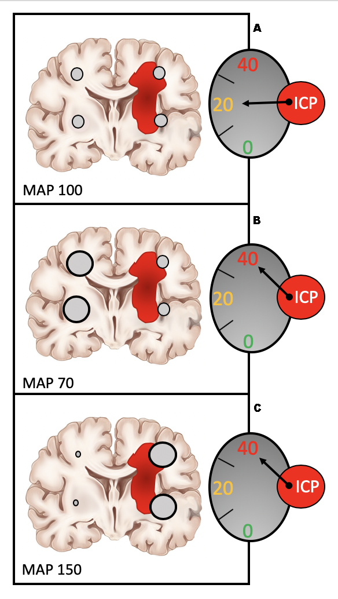
SDC 17
Role of heterogeneous autoregulation in plateau wave and dysregulation physiology
(A) A patient with heterogeneous injury is depicted with dysautoregulation on the injured side and intact autoregulation on the contralateral (uninjured) side. The injury and associated mass and edema effect increase ICP somewhat with associated decrement in intracranial compliance.
(B) In this physiologic context, a decrement in blood pressure produces vasodilation with increased cerebral blood volume on the uninjured side with a corresponding increase in ICP.
(C) In contrast, an increase in blood pressure causes vasoconstriction on the uninjured side, but dysregulated hyperemia and increased cerebral blood volume on the injured side. Notably, in this depiction, similar elevations in ICP are produced by distinctly different physiologic conditions.
ICP, intracranial pressure

