Slide 1
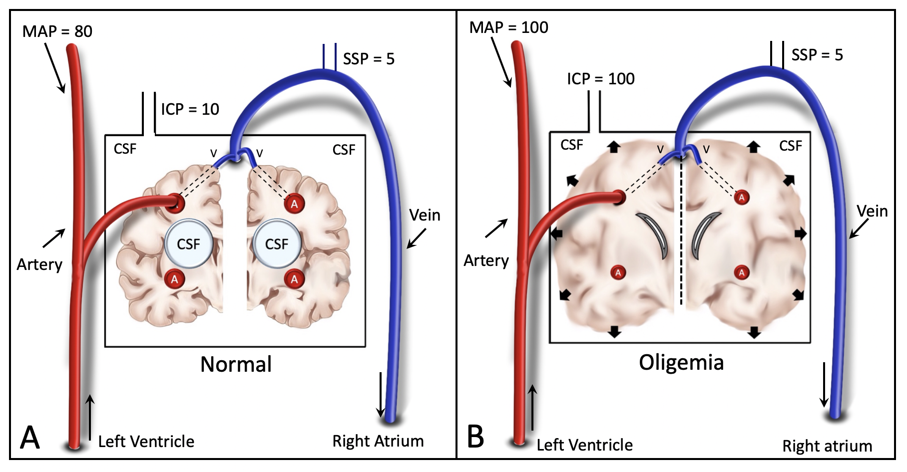
SDC 24
Oligemic Intracranial Hypertension.
Normal physiologic state with normal blood pressure and ICP with normal blood vessels.
ICP is increased to systemic blood pressure levels due to massive tissue edema, pinching off blood flow and compressing the ventricles
ICP, intracranial pressure

