Slide 1
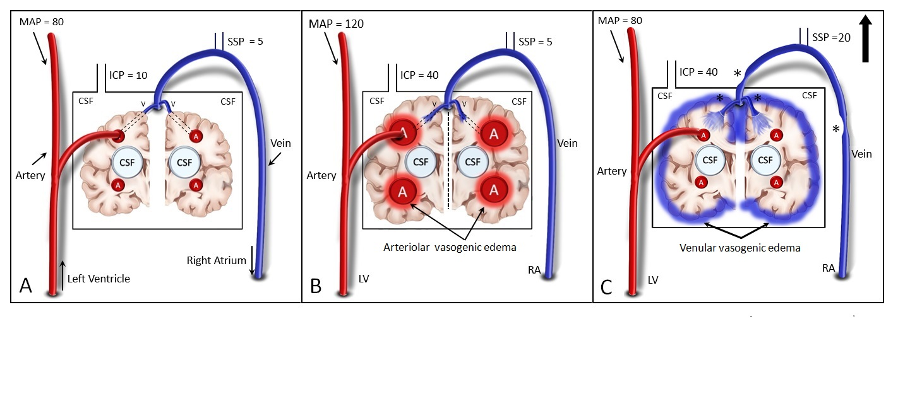
SDC 25
Vasogenic edema from arterial and venous causes
Baseline state with normal blood pressure, venous pressure, and ICP.
Dysregulated cerebral hyperemia with hypertension, produces peri-arteriolar tissue vasogenic edema with elevated ICP
Increased venous pressure, at possible points noted by an asterisk, produces peri-venular tissue vasogenic edema with elevated ICP.
Note the depiction of similar levels of elevated ICP from distinctly different causes of vasogenic edema.
ICP, intracranial pressure

