Slide 1
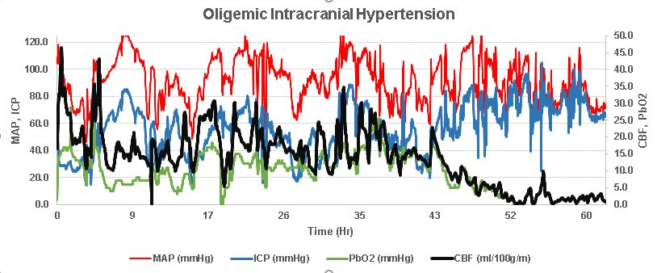
SDC 26. Oligemic intracranial hypertension progressing to brain death. Graph from a post cardiac arrest patient in the UPenn NeuroICU with intracranial physiology progressing to brain death. ICP is persistently high and rising, eventually in the range of arterial blood pressure. This may indicate concurrent impairment in blood brain barrier, as ICP initially varies directly with MAP but then progressively increases. Concomitantly there is seen a progressive decrement in CBF (thermodilution) and PbO₂, both approaching zero by the end of the tracing. Brain tissue temperature (not shown) correspondingly decreases as blood flow ceases. MAP-mean arterial pressure, ICP-intracranial pressure, PbO₂- brain tissue PO₂, CBF-cerebral blood flow.

