Slide 1
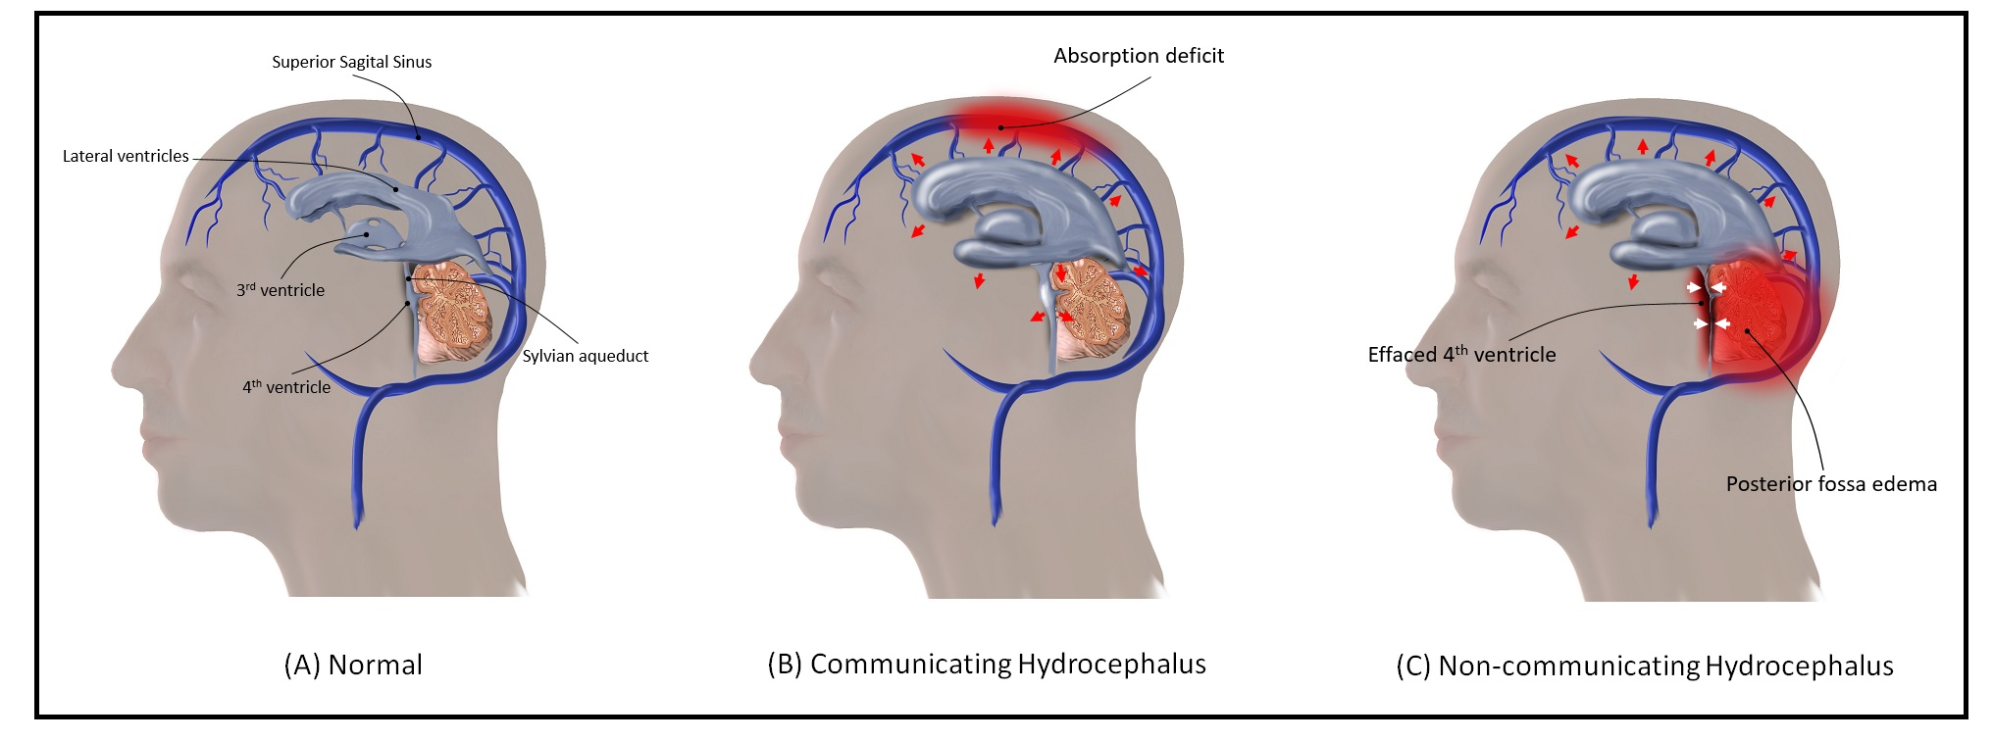
SDC 27. Hydrocephalus. (A) CSF is produced in the ventricles, traverses the 4th ventricle to be absorbed in the sagittal sinus. (B) Communicating hydrocephalus arises when there is an obstruction to reabsorption of CSF in the sagittal sinus. (C) Non-communicating hydrocephalus arises when there is interference with flow of CSF from ventricles to the sagittal sinus as may arise with obstruction or edema in the posterior fossa. CSF-cerebrospinal fluid

