Slide 1
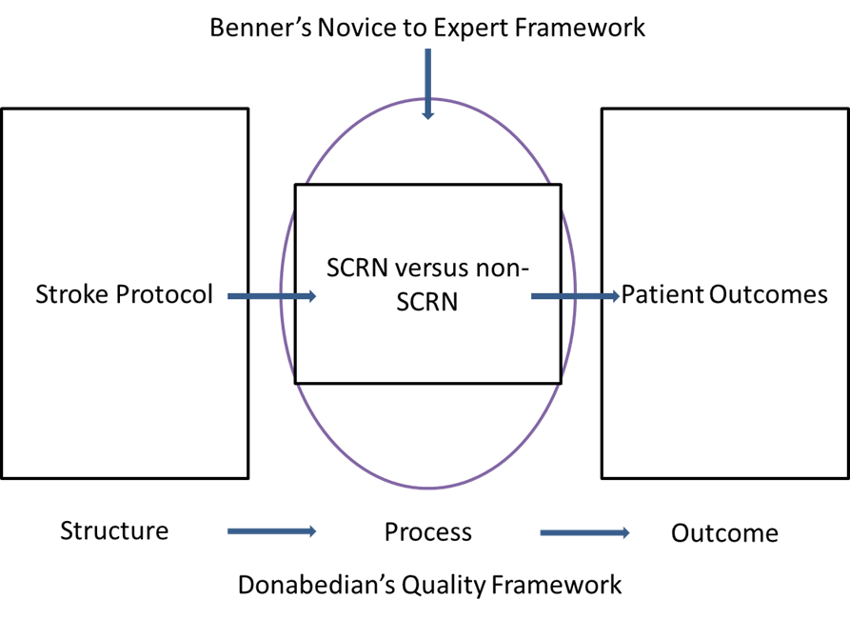
Figure 1 Benner/Donabedian Framework (Fant, 2016)

