Slide 1
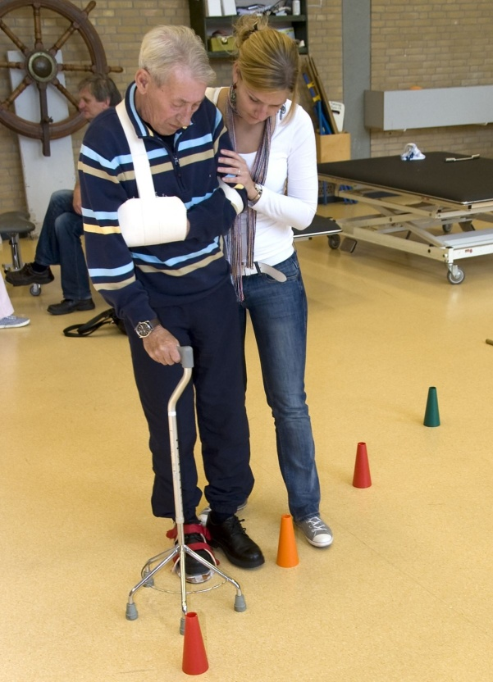
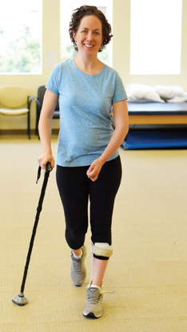
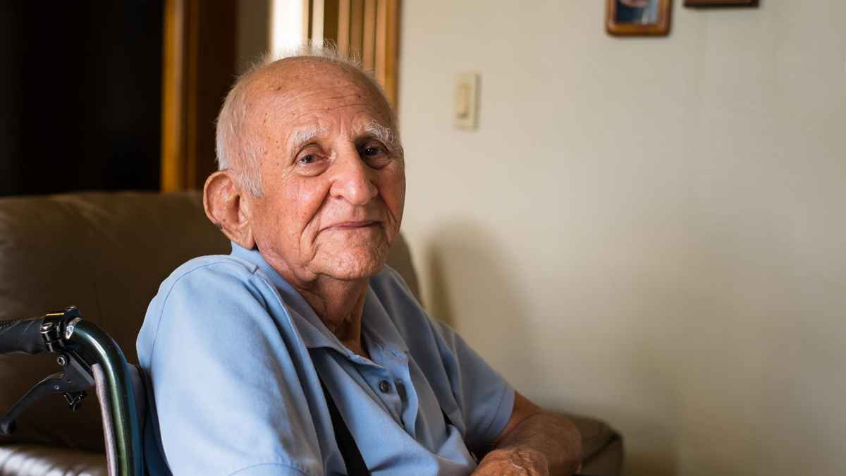
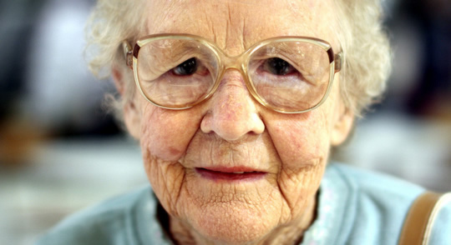

Slide 2
Rational
In this paper we focused our attention on PwMS.
More than 50% of PwMS fall at least once a year.
More than 90% report balance and mobility problems. Which makes them prone to falling.
Decline in both gait speed and frontal plane (medio-lateral) stability have been associated with increased falling risk in PwMS.

Slide 3
Reliability and Concurrent Validity of the Narrow Path Walking Test in People with Multiple Sclerosis

Slide 4
Objective
To test the reliability and concurrent validity of
a novel balance walking test in PwMS called
the Narrow Path Walking Test.

Slide 5
Narrow Path Walking Test

Slide 6
Methods
30 volunteers with MS.
0
Test 1:
NPWT+ Clinical Tests
Test 2:
NPWT
0
1
2
3
4
5
6
7
(Days)

Slide 7
Outcome measures
Relative reliability of reproducibility of testing procedure between tests
Absolute reliability (measurement error )
Number of Steps
Trial time
Step Errors
Cog. Task Errors
Number of balance losses.
Trial Velocity
Step Length

Slide 8
Correct Step

Slide 9
Step Error

Slide 10
Conclusions
The NPWT is easy to administer.
We provide Smallest Real Difference values for the individual and the group level.
Making the NPWT applicable not only for research but also for assessment of clinical progress in PwMS.

