Slide 1
Supplement 1. Average antibiotic usage for the treatment of acute pyelonephritis in Korea by hospital type
Second-generation cephalosporins
Fourth-generation cephalosporins
Beta-lactam/beta-lactamase inhibitors
Trimethoprim/sulfamethoxazole

Slide 2
A
B
DDD
DDD
Year
Year
C
D
DDD
DDD
Year
Year

Slide 3
Supplement 2. Mapping of clusters with higher average antibiotic usage of acute pyelonephritis in Korea by antibiotic class
Second-generation cephalosporins
Fourth-generation cephalosporins
Beta-lactam/beta-lactamase inhibitors
Trimethoprim/sulfamethoxazole

Slide 4
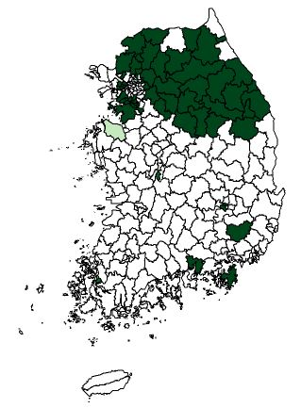
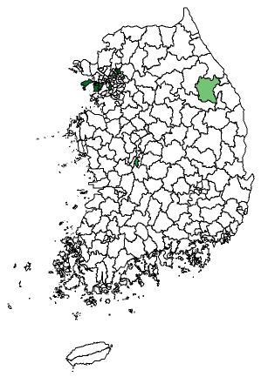
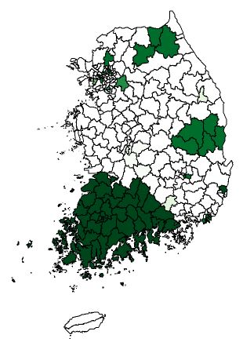
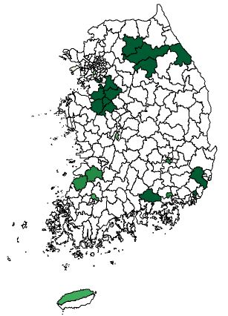
A
B
Average: 0.67 DDD/event
Average: 0.05 DDD/event
Gyeonggi-Gangwon provinces cluster
(1.02 DDD/event, RR 1.59, P <0.001)
The southern regions of Gyeonggi province cluster
(1.19 DDD/event, RR 1.84, P <0.001)
Incheon cluster
(0.17 DDD/event, RR 3.62, P <0.001)
C
Gangwon province cluster
(1.13 DDD/event, RR 1.58, P <0.001)
D
Average: 0.72 DDD/event
Average: 0.09 DDD/event
Gangwon province cluster
(0.14 DDD/event, RR 1.63, P <0.001)
Gyeongsangbuk province cluster
(1.18 DDD/event, RR 1.65, P <0.001)
The sourthern regions of Gyeonggi province cluster
(0.16 DDD/event, RR 1.96, P <0.001)
Jeollabuk-Jeollanam-Gyeongsangnam provinces cluster
(0.94 DDD/event, RR 1.38, P <0.001)
Busan cluster
(1.13 DDD/event, RR 1.61, P <0.001)

Slide 5
Supplement 3. Mapping of clusters with higher average medical costs and hospital days for the treatment of acute pyelonephritis in Korea
Clusters with higher average medical costs
Clusters with higher average hospital days

Slide 6
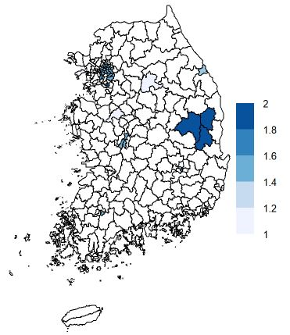
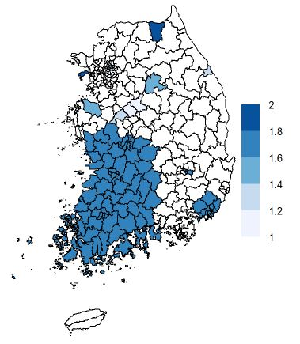
A
B
Average: 1,316,000 won/event
Gyeongsangbuk province cluster
(1,568,000 won/event, RR 1.20, P <0.001)
Average: 9.0 days/event
Seoul cluster
(1,458,000 won/event, RR 1.13, P <0.001)
Chungcheongnam-Jeollabuk-Jeollanam provinces cluster
(9.8 days/event, RR 1.11, P <0.001)
Busan cluster
(1,648,000 won/event, RR 1.27, P <0.001)
Busan and surrounding areas cluster
(9.9 days/event, RR 1.12, P <0.001)

