Slide 1
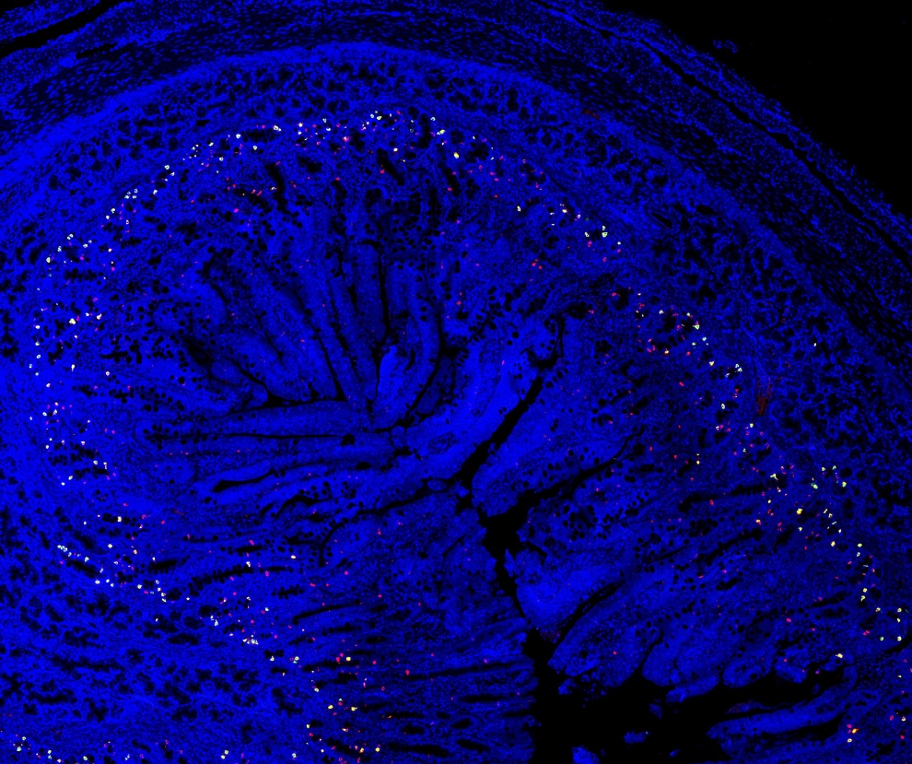
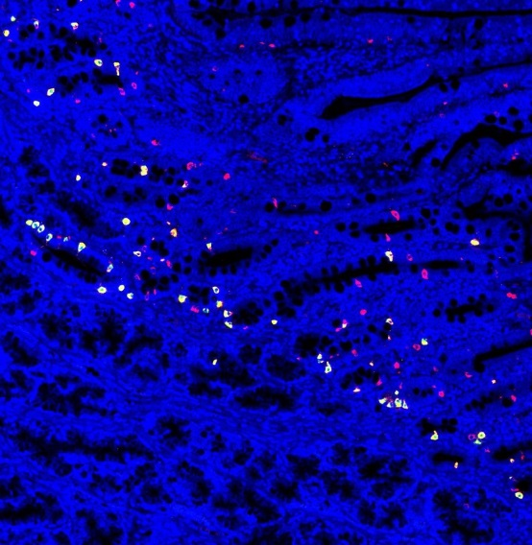
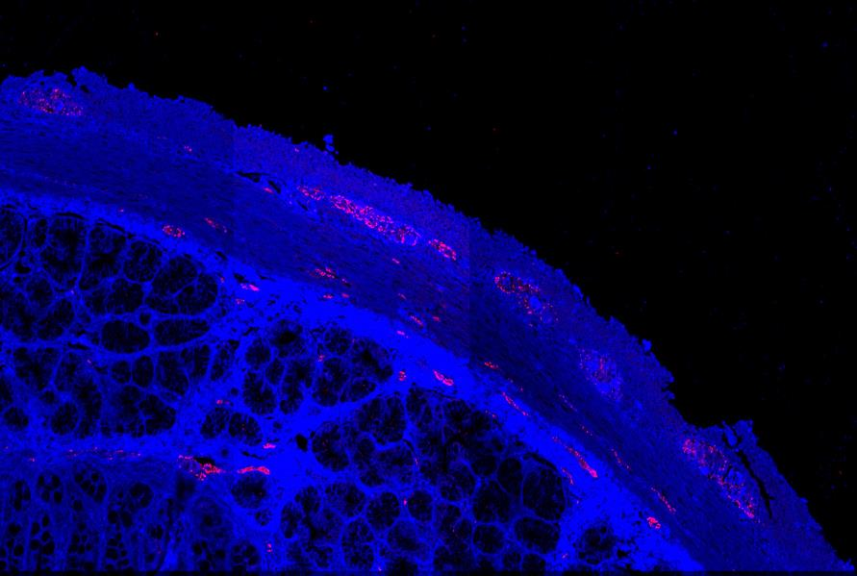
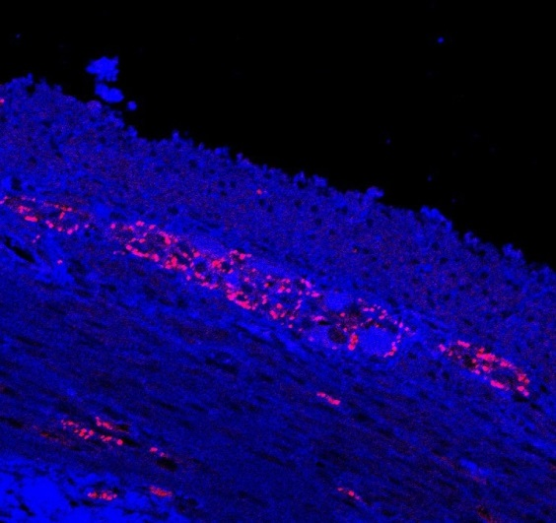
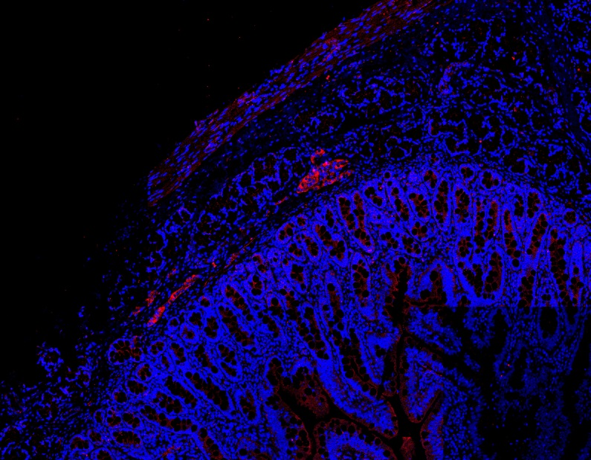
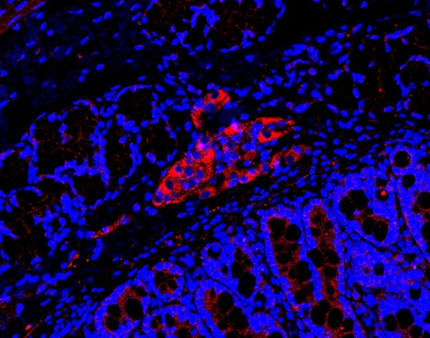
a)
b)
c)
Supplemental Figure 1. Representative images of immunofluorescent detection of neurotransmitters and secretory cells in the 31-day-old piglet intestine. Panel A) Serotonin and EC-cells in duodenum taken at 10x magnification; Green=serotonin, Red=EC-cells, blue=DAPI. Panel B) TH in duodenum take at 20x; Red=TH, blue=DAPI. Panel C) VIP in duodenum; Red=VIP, blue=DAPI. Panels showing additional magnification were generated by manually enlarging specific areas within the image.

