Slide 1
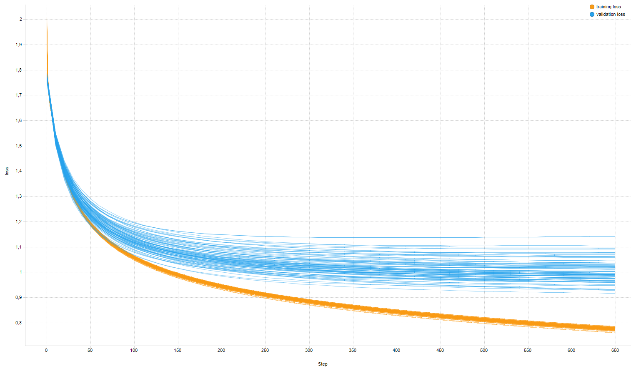
Supplementary Figure S1
2.0
Training
Validation
1.8
1.6
Loss
1.4
1.2
1.0
0.8
0
50
100
150
200
250
300
350
400
450
500
550
600
650
Epochs
Training and validation loss of stool consistency classification over the 10 10-fold cross-validations. The orange and blue curves represent the loss on the training and validation sets, respectively, and indicate an acceptable degree of model fit. The loss is a measure of the fit between the model's predicted score and the researchers' final score; with successful training, loss decreases with successive training epochs, where each epoch represents one pass through the dataset. A learning rate of 0.001 was used and training was performed for 650 epochs, after which the training loss reached a plateau

