Slide 1
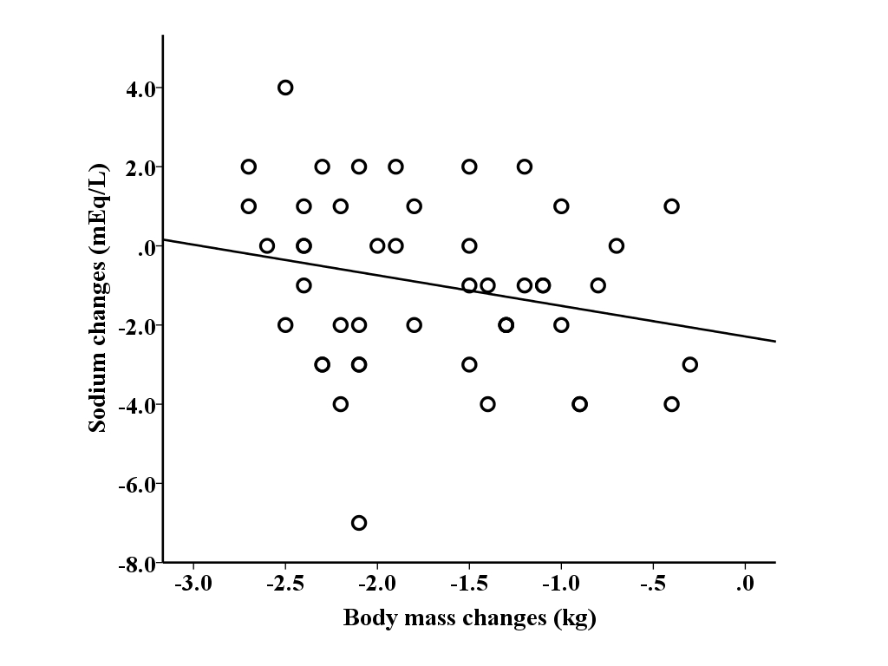
SDC 1. Relationship between sodium changes and body mass changes (r= -0.233, p=0.114)

