Slide 1
Picture This! Using Photovoice to Facilitate Cultural Competence in Students
(Supplemental Digital Content)
Journal of Christian Nursing, 2013, 30(3)
Sample Digital Images of Nursing Students’ Perceptions of Challenges and Rewards
Experienced by the Elderly
By Shelby Garner, PhD, RN, CNE
and
Mallorie Morton, SN, Libby Bridges, SN,
Sean Diaz, SN, Emily Dunlap, SN, Katie Beacham, SN

Slide 2
Pets are rewards for the elderly.

Slide 3
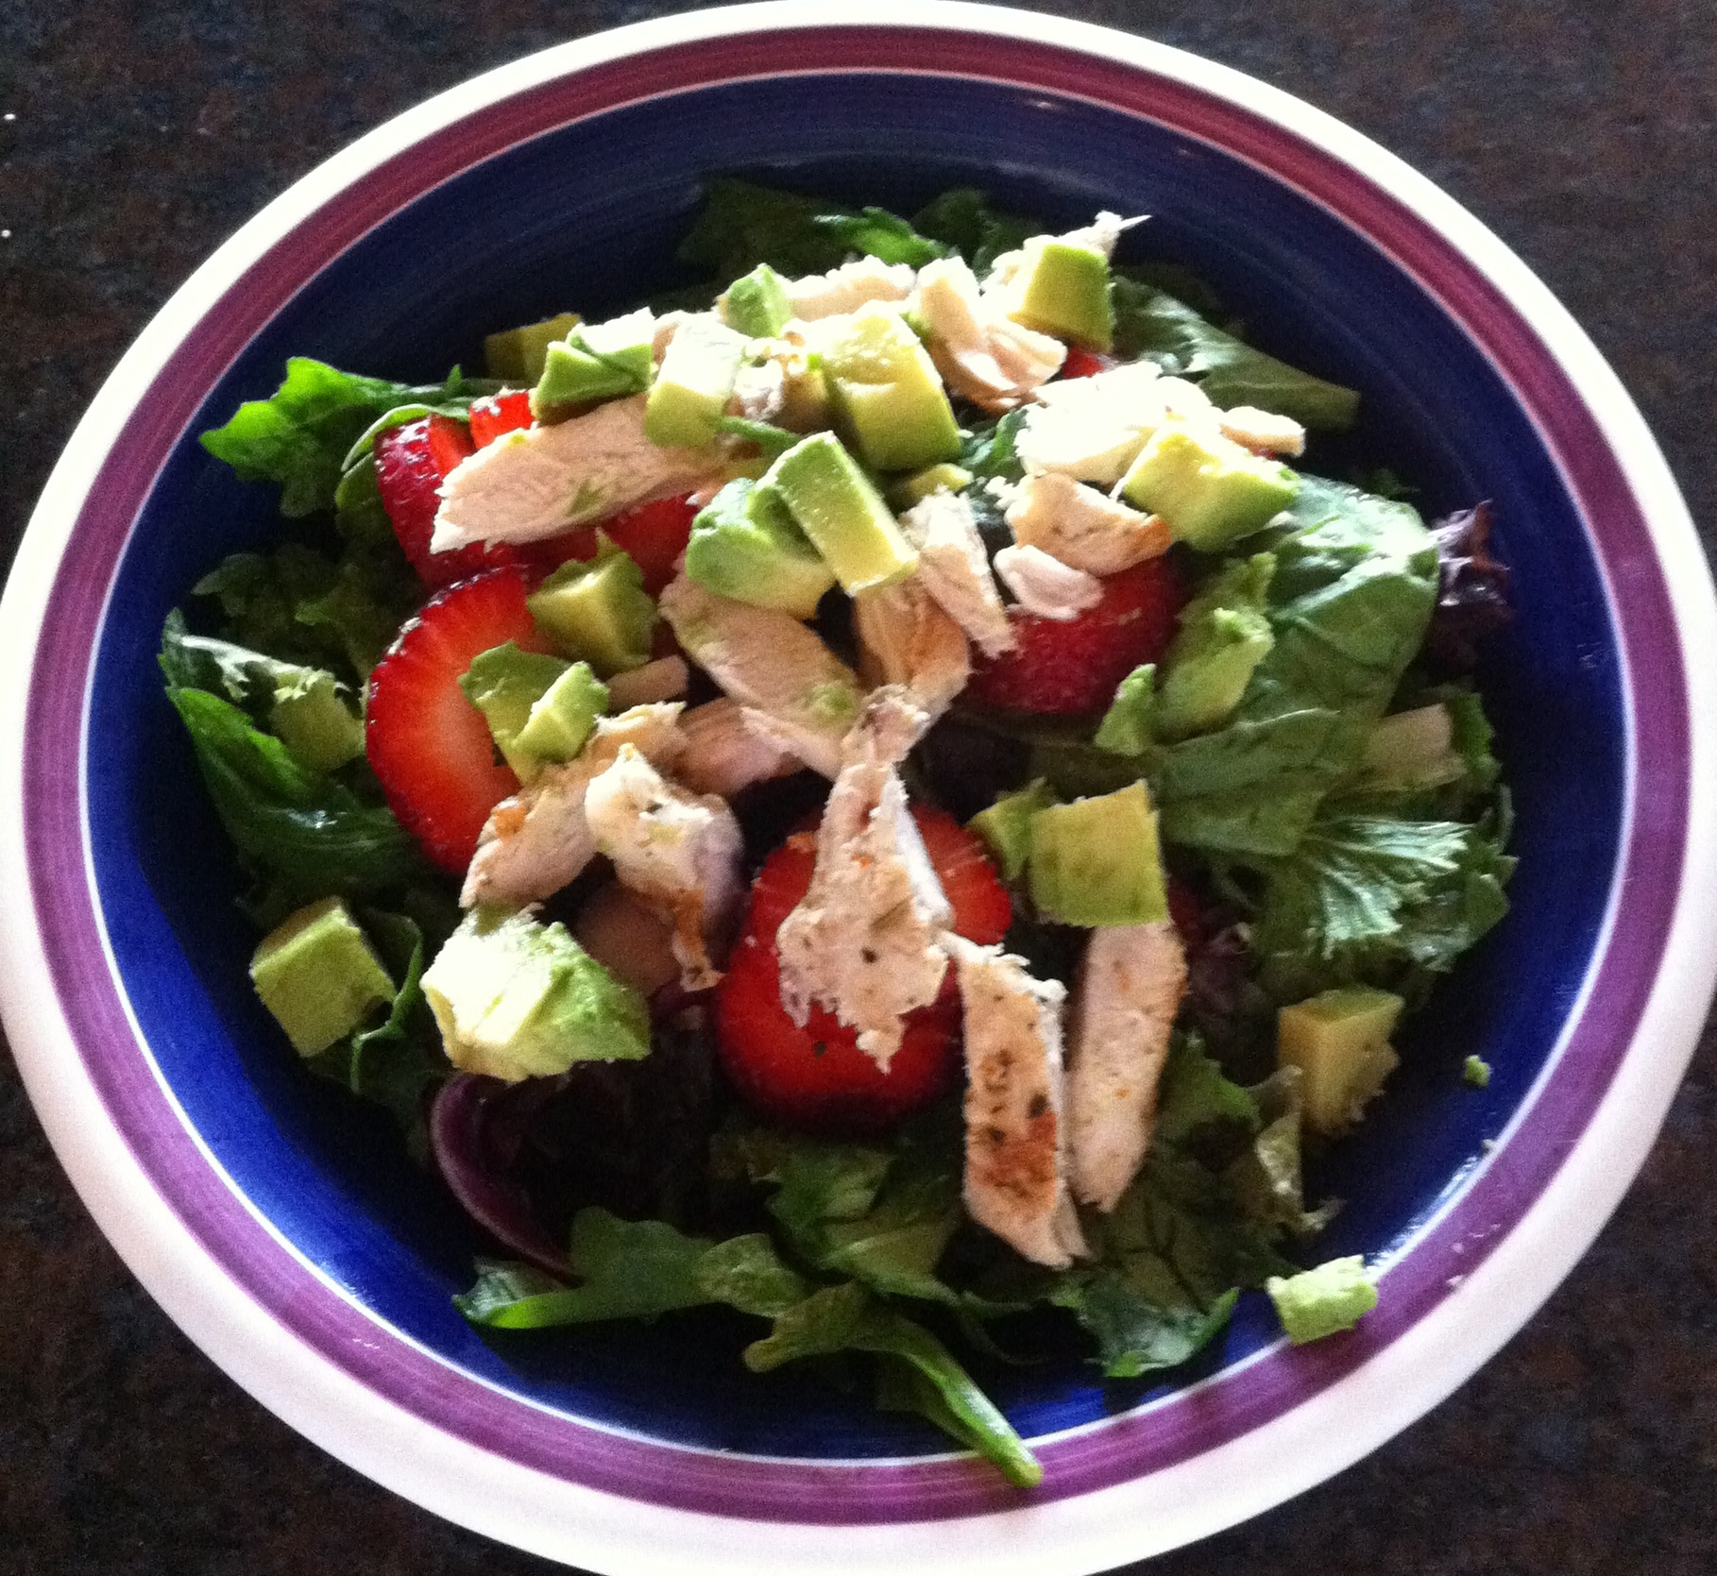
Challenge:
Eating a Healthy Diet
The elderly have a difficult time preparing and eating the proper foods with the nutrients their bodies need.

Slide 4
Cars are challenges as vision, agility, and reaction times change.

Slide 5
Stairs are often difficult for the elderly to navigate.

Slide 6
Taking out the trash is a challenge for the elderly.

Slide 7
Cleaning becomes more challenging for the elderly.

Slide 8
Yard work is a challenge.

Slide 9
It is often a challenge to keep the house well maintained.

Slide 10
The elderly are challenged by technology.

Slide 11
Medical supplies and medicine are difficult to afford and keep on a schedule.

