Slide 1
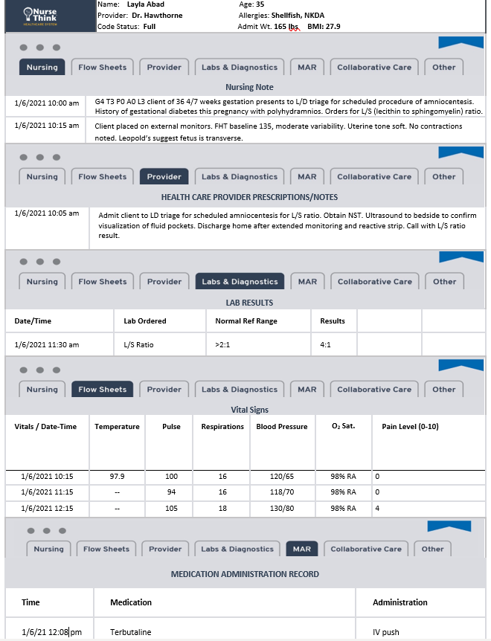
NCLEX Clinical Judgement: Antenatal Testing, Gestational Conditions, and OB Emergencies
Meet
Layla Abad

Slide 2
Objectives
Discuss patient situation or presenting problem for a pregnant patient presenting for high-risk antenatal testing
Demonstrate awareness of a variety of sources of patient information
Recognize patient data essential to the patient assessment and diagnosis phases of the nursing process for a pregnant patient during high-risk antenatal testing
Interpret patient data to determine its relevance to pregnancy and labor
Discriminate between relevant and irrelevant information high-risk pregnant patient
Utilize critical thinking skills to develop cue recognition in a pregnant patient post-procedure
Apply patient data to nursing diagnoses of a laboring patient
Synthesize information to develop applicable nursing diagnoses in a laboring patient
Predict nursing and medical interventions for a patient with an obstetrical emergency, based on relevant data gathered
Prioritize nursing actions based on patient data and available intervention alternatives for a patient in labor
Select interventions from several alternatives for pregnant patient
Evaluate the results of nursing interventions based on achievement of patient goals and outcomes for a patient during an obstetrical emergency

Slide 3
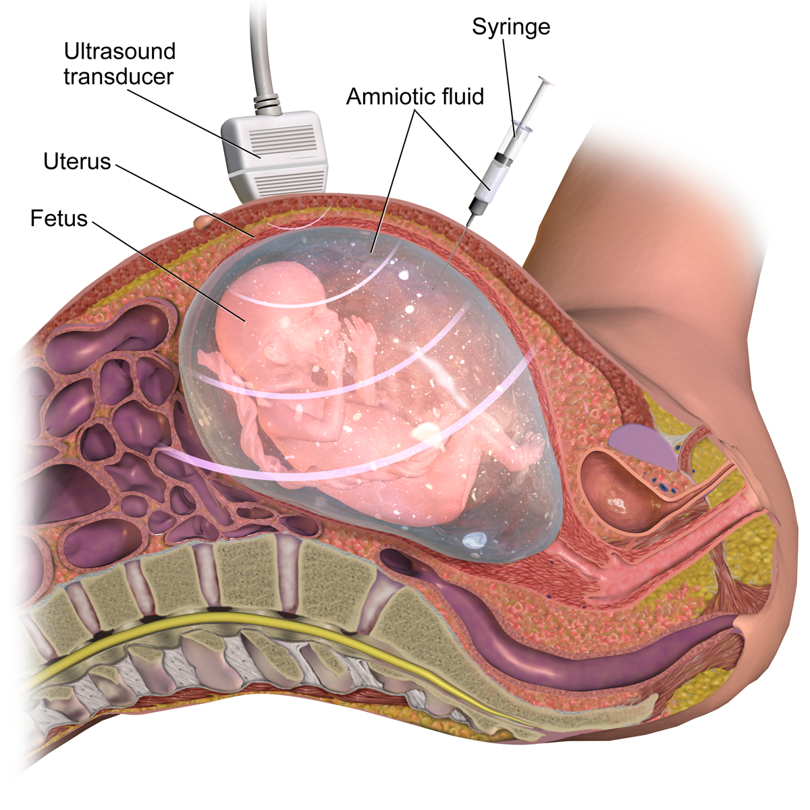
Part I: Antenatal Testing and Gestational Conditions
Image Source: Ricci, S. S., Kyle, T., & Carman, S. (2020). Maternity and pediatric nursing (4th ed.).

Slide 4
NCLEX Clinical Judgement: Antenatal Testing, Gestational Conditions, and OB Emergencies
A nurse working on a busy LD Unit just receives the client described above. Highlight important information from the initial nursing note and MD order. (RECOGNIZE CUES)
Notes:
🍐 This is a Pear Deck Drawing Slide
🍐 To edit the type of question, go back to the "Ask Students a Question" in the Pear Deck sidebar.

Slide 5
NCLEX Clinical Judgement: Antenatal Testing, Gestational Conditions, and OB Emergencies
Potential Intervention | Essential | Nonessential
Place client on continuous fetal monitoring | O | O
Draw admission labs (CBC, HIV, Type/Screen) | O | O
Gather supplies for artificial rupture of membranes | O | O
Bring ultrasound to bedside | O | O
Start an IV of NS and prepare to administer pitocin | O | O
Ask client to empty bladder and change into hospital gown | O | O
After receiving orders from the MD, the nurse placed the client in LD Triage Bed 2 and obtains a set of vital signs. For each potential nursing action, indicate whether the action is essential or nonessential by highlighting the corresponding bubble. (ANALYZE CUES)
Notes:
🍐 This is a Pear Deck Drawing Slide
🍐 To edit the type of question, go back to the "Ask Students a Question" in the Pear Deck sidebar.

Slide 6
NCLEX Clinical Judgement: Antenatal Testing, Gestational Conditions, and OB Emergencies
At 10:35, the MD arrives at the bedside. The amniocentesis is performed. The client tolerated the procedure well. The nurse places a bandage on the client’s abdomen. Based on the data above, what is the nurse’s next best action? (PRIORITIZE HYPOTHESES/GENERATE SOLUTIONS)
Notes:
🍐 This is a Pear Deck Multiple Choice Slide. Your current options are: A: Obtain another set of vital signs, B: Send sample to lab for analysis, C: Place client back on continuous fetal monitoring, D: Monitor for leakage of amniotic fluid,
🍐 To edit the type of question or choices, go back to the "Ask Students a Question" in the Pear Deck sidebar.

Slide 7
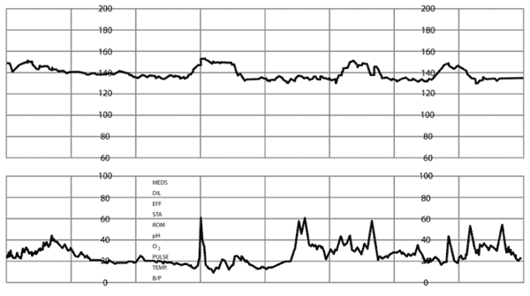
NCLEX Clinical Judgement: Antenatal Testing, Gestational Conditions, and OB Emergencies
At 11:00, the nurse placed the client on monitors with plans to discharge the client home. Based on Layla’s assessment data, prepare a plan of care for the client. Highlight the most probable diagnosis, and then choose two actions to take and two parameters to monitor by highlighting your choices.
(TAKE ACTIONS)
Choose two (2) actions to take based on chosen diagnosis. Prepare to D/C the client home Call SBAR report to physician and continue to monitor FHTs and contraction pattern Prepare for a D&C Prepare to administer terbutaline Start IV and prepare to administer antibiotics | What condition is your client most likely experiencing? Spontaneous Abortion Maternal Hemorrhage Preterm Labor Chorioamnionitis | Choose two (2) parameters to monitor based on chosen diagnosis. Evaluate FHT and UC pattern q 30 minutes Obtain BP q 15 minutes Monitor vaginal bleeding with pad counts Monitor for leakage of fluid Obtain CBC for WBC count
Notes:
🍐 This is a Pear Deck Drawing Slide
🍐 To edit the type of question, go back to the "Ask Students a Question" in the Pear Deck sidebar.

Slide 8
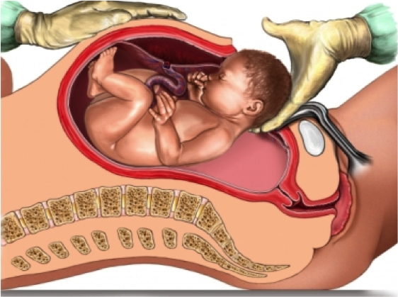
Part II: OB Emergencies
Image Source: Ricci, S. S., Kyle, T., & Carman, S. (2020). Maternity and pediatric nursing (4th ed.).

Slide 9
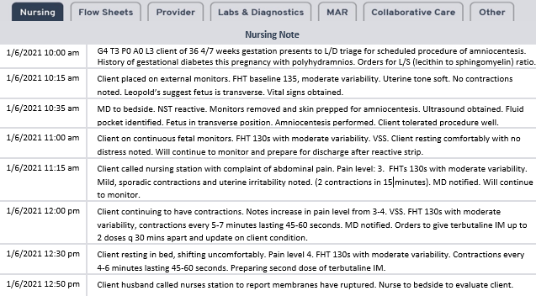
NCLEX Clinical Judgement: Antenatal Testing, Gestational Conditions, and OB Emergencies
The client is now in preterm labor. Terbutaline has been administered twice, but the client continues to have regular uterine contractions. Based on the above data, what obstetrical emergency should the nurse anticipate? (PRIORITIZE HYPOTHESES)
Notes:
🍐 This is a Pear Deck Multiple Choice Slide. Your current options are: A: Shoulder Dystocia, B: Cord Prolapse, C: Uterine Rupture, D: Amniotic Fluid Embolus,
🍐 To edit the type of question or choices, go back to the "Ask Students a Question" in the Pear Deck sidebar.

Slide 10
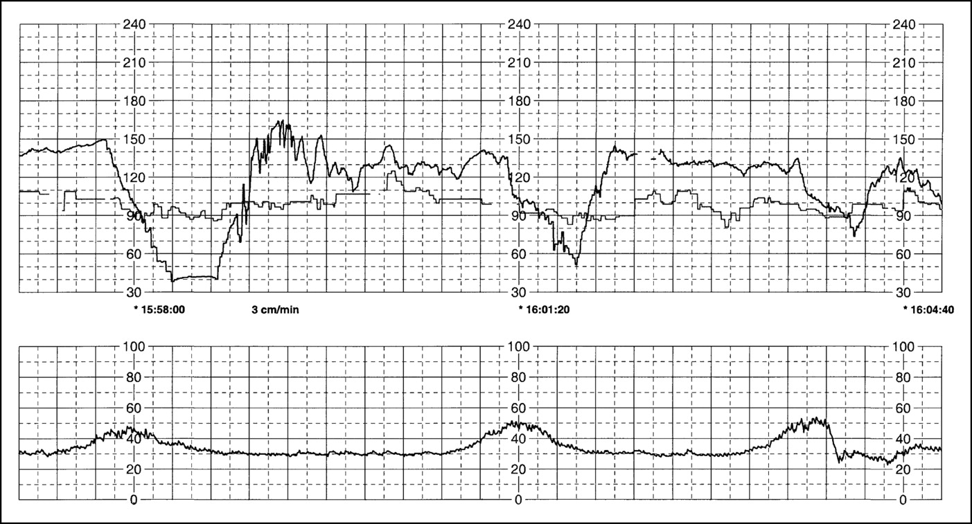
NCLEX Clinical Judgement: Antenatal Testing, Gestational Conditions, and OB Emergencies
The nurse arrives in the room to find the client in significant distress. Based on the information above and the fetal monitoring strip, indicate whether the data shows an improvement or decline in the client’s condition by highlighting the corresponding bubble. (EVALUATING OUTCOMES)
Assessment Data | Improved | Declined
“Ruptured” | O | O
“Cord noted in cervix” | O | O
SVE 5/100/-2 | O | O
Deep, variable decelerations | O | O
Contractions q 4 minutes | O | O
minimal-moderate variability | O | O
Notes:
🍐 This is a Pear Deck Drawing Slide
🍐 To edit the type of question, go back to the "Ask Students a Question" in the Pear Deck sidebar.

Slide 11
NCLEX Clinical Judgement: Antenatal Testing, Gestational Conditions, and OB Emergencies
Based on the above assessment data, what is next most appropriate nursing action? (TAKE ACTIONS)
Notes:
🍐 This is a Pear Deck Multiple Choice Slide. Your current options are: A: Evaluate for signs of DIC and prepare to perform CPR, B: Lift the presenting part, do not remove hand, and call for help, C: Obtain type and cross and prepare for a cesarean section, D: Apply suprapubic pressure while another nurse performs McRobert's Maneuver,
🍐 To edit the type of question or choices, go back to the "Ask Students a Question" in the Pear Deck sidebar.

Slide 12
NCLEX Clinical Judgement: Antenatal Testing, Gestational Conditions, and OB Emergencies
At 12:55 pm, the client was rushed to c-section secondary to cord prolapse. The client was placed under general anesthesia. A viable female infant was delivered at 1:03 pm. Mrs. Abad and her infant are now resting in RR3. VSS. Pain level 5.
Based on this scenario, what is your priority nursing diagnosis? (PRIORITIZE HYPOTHESES)
Notes:
🍐 This is a Pear Deck Multiple Choice Slide. Your current options are: A: Risk for Hemorrhage, B: Risk for Infection, C: Acute Pain, D: Posttraumatic Syndrome,
🍐 To edit the type of question or choices, go back to the "Ask Students a Question" in the Pear Deck sidebar.

