Slide 1
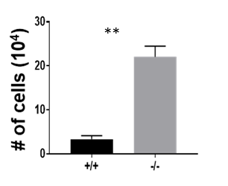
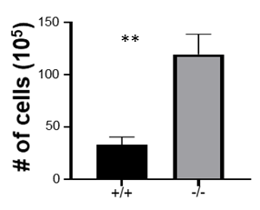
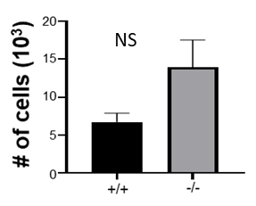
A.
B.
C.
IFNγ+
D.
IL-17+
E.
IL-17+IFNγ+
F.
Total CD4 T-cells
GM-CSF+CD4
*
*
6
*
*
# of cells (10³)
4
NS
# of cells (10³)
# of cells (10³)
# of cells (10³)
# of cells (10³)
2
0
G.
Infl. Macs
H.
Plasma cells
I.
GC B cells
e-Figure 2: (A) Spinal cord infiltration of IFN-γ⁺ and IL-17⁺ and IL-17⁺/IFN-γ⁺ CD4 T cells in BCMA^{+/+} and BCMA^{-/-} mice cells (EAE day 15) were measured by flow cytometry. Brain infiltration (B) total CD4 T cells, (C) IFNγ⁺ CD4 T cells, (D) IL-17⁺ CD4 T cells, (E) IL-17⁺/IFN-γ⁺ CD4 T cells, (F) GM-CSF⁺ CD4 T cells, (G) inflammatory macrophages (H) CD138⁺ Plasma cells and (I) germinal center (GC) B cells were measured by flow cytometry. Error bars represent SEM, and two-tailed Student t tests were used to determine statistical significance (p). *p < 0.05 and ** p <0.01.

