Slide 1
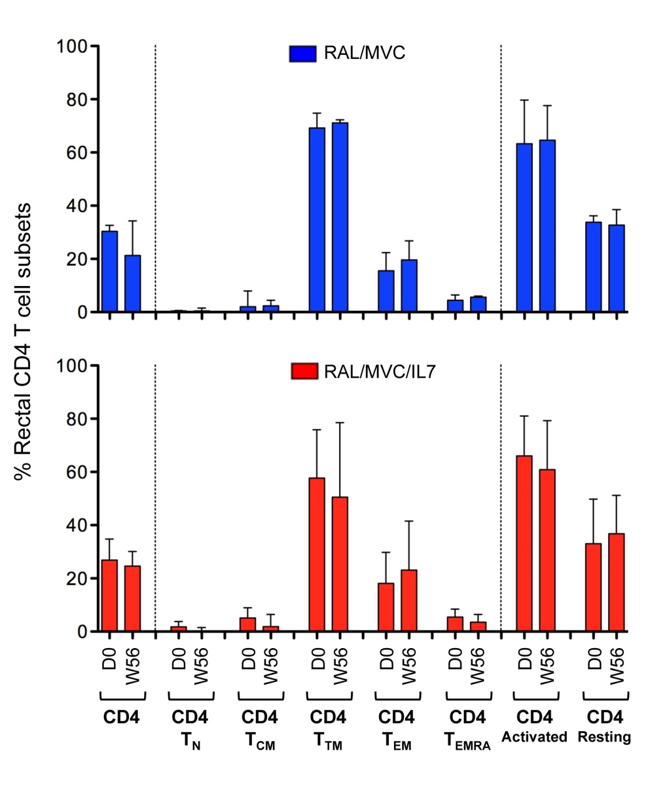
Supplementary Figure 2: Median change from baseline in the proportions of rectal CD4+ T cell subpopulations and activation

