Slide 1
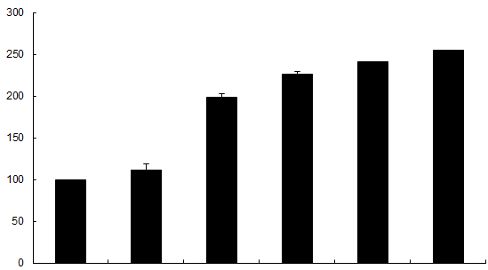
Supplemental Digital Content: S1
*
*
*
*
Fluorescent Intensity (% Control)
Control 5 10 25 50 100
Recombinant Fas ligand increases RLMEC permeability compared to untreated control cells (*p < 0.05; n = 6). RLMEC hyperpermeability is expressed as a percentage of the basal fluorescence. Among various concentrations of Fas ligand treatment groups (10ng/ml, 25ng/ml, 50ng/ml and 100ng/ml) fluorescent intensity of FITC-albumin in the media from the abluminal chamber did not differ statistically.

