Slide 1
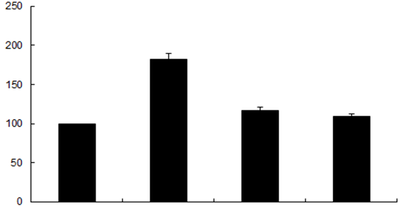
Supplemental Digital Content: S3
*
a
Fluorescent Intensity (% Control)
Control Fas Ligand Z-DEVD + Fas Ligand Z-DEVD
Caspase-3 inhibitor, Z-DEVD-FMK attenuates Fas ligand induced monolayer hyperpermeability in RLMECs. Hyperpermeability in RLMECs is expressed as a percentage of the basal fluorescence. Fas ligand treated monolayers show significant increase in permeability compared to the untreated control monolayers (*p < 0.05; n = 6). Fas ligand treated monolayers when pre-treated with Z-DEVD-FMK show significant decrease in permeability compared to the Fas ligand treated monolayers (ª p < 0.05; n = 6). Z-DEVD-FMK alone treated group shows no significant change in permeability compared to the untreated control cells.

