Slide 1
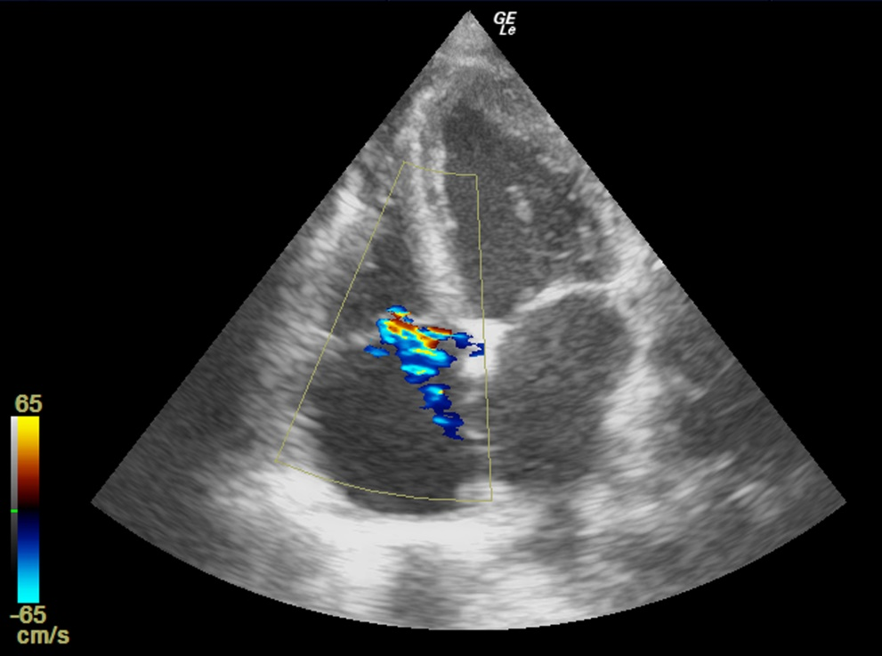
Video 1. Pulmonary hypertension occurs in a COVID-19 patient with ARDS who undergo mechanical ventilation

