Slide 1
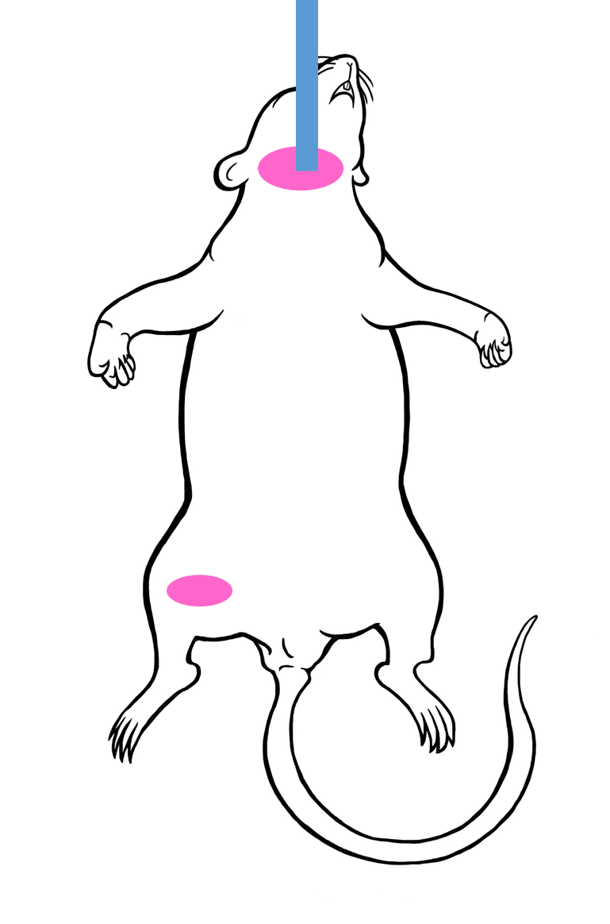
A
Room Air
Ventilator
Test solution
PC, Labchart 7
Carotid
artery
Jugular vein
PV Catheter
MPVS300 and Powerlab 8/30
Femoral artery
Pressure transducer
37°C
B
Time points
Baseline
Shock
Early R
Late R
Hemorrhage (30 min)
Shock (30 min)
Resuscitation (60 min)
Procedures
50% BV
Test solution
90% baseline BP

