Slide 1
A 23-year-old woman with impaired facial recognition
Teaching NeuroImages
Neurology
Resident and Fellow Section
© 2018 American Academy of Neurology

Slide 2
Vignette
A 23-year-old right-hand-dominant woman presented with three weeks of progressive difficulty recognizing faces, including her own, subsequently becoming psychotic.
Neuroimaging investigations are attached (Figure 1).
Beecher et al.
© 2018 American Academy of Neurology

Slide 3
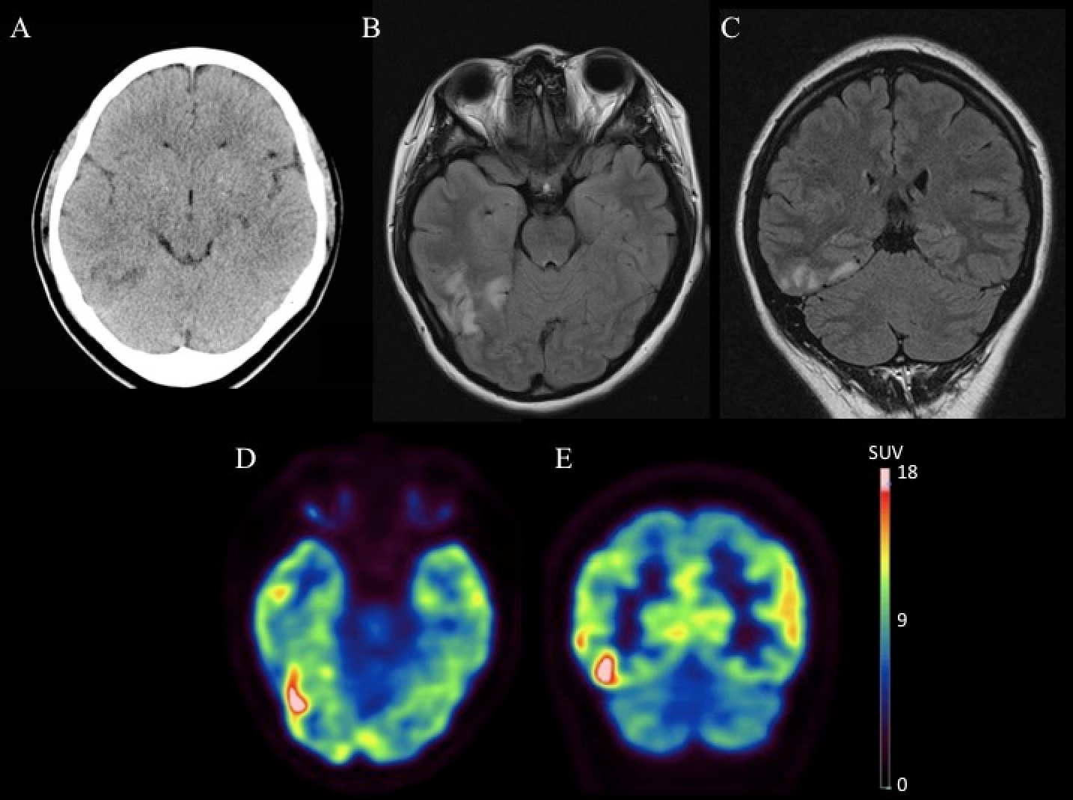
Imaging
Beecher et al.
© 2018 American Academy of Neurology
Notes:
CT head (A) revealing right posterior temporal hypodensity. Axial (B) and coronal (C) T2 fluid-attenuated inversion-recovery MRI demonstrate high signal in right posterior temporal lobe and fusiform gyrus. Axial (D) and coronal (E) FDG-PET/CT images demonstrate right posterior-inferior temporal hypermetabolism (standardized uptake value (SUV) 0-18, CIMSNeuro scale, Oasis, Segami Corporation).

Slide 4
Teaching NeuroImages:
Prosopagnosia heralding anti-NMDA receptor encephalitis
Electroencephalogram demonstrated right posterior temporal slowing
CSF and serum anti-N-methyl-D-aspartate receptor (NMDAR) antibodies were positive
CT abdomen/pelvis revealed ovarian teratoma
Teratoma removal, plasmapheresis, and one cycle of rituximab yielded symptom resolution over one month
Anti-NMDAR encephalitis rarely presents with prosopagnosia,¹ and in this case, is likely secondary to right fusiform gyrus dysfunction.²
Beecher et al.
© 2018 American Academy of Neurology
Notes:
References
1. Sawamura H, Yamamoto T, Ohtomo R, Bannai T, Wakakura M, Tsuji S. Anti-NMDA receptor encephalitis associated with transient cerebral dyschromatopsia, prosopagnosia, and lack of stereopsis. J Neuro-ophthalmol 2014;34:144–148.
2. Barton JJ. Disorders of higher visual processing. Handb Clin Neurol 2011;102:223–261.

