Slide 1
A 59-year-old woman with a left homonymous hemianopia
Teaching NeuroImages
Neurology
Resident and Fellow Section
© 2017 American Academy of Neurology

Slide 2
Vignette
59-year-old woman
Sudden painless left-sided vision loss in both eyes
MRI showed a right occipital lobe stroke
Optical coherence tomography scans of the macula, segmented to analyse the macular retinal ganglion cell complex (ganglion cell layer and inner plexiform layer), were obtained at follow-up visits
© 2017 American Academy of Neurology
Micieli et al

Slide 3
Imaging
© 2017 American Academy of Neurology
Micieli et al
Notes:
Humphrey visual field test demonstrating a complete left homonymous hemianopia (A) and diffusion weighted magnetic resonance imaging showing a right occipital lobe stroke (B).

Slide 4
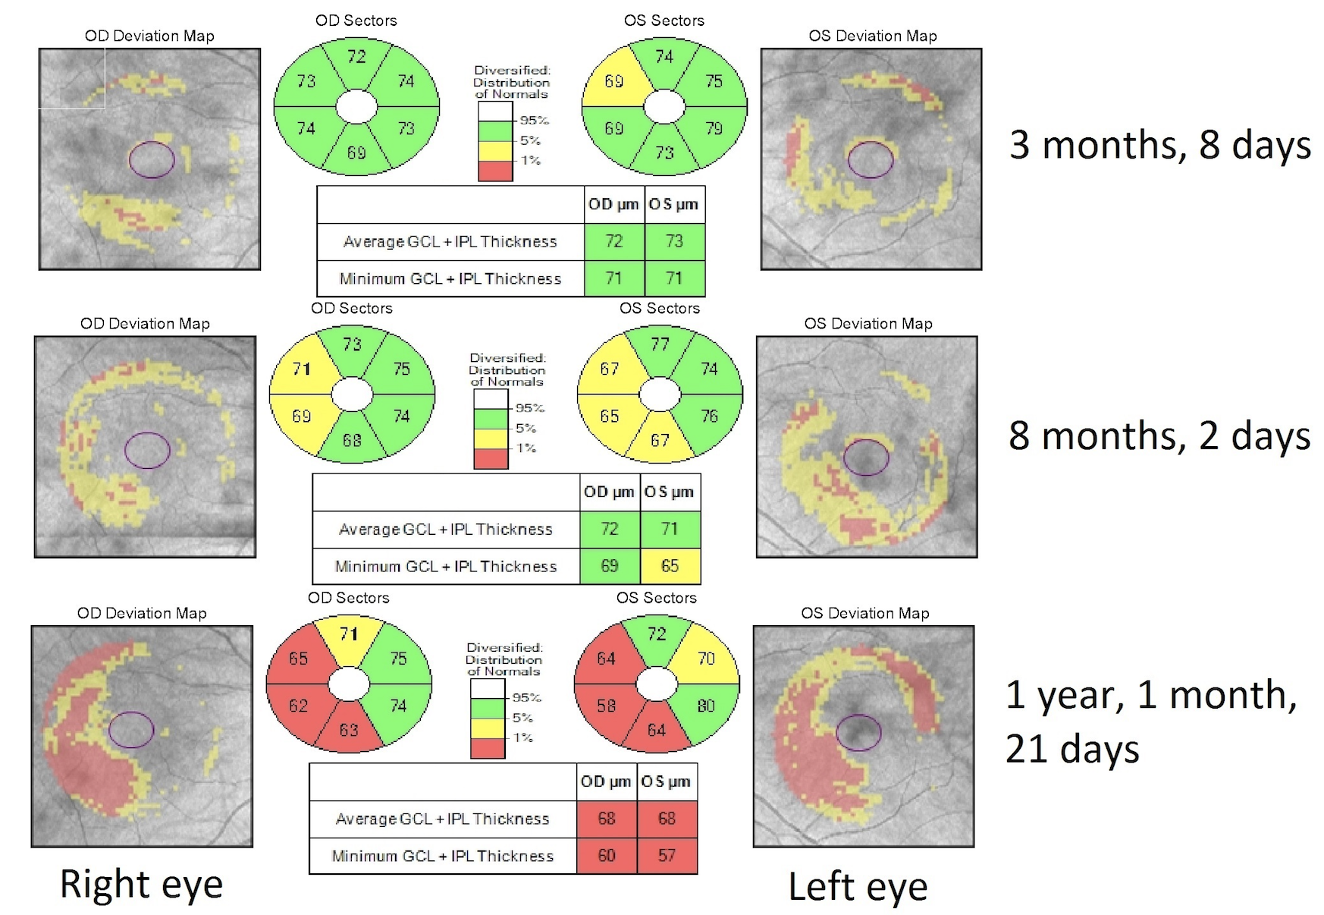
Imaging
© 2017 American Academy of Neurology
Friang et al
Notes:
Optical coherence tomography of the macula, segmented to analyze the macular retinal ganglion cell complex (ganglion cell layer and inner plexiform layer) showed thinning in the nasal retinal of the left eye about 100 days after vision loss that increased with time in both eyes.

Slide 5
Evolving trans-synaptic degeneration of retinal ganglion cells after occipital lobe stroke
³²
³²
Advances in optical coherence tomography allow visualization of retrograde trans-synaptic degeneration (RTSD) of retinal ganglion cells in the visual system
RTSD occurs in some adults with acquired lesions of the retrogeniculate visual pathways
RTSD occurred earlier and to a greater degree in the eye with the temporal visual field loss, which has been previously observed ^{1,2}
© 2017 American Academy of Neurology
Micieli et al
Notes:
1. Théoret H, Herbin M, Boire D, Ptito M. Transneuronal retrograde degeneration of retinal ganglion cells following cerebral hemispherectomy in cats. Brain Res 1997;775(1–2):203–8.
2. Dinkin M. Trans-synaptic retrograde degeneration in the human visual system: slow, silent and real. Curr Neurol Neurosci Rep 2017;17(2):16.

