Slide 1
A 58-year-old woman with dystonia and parkinsonism
Teaching NeuroImages
Neurology
Resident and Fellow Section
© 2018 American Academy of Neurology

Slide 2
Vignette
A 58-year-old woman presented with generalized dystonia that was later followed by akinetic-rigid parkinsonism
Brain MRI revealed hyperintensities in the bilateral putamen while DaT-SPECT (123I-Ioflupane) showed decreased radiotracer uptake in both basal ganglia, more evident on the left side
© 2018 American Academy of Neurology
Marangi, et al.

Slide 3
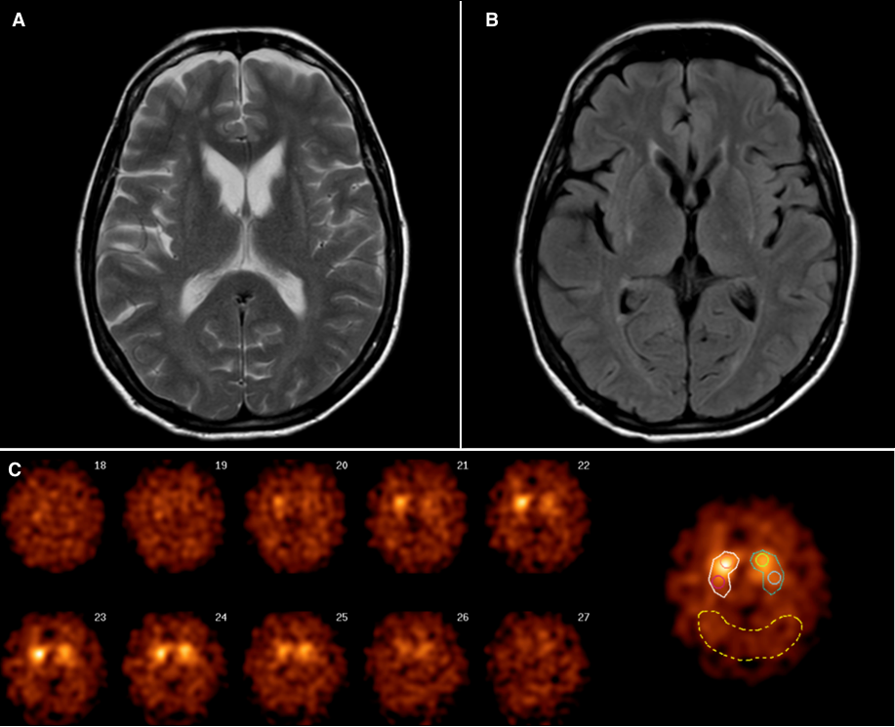
Imaging
A
B
C
© 2018 American Academy of Neurology
Marangi, et al.
Notes:
Figure. MRI and DaT-SCAN SPECT findings
A-B) Axial T2WI and FLAIR images show increased signal of both putamina. C) DaT-SCAN SPECT demonstrates a bilaterally decreased radiotracer uptake in basal ganglia suggestive of nigrostriatal dopaminergic system dysfunction. A more diffuse involvement of putamen and caudate nucleus can be noted on the left side.

Slide 4
Brain MRI and DaT-SPECT imaging in adult GM1 gangliosidosis
MRI findings are typical of adult GM1 gangliosidosis (aGM1-g)
Selective involvement of the basal ganglia in aGM1-g is thought to be related to a higher turnover of GM1 ganglioside in this region. Our report suggests a presynaptic pattern of dopaminergic dysfunction in this disease
Marangi, et al.
© 2018 American Academy of Neurology
Notes:
References
Roze E, Paschke E, Lopez N, et al. Dystonia and parkinsonism in GM1 type 3 gangliosidosis. Mov Disord 2005 Oct;20(10):1366-1369
Yoshida K, Ikeda S, Kawaguchi K, Yanagisawa N. Adult GM1 gangliosidosis: immunohistochemical and ultrastructural findings in an autopsy case. Neurology 1994;44:2376 –2382

