Slide 1
37-year-old female with acute deterioration of consciousness
Teaching NeuroImages Neurology Resident and Fellow Section
Wenzhao Liang et al.
© 2013 American Academy of Neurology

Slide 2
Vignette
Previously healthy 37-year-old female
After a three-day history of chills, fever and myalgias
Developed acute confusional state and deteriorated into coma
MRI showed multifocal, symmetric lesions affecting the bilateral thalami and pons
Laboratory test detected elevated serum aminotransferases, increased CSF protein and no specific virus
Recovered gradually with intravenous methylprednisolone and immunoglobulin in about one month
Wenzhao Liang et al.
© 2013 American Academy of Neurology

Slide 3
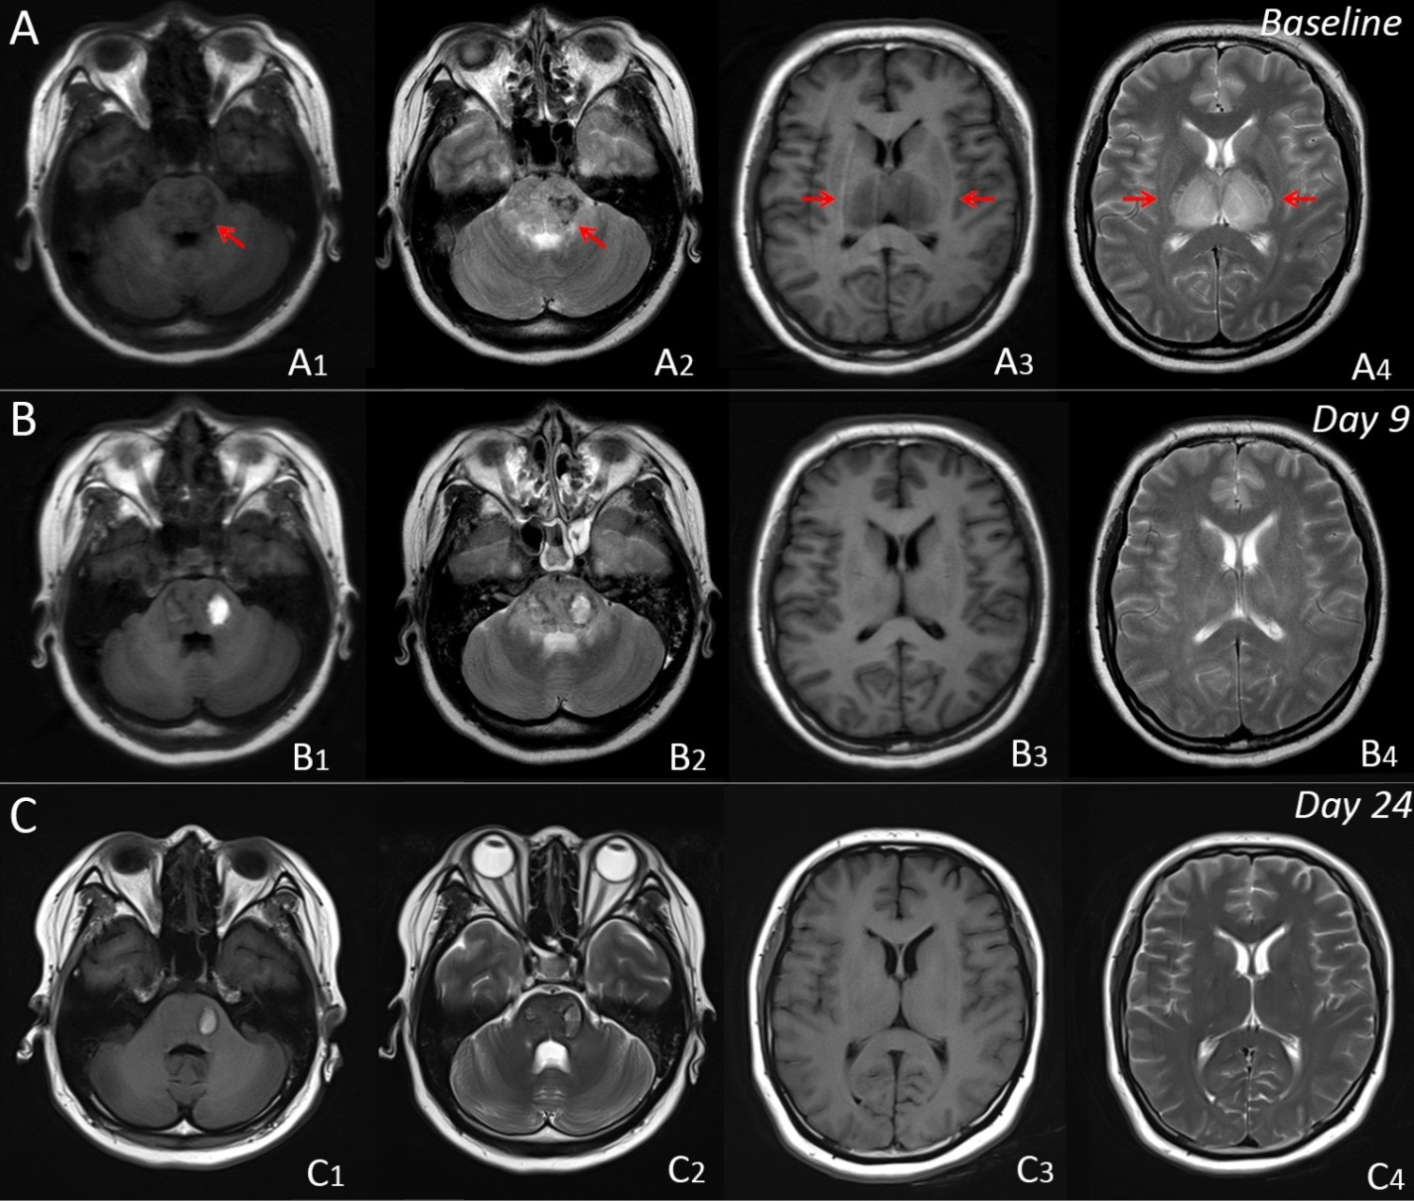
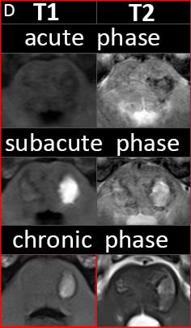
Imaging
A
Wenzhao Liang et al.
© 2013 American Academy of Neurology
Notes:
Figure 1 Radiographic evolution on T1 and T2 weighted image
(A)Initial MRI showed hypointense T1 and T2 signals in the pons (A1-2) , hypointense T1 and hyperintense T2 signals in the bilateral thalami (A3-4), and demonstrated haemorrhagic necrosis. (B-C) Repeated MRI revealed gradual reduction of the pontine (B-C1: T1, B-C2: T2) and thalamic lesions (B-C3: T1, B-C4: T2).(D) Evolution of hemorrhage on MR images.

Slide 4
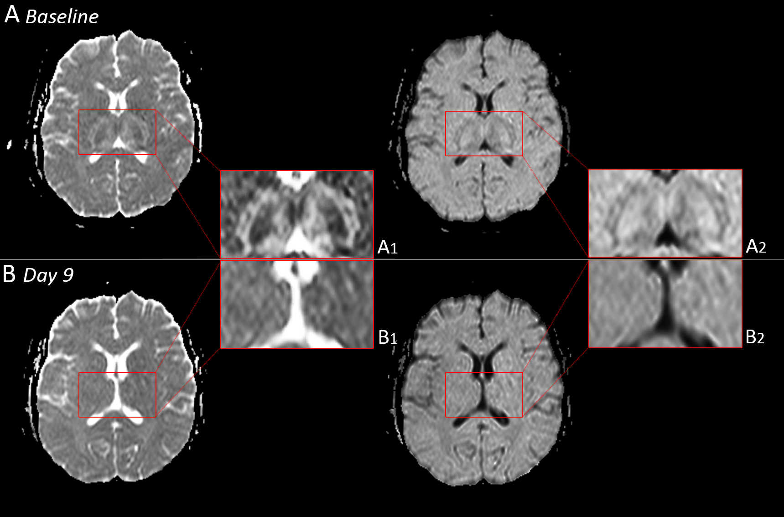
Imaging
Wenzhao Liang et al.
© 2013 American Academy of Neurology
Notes:
Figure 2 Image findings of ADC and DWI sequences
(A) at admission, ADC and DWI showed "target-like" lesions and edema in the bilateral thalami. (B) Day 9, ADC and DWI revealed a regression of the lesions.

Slide 5
Radiographic evolution in an adult case of acute necrotizing encephalopathy
Acute necrotizing encephalopathy (ANE) occurs rarely in adult patients.
Radiographic features include multifocal, symmetric lesions affecting the bilateral thalami and pons.^{1, 2}
The diagnosis can be made through the combination of characteristic radiological findings and clinical features.^{1, 2}
ANE should be included in the differential diagnosis for diseases with symmetrical thalamic lesions. (details in supplemental data)
Wenzhao Liang et al.
© 2013 American Academy of Neurology
Notes:
References
1.Bassuk AG, Burrowes DM, McRae W. Acute necrotizing encephalopathy of childhood with radiographic progression over 10 hours. Neurology. 2003;60:1552-1553.
2.Mizuguchi M. Acute necrotizing encephalopathy of childhood: a novel form of acute encephalopathy prevalent in Japan and Taiwan. Brain Dev. 1997;19:81-92.

