Slide 1
10-year-old boy with acute crural paraparesis
Teaching NeuroImages
Neurology
Resident and Fellow Section
© 2018 American Academy of Neurology

Slide 2
Vignette
A 10-year-old boy from the rural Brazil was admitted to the hospital with a history of three days of decreased muscle strength in the lower limbs preceded by a two months of back pain.
Physical examination revealed spastic crural paraparesis without sensory or autonomic deficits.
© 2018 American Academy of Neurology
ALMEIDA JUNIOR, et al

Slide 3
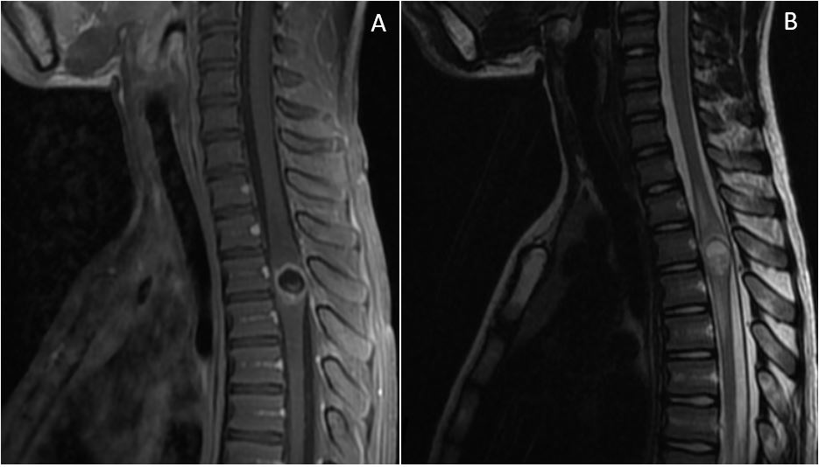
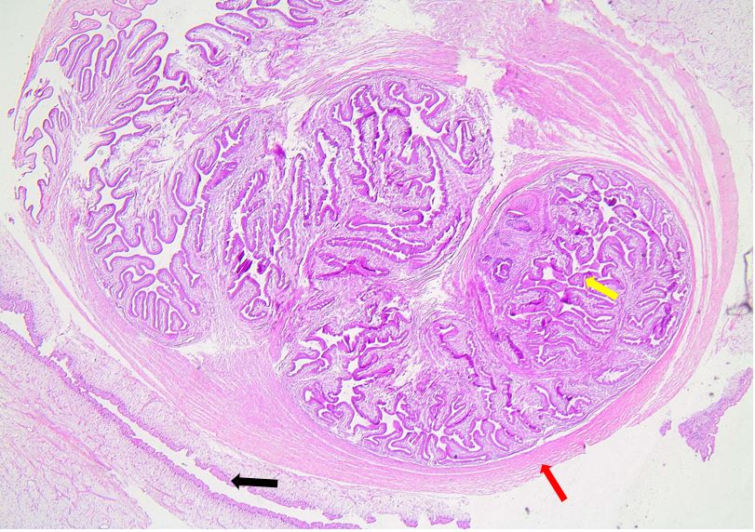
Figure1
Figure 2
© 2018 American Academy of Neurology
ALMEIDA JUNIOR, et al
Notes:
Figure1. MRI shows intramedullary cystic lesion located at T3-T4 level
(A) Gadolinium-enhanced sagital T1; (B) Sagital T2. MRI shows intramedullary cystic lesion located at T3-T4 level, with a thick wall and contrast enhancement, associated with adjacent vasogenic edema. The colloidal phase of cysticercosis mimics tumoral lesion. The lesion features hyperintense signal on T2 (due to proteinaceous content of the fluid) with a streak of hyperintensity on T1 (which could indicate the degenerative scolex).
Figure 2. Encapsulated cysticercus larvae stained in haematoxylin and eosin.
Histopathology showing encapsulated cysticercus larvae (H&E, 40x). Outer membrane (black arrow), larval scolex (red arrow), and larval intestine (yellow arrow).

Slide 4
Spinal intramedullary cysticercosis: the pseudotumoral form- Neuroimaging findings
Intramedullary cysticercosis is a rare parasitic infection caused by a cyst of Taenia solium, which affects 0.7%-5.8% of all patients with neurocysticercosis¹.
The diagnosis is made mainly by CT and MRI. These techniques can demonstrate the number of lesions, form, location and the degree of inflammatory response, such as perilesional edema and rupture of the blood-brain barrier².
This type of presentation is usually underdiagnosed, because in the degeneration phases it is difficult to visualize the structures of the parasite, mainly the scolex, even in the MRI, and the immunological tests can be negative due to the intraparenchymal location².
In addition to patients from the endemic areas, it is necessary to consider this as a differential diagnosis in travellers who present with acute/subacute spinal cord syndrome and/or this type of lesion in MRI.
© 2018 American Academy of Neurology
ALMEIDA JUNIOR, et al
Notes:
1. Chhiber SS, Singh B, Bansal P, Pandita KK, Razdan S, Singh J. Intramedullary spinal cysticercosis cured with medical therapy: case report and review of literature. Surg Neurol. 2009 Dec;72(6):765-768; discussion 768-769.
2. Lucato LT, Guedes MS, Sato JR, Bacheschi LA, Machado LR, Leite CC. The role of conventional MR imaging sequences in the evaluation of neurocysticercosis: impact on characterization of the scolex and lesion burden. AJNR Am J Neuroradiol. 2007 Sep;28(8):1501–4.

