Slide 1
Teaching NeuroImages
Morning Glory Disc Anomaly
Neurology
Resident and Fellow Section
© 2018 American Academy of Neurology

Slide 2
Vignette
A 7-month-old girl presented with a strabismus.
Fundoscopy revealed a typical Morning Glory Disc Anomaly (MGDA) of the right eye, including an enlarged funnel-shaped excavation of the optic disc, a peripapillary pigmented ring and a radial aspect of the retinal vessels.
Brain Magnetic Resonance Imaging (MRI) showed the excavation and abnormal tissue at the optic nerve insertion consistent with glial tuft.
Poillen et al.
© 2018 American Academy of Neurology

Slide 3
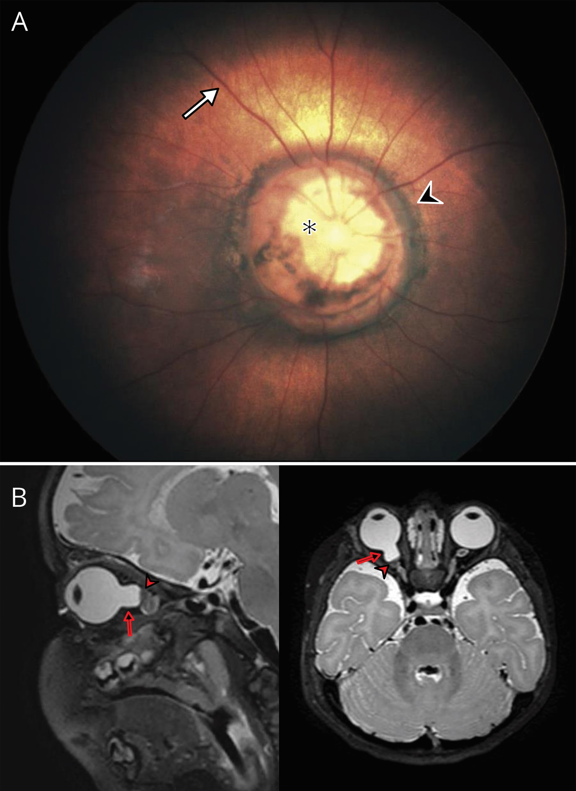
Imaging
Poillen et al.
© 2018 American Academy of Neurology
Notes:
Figure. Fundoscopy and brain MRI. A) Right eye fundoscopy. Fundoscopy shows a funnel-shaped excavation of the optic disc (black asterisk), a pigmented ring in the peripapillary area (black arrowhead) and a radial aspect of the retinal vessels (white arrow). B) Brain MRI. T2 weighted images find the excavation (black arrow) and glial tuft at the optic nerve insertion (white arrowhead).

Slide 4
Morning Glory Disc Anomaly
The symptoms caused by a MGDA are various and not always present: variable visual acuity (often poor) for the affected eye, visual field defects, enlarged blind spot are the most common symptoms. Serous retinal detachments can occur.
The pathology is usually unilateral. MRI helps making the diagnosis and detecting associated intracranial abnormalities(1), especially midline anomalies like transphenoidal basal encephalocele and Moya-Moya syndrome.
There is no treatment for MGDA, however optimizing visual acuity is important to prevent amblyopia(2).
Poillen et al.
© 2018 American Academy of Neurology
Notes:
References:
1. Ellika S, Robson CD, Heidary G, Paldino MJ. Morning glory disc anomaly: characteristic MR imaging findings. AJNR Am J Neuroradiol 2013;34(10):2010–4.
2. Lit ES, D’Amico DJ. Retinal manifestations of morning glory disc syndrome. Int Ophthalmol Clin 2001;41(1):131–8.

