Slide 1
9 year old girl with progressive spasticity
Teaching NeuroImages
Neurology
Resident and Fellow Section
© 2018 American Academy of Neurology

Slide 2
VIGNETTE
9 year old , with progressive difficulty in walking
Onset at 5 years of age
Dragging ,tripping and falling
Decline in scholastic performance
Anxiety , irritability
No seizures
Family history negative
© 2018 American Academy of Neurology
Sesh et al.

Slide 3
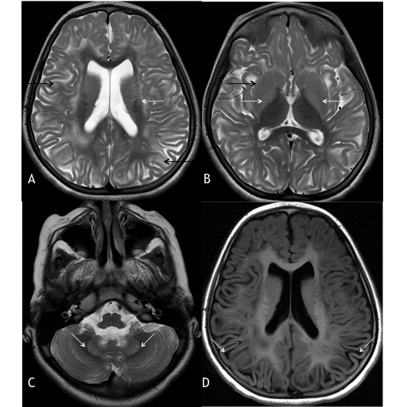
Imaging
© 2018 American Academy of Neurology
Sesh et al.
Notes:
: MR axial T2W images show (A) bilateral symmetrical WM hyperintensity (black arrows) in centripetal pattern involving subcortical and deep WM with sparing of periventricular WM (white arrows); (B) hyperintense basal ganglia (white arrows) with more hyperintensity along the outer rim of putamen (outer rim sign, black arrows); (C) hyperintense dentate nucleus (white arrows) (D) FLAIR image shows rarefaction (white arrows).

Slide 4
Leukoencephalopathy with basal ganglia hyperintensity and outer rim sign of putamen
Urine analysis showed elevated levels of L-2-hydroxyglutaric acid, which confirmed the diagnosis of L-2 Hydroxyglutaric aciduria.
Other differential diagnosis in Leighs disease, 3-hydroxy-3-methylglutaric aciduria and succinic semialdehyde dehydrogenase deficiency
Characteristic MRI findings in L-2HGA are bilateral symmetric basal ganglia and dentate nuclei involvement along with subcortical white matter (WM) abnormality.
© 2018 American Academy of Neurology
Sesh et al.
Notes:
1.Kranendijk M, Struys EA, Salomons GS, Van der Knaap MS, Jakobs C. Progress in understanding 2-hydroxyglutaric acidurias. J Inherit Metab Dis. 2012;35:571–87.
2.Steenweg ME, Salomons GS, Yapici Z, Uziel G, Scalais E, Zafeiriou DI, et al. L-2-Hydroxyglutaric aciduria: pattern of MR imaging abnormalities in 56 patients. Radiology. 2009;251:856–65.

