Slide 1

A 63 year old man with progressive diplopia
Teaching NeuroImages
Neurology
Resident and Fellow Section
© 2018 American Academy of Neurology

Slide 2
Vignette
63 year old man.
No previous medical records.
Slowly progressive left eye pain and diplopia.
Physical examination:
  swollen red left eye with marked conjunctival inflammation
  ipsilateral sixth nerve palsy
  intraocular pressure 35 mm Hg
Ocular fluorescein angiography: severe ingurgitation in the left Superior Ophthalmic Vein.
G. Parrilla et al
© 2018 American Academy of Neurology

Slide 3
Imaging
G. Parrilla et al
© 2018 American Academy of Neurology
Notes:
Figure 1. Photograph of the patient’s eyes. Top image: pre-treatment. Bottom image: post-treatment.

Slide 4
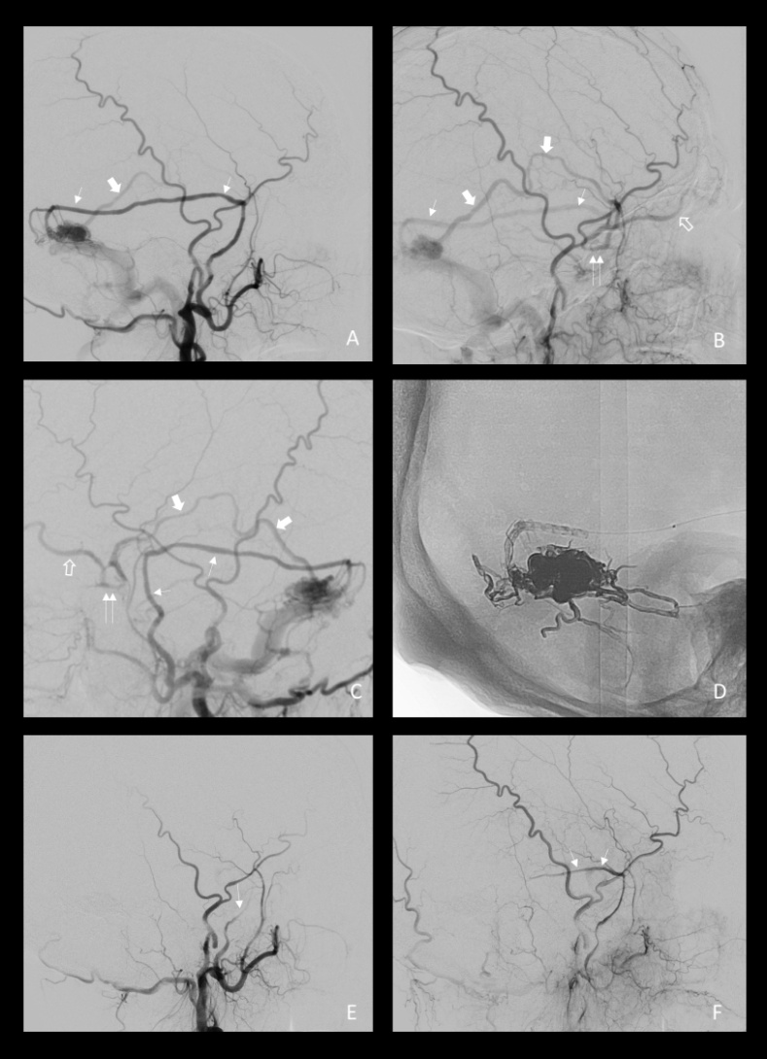
Imaging
G. Parrilla et al
© 2018 American Academy of Neurology
Notes:
Figure 2. Digital subtraction angiography. A, B, C: left transverse sinus dural fistula supplied by the left Middle Meningeal Artery (white-thin arrows), draining to the Superficial Middle Cerebral vein (white-thick arrows), Cavernous Sinus (white-double arrows) and Superior Ophthalmic Vein (white-empty arrows). D: cast of ethylene-vinyl-alcohol-copolymer. E, F: occlusion of the shunt.

Slide 5
Complex Transverse Sinus Fistula and Cavernous Sinus Syndrome
Cavernous sinus syndrome is generally caused by carotid-cavernous dural fistulas.
Exceptionally, it can be due to complex non-cavernous fistulas with rerouting of the venous drainage that reach the cavernous sinus.
G. Parrilla et al
© 2018 American Academy of Neurology
Notes:
References
Buchanan TAS, Harper DG, Hoyt WF. Bilateral proptosis, dilatation of conjunctival veins, and papilloedema: a neuro-ophthalmologic syndrome caused by arteriovenous malformation of the torcular Herophili. British Journal of Ophtalmology 1982; 66: 186-9.
Yamamoto T, Ohshima T, Goto S, Nishihori M, Nishizawa T, Shimoto S, Kato K. A case of cavernous sinues dural arteriovenous fistula after transverse-sigmoid sinus dural arteriovenous fistula treatment with radical transvenous coil embolization. No Shinkei Geka 2015; 43:753-7.

