Slide 1
An 85-year-old male with intractable vomiting and vertigo
Teaching NeuroImages
Neurology
Resident & Fellow Section
Cardenas Y, et al.
© 2017 American Academy of Neurology

Slide 2
Vignette
An 85-year-old male
48 hours of recurrent vomiting and vertigo with rapidly progressive dysphagia and quadriplegia.
MRI-MRA showed a paramedian medullary infarct (Figure 1-A-B-C)
Cardenas Y, et al.
© 2017 American Academy of Neurology

Slide 3
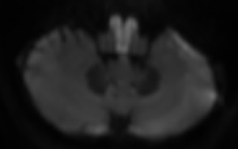
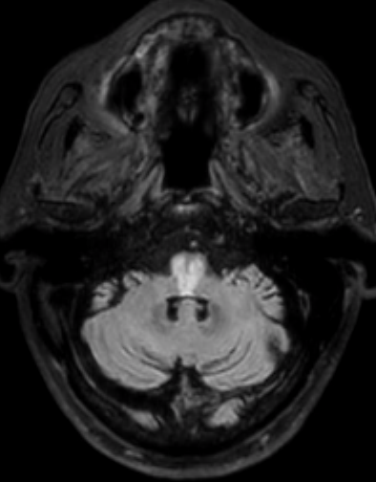
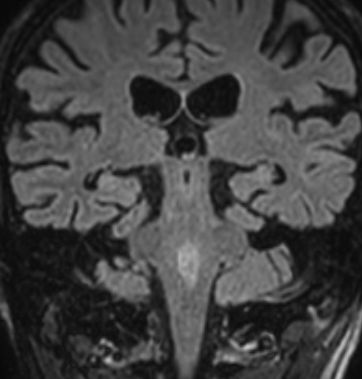
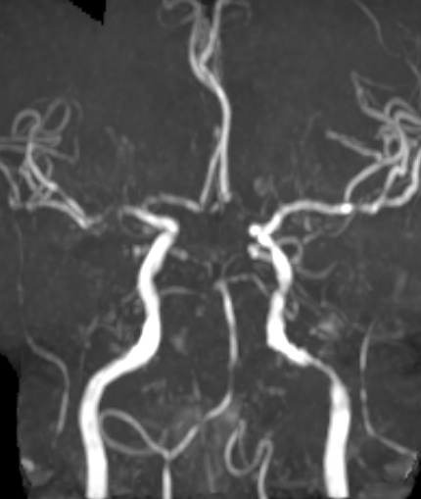
Neuroimaging
Cardenas Y, et al.
© 2017 American Academy of Neurology
Notes:
(A) DWI and (B) Axial FLAIR Image shows an infarction in the bilateral paramedian medulla, with evidence of pontine extension involving the floor of the 4th ventricle (C). (D) MRA reconstruction demonstrates occlusion of the left vertebral artery and areas of thrombosis and stenosis of the proximal basilar artery.

Slide 4
The Heart Sign in a patient presenting as a locked in syndrome
The “HEART SIGN” is the hallmark of the medial medullary infarct, a rare posterior circulation stroke caused by occlusion of the anterior spinal artery.
Clinical presentation is determined by anteroposterior extension.
Associated with quadriplegia, tongue weakness and sensory loss, localized to the pyramidal tracts, hypoglossal nucleus and medial lemniscus respectively.
Our case correlates with pontine extension evidenced by recurrent vomiting, facial diplegia and horizontal ophthalmoplegia, with the involvement of the area postrema, facial colliculus, and paramedian-pontine-reticular-formation.
Cardenas Y, et al.
© 2017 American Academy of Neurology
Notes:
Deshpande A, Chandran V, Pai A, Rao S, Shetty R. Bilateral medial medullary syndrome secondary to Takayasu arteritis. BMJ Case Reports. 2013;2013:bcr0120125600. doi:10.1136/bcr-01-2012-5600.
Benito-Leon J, Alvarez-Cermeno J. Isolated total tongue paralysis as a manifestation of bilateral medullary infarction. Journal of Neurology, Neurosurgery, and Psychiatry. 2003;74(12):1698-1699. doi:10.1136/jnnp.74.12.1698-a.

