Slide 1
Teaching NeuroImages Neurology Resident & Fellow Section
A 78-year-old male with apahsia and right-sided-hemiparesis.
© 2018 American Academy of Neurology

Slide 2
Vignette
78 year-old-male with sudden-onset right-sided weakness and mutism; no history of fever, seizures or headache. On examination abulia, transcortical motor aphasia, right dense hemiplegia were noted.
Contrast-enhanced brain MRI suggested meningitis (figure 1) and ruled out stroke (figure 2).
Cerebrospinal-Fluid analysis: lymphocytic (94%) pleocytosis (163 cells/mm³), abundant Gram-positive-cocci and hyperproteinorrachy (48 mg/dL) with normal CSF-serum glucose ratio.
After 14 days of ceftriaxone-plus-vancomycin, recovery of hemiparesis (MRC 4/5), speech (improved fluency) and CSF-pleocytosis resolution (2 cells/mm³), patient was discharged.
© 2018 American Academy of Neurology
Castillo et al.

Slide 3
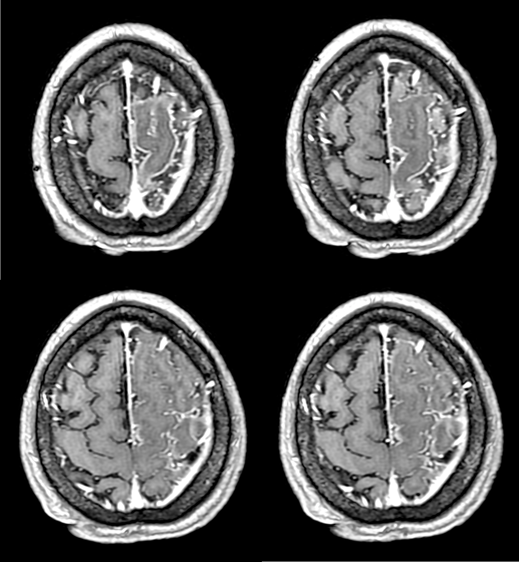
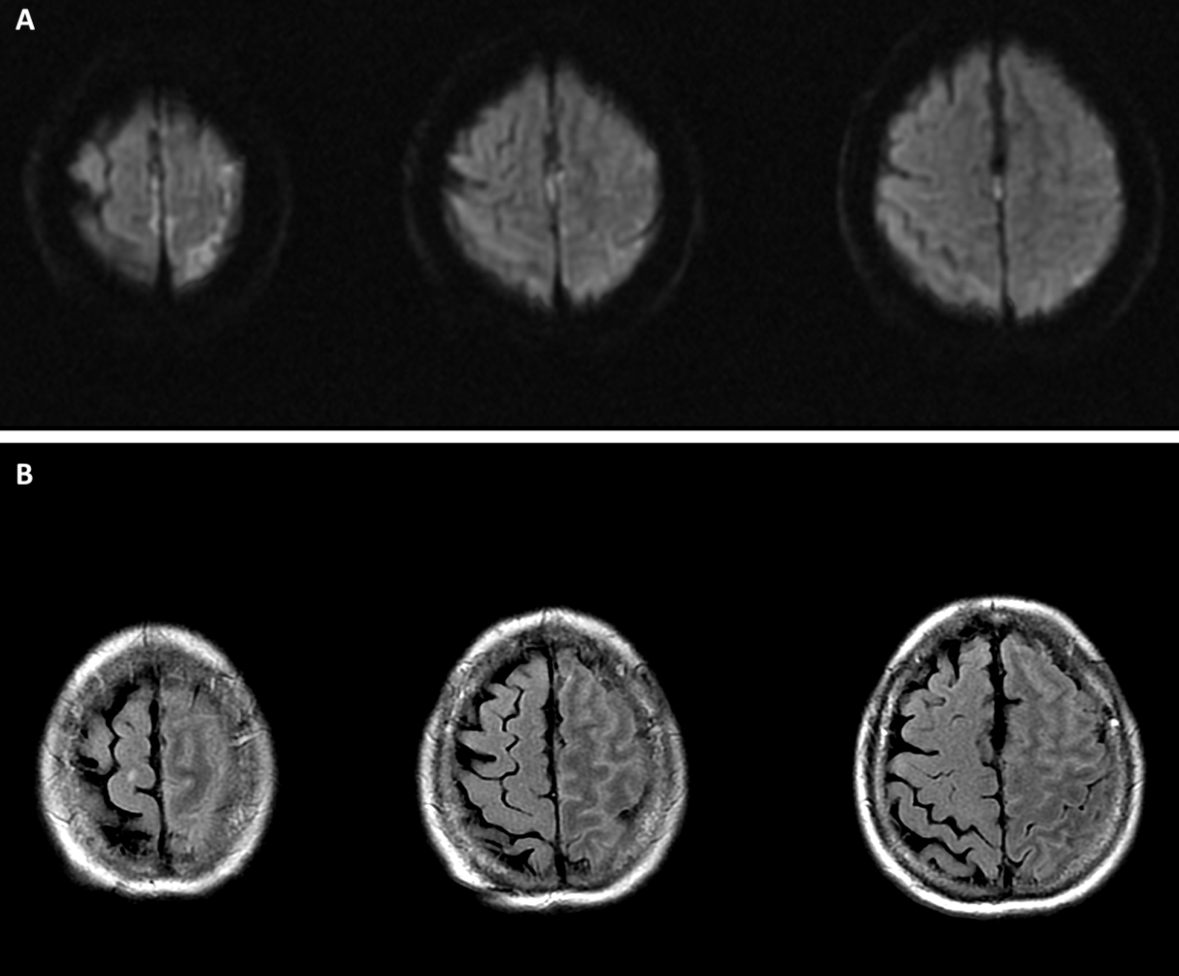
Imaging
© 2018 American Academy of Neurology
Castillo et al.
Notes:
Figure 1. Contrast-Enhanced MRI.
Contrast-enhanced magnetic resonance imaging T1 sequence showing localized unilateral meningeal enhancement on superior and middle left frontal gyri.
Figure 2. Non-contrast enhanced MRI.
Magnetic resonance imaging showing axial diffusion weighted imaging (DWI, Panel A) and FLAIR (Panel B) sequences. There is increased FLAIR signal on prefrontal, superior and middle left frontal gyri without any corresponding changes on DWI.

Slide 4
Hemi-meningitis mimicking acute ischemic stroke.
Localized meningitis is rare.
We found two reports: one stroke-mimic(1), and another associated with necrotizing vasculitis(2).
Castillo et al.
© 2018 American Academy of Neurology
Notes:
1. Ingolfsdottir HM, Caye-Thomasen P. Stroke? Localized, otogenic meningitis! Scand J Infect Dis 2011;43:392-4.
2. Wingerchuk DM, Dyck PJ, Mertz LE. Hemi-meningitis: A focal sign heralding a multisystem necrotizing vasculitis. Neurology 2008;70:2014.

