Slide 1

A 20 year old male with distal parasthesia
Teaching NeuroImages Neurology Resident and Fellow Section
© 2018 American Academy of Neurology

Slide 2
Vignette
A 20 year old male presented to the emergency department with a three week history of parasthesia of his lower limbs.
His gait became clumsy and he was unable to continue his work as a lorry driver.
He then developed parasthesia in his fingers.
In the 48 hours before admission his mobility deteriorated and he was struggling to mobilise with crutches.
The patient was vegetarian but ate both mushrooms and dairy products, however his vitamin B12 level was low (84ng/L).
After questioning he admitted to regular recreational nitrous oxide use at parties.
© 2018 American Academy of Neurology
Stafford, et al.

Slide 3
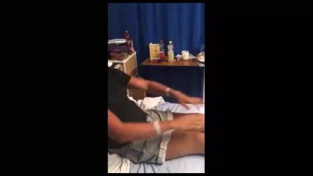
Imaging
1) A 20 year old male with distal parasthesia (video)
Stafford, et al.
© 2018 American Academy of Neurology
Notes:
A 20 year old male with distal parasthesia (video)
Examination revealed a clear dorsal column syndrome with pseudoathetosis of the upper limbs, reduced proprioception of upper and lower limbs with reduced vibration sensation to the xiphisternum. Knee jerk reflexes were brisk bilaterally with absent ankle jerk reflexes and extensor plantars.

Slide 4
Subacute Combined Degeneration with Nitrous Oxide Abuse
Examination of the patient revealed a clear dorsal column syndrome .
MRI showed high signal in the dorsal column throughout the spinal cord.
Vitamin B12 levels in this patient were low (84ng/L).
Nitrous oxide deactivates vitamin B12 by oxidising the cobalt ions in vitamin B12. This impairs transmethylation of homocysteine and ultimately affects myelin synthesis¹.
This patient was managed with vitamin B12 replacement and neurophsyiotherapy and rehabilitation.
Nitric oxide abuse should always be considered in a young patient with a dorsal column syndrome.
Stafford, et al.
© 2018 American Academy of Neurology
Notes:
Vasconcelos, O et al. 2006. Potential Outcome Factors in Subacute Combined Degeneration Review of Observational Studies. Journal of General Internal Medicine, 21/10, 1063-1068.

