Slide 1
A diffuse infiltrating retinoblastoma
Teaching NeuroImages
Neurology
Resident and Fellow Section
© 2017 American Academy of Neurology

Slide 2
Vignette
4-year-old girl
Painless heterochromia iridis
Loss of visual acuity
Funduscopic examination
total retinal detachment
vitreous hemorrhage.
© 2017 American Academy of Neurology
Friang et al

Slide 3
Imaging





*
© 2017 American Academy of Neurology
Friang et al
Notes:
Imaging. Ultrasonography and axial T2-weighted MR imaging showing a total retinal detachment (arrows) with a coarse nodular calcification on a thickened retinal fold (arrowhead) and a subretinal hemorrhage (asterisk)

Slide 4
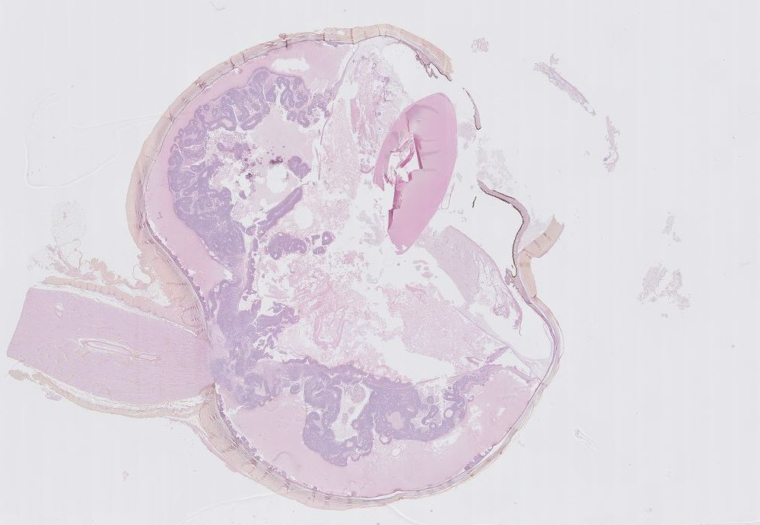
Imaging
© 2017 American Academy of Neurology
Friang et al
Notes:
Histology showing a diffuse infiltrating retinoblastoma.

Slide 5
A diffuse infiltrating retinoblastoma
This entity is rare
It must be suspected in case of a calcified retinal detachment in young children
Enucleation is the diagnosis of choice
© 2017 American Academy of Neurology
Friang et al
Notes:
1. Brisse HJ, Lumbroso L, Fréneaux PC, et al. Sonographic, CT, and MR imaging findings in diffuse infiltrative retinoblastoma: report of two cases with histologic comparison. AJNR Am J Neuroradiol. 2001;22:499–504.
2. Shields CL, Ghassemi F, Tuncer S, Thangappan A, Shields JA. Clinical spectrum of diffuse infiltrating retinoblastoma in 34 consecutive eyes. Ophthalmology. 2008;115:2253–2258.

