Slide 1
A 27 YEAR OLD MAN WITH ORTHOSTATIC HEADACHE
Teaching NeuroImages
Neurology
Resident and Fellow Section
© 2017 American Academy of Neurology

Slide 2
Vignette
A 27-years old man visited our center with a newly developed orthostatic headache.
A few weeks ago, he underwent multiple and repetitive acupunctures at the low-back (L3-S1) to relieve pain, which remained after laminectomy and interbody fusion (L4-S1) for the last few years.
Headache
started with standing,
tinnitus and nausea.
Clear fluid drops observed from the skin at the left low-back
© 2017 American Academy of Neurology
Noh et al.

Slide 3
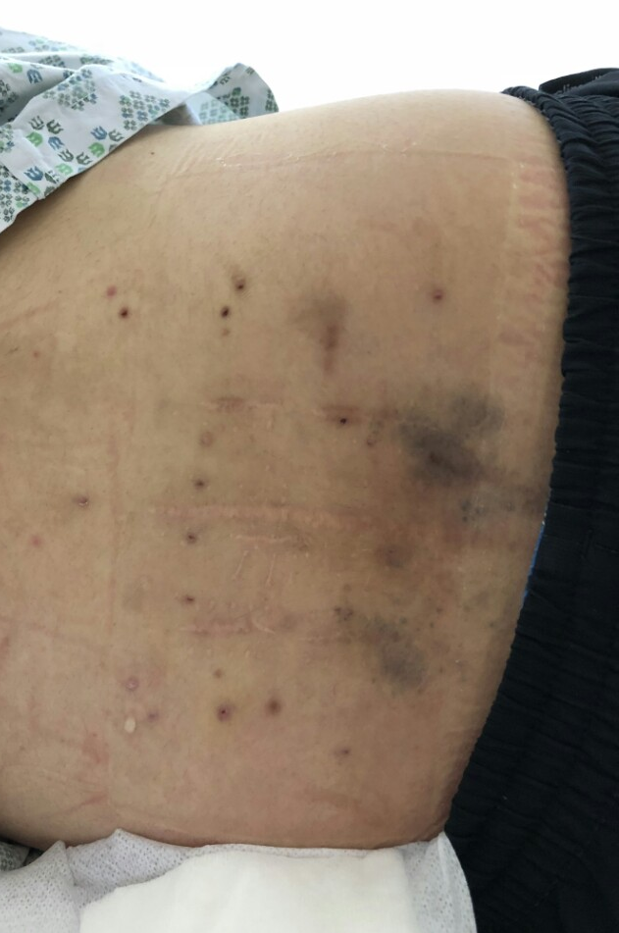
Imaging
Figure 1. Clear fluid drops at the low-back
Figure 2. Fistula formation and CSF leakage
© 2017 American Academy of Neurology
Noh et al.
Notes:
Figure 1 CSF drops at low back
CSF, as water drops, was observed from the left lumbar skin, most prominently in the morning and at the left lateral decubitus position.
Figure 2 Fistula formation and CSF leakage
CSF leakage (left L3-4-5 area; arrow) and abnormal fluid collection (along the left paraspinal muscle; arrow head) was observed (A). A fistula formation (arrow) between neural foramen and abnormal fluid collection was observed at the laminectomy site (A and B magnetic resonance myelography, C: T2 weighted image).

Slide 4
Cerebrospinal Fluid Leakage Observed from Skin after Acupuncture
Repetitive acupuncture treatment after laminectomy may cause intracranial hypotension with fistula formation.
Duroplasty (L4-5) with primary suture of the fistula improved the patient’s orthostatic headache.
© 2017 American Academy of Neurology
Noh et al.
Notes:
Reference
1.Chazen JL, Talbott JF, Lantos JE, Dillon WP. MR myelography for identification of spinal CSF leak in spontaneous intracranial hypotension. AJNR American journal of neuroradiology 2014;35:2007-2012.

