Slide 1
Teaching NeuroImages
Lower cervical spine dural arteriovenous fistula presenting as subarachnoid hemorrhage
Neurology
Resident and Fellow Section
© 2018 American Academy of Neurology

Slide 2
Vignette
A 39-year-old man presented with sudden neck pain and headache.
CT showed subarachnoid hemorrhage around medulla oblongata.
Diagnostic angiography demonstrated a rare spinal dural arteriovenous fistula at the level of C5.
Gao et al.
© 2018 American Academy of Neurology

Slide 3
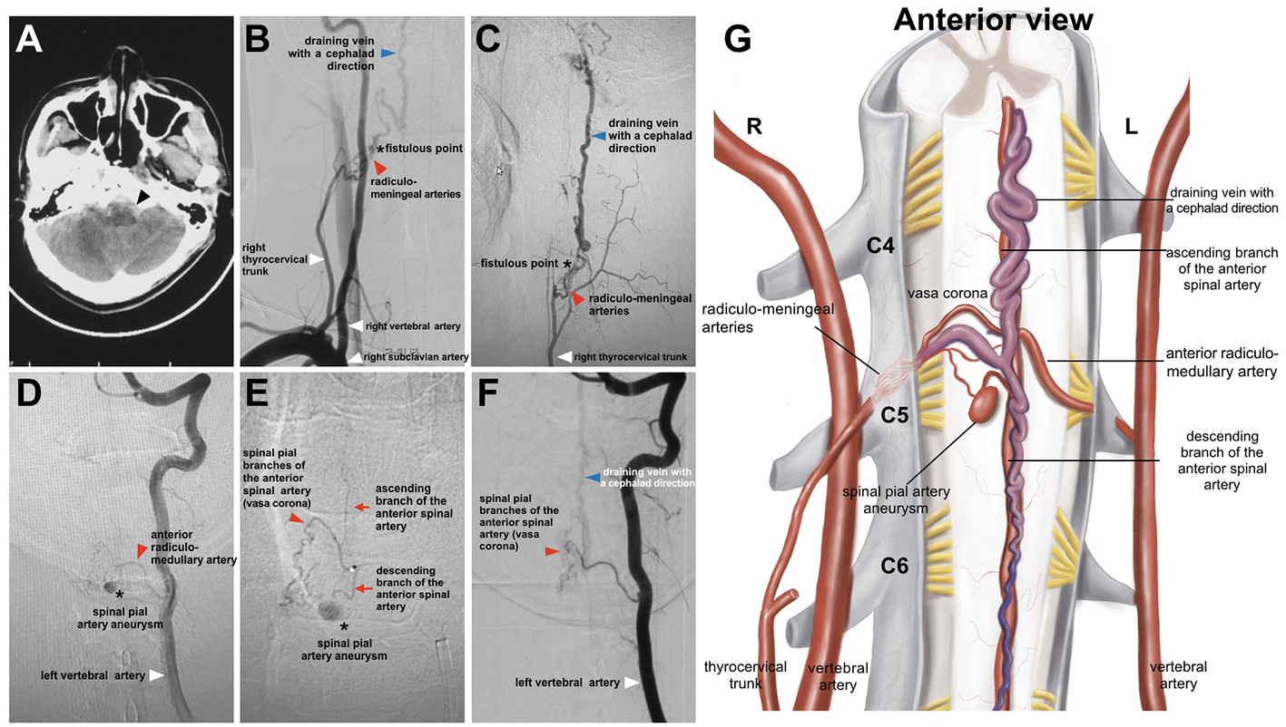
Imaging
Gao et al.
© 2018 American Academy of Neurology
Notes:
Figure 1
(A) subarachnoid hemorrhage on CT (black arrowhead). Anterior (B) and lateral view (C), angiography of right thyrocervical trunk. (D) angiography of left vertebral artery. (E) superselective angiography of anterior radiculo-medullary artery. (F) control angiography after aneurysm embolization. (G) schematic illustration.

Slide 4
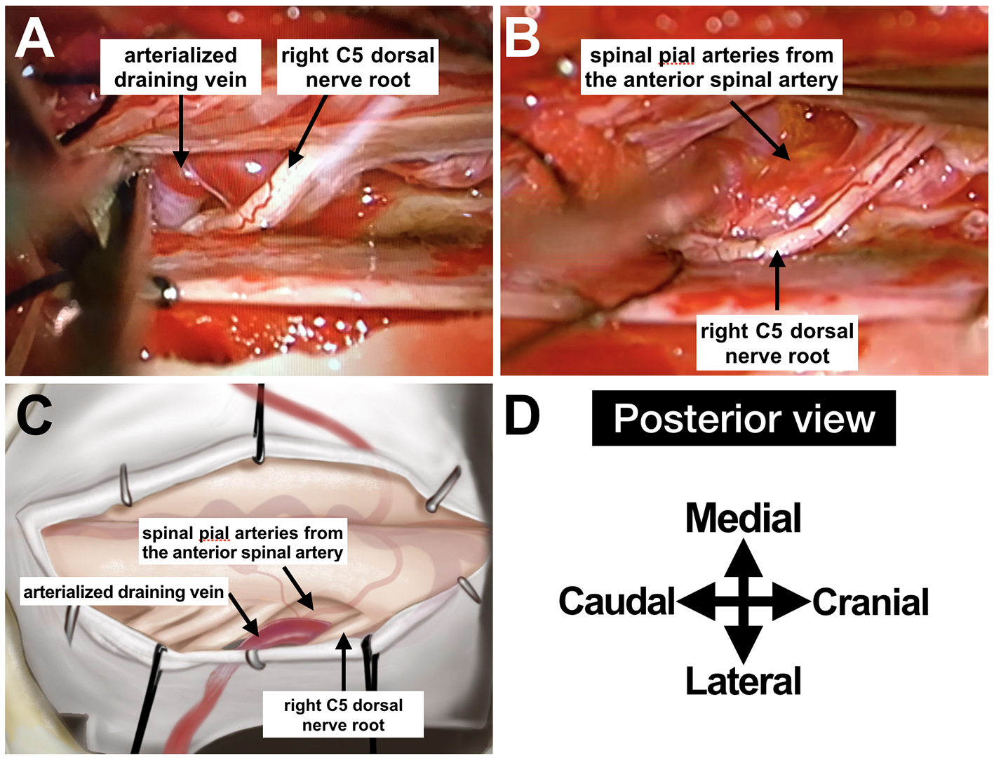
Imaging
Gao et al.
© 2018 American Academy of Neurology
Notes:
Figure 2
Intraoperative findings (A and B), illustration (C) and surgical orientation (D)

Slide 5
Lower cervical spine dural arteriovenous fistula presenting as subarachnoid hemorrhage
The fistula recruits additional spinal pial arteries from the anterior spinal artery as feeding artery, most likely due to the venous-sump effect induced by the dural shunt.(1)
A spinal pial aneurysm, potential cause of hemorrhage, was presumed to be related to the hemodynamic stress produced by the high-flow through the shunt(2).
Endovascular embolization of the aneurysm and surgical interruption of the fistula was performed successfully.
Gao et al.
© 2018 American Academy of Neurology
Notes:
References
1. Kim DJ, Willinsky R, Geibprasert S, et al. Angiographic characteristics and treatment of cervical spinal dural arteriovenous shunts. AJNR Am J Neuroradiol. 2010;31:1512–1515.
2. Lucas JW, Jones J, Farin A, Kim P, Giannotta SL. Cervical spine dural arteriovenous fistula with coexisting spinal radiculopial artery aneurysm presenting as subarachnoid hemorrhage: case report. Neurosurgery. 2012;70:E259–63–discussionE263.

