Slide 1
Teaching NeuroImages
Wish bone pattern of iron accumulation: A characteristic imaging sign in GM1 gangliosidosis
Neurology
Resident & Fellow Section
© 2018 American Academy of Neurology

Slide 2
Vignette
A 8-year-old girl, with no significant development or family history, presented with progressive orolingual and limb dystonia since 3 years of age.
MRI brain showed bilateral posterior putamen volume loss and hyperintensity.
Susceptibility weighted images (SWI) showed globus pallidus blooming in characteristic wish bone pattern with medial and lateral parts forming the forked ends.
MRI spine showed features of dysostosis with platyspondyly and vertebral beaking.
B-Galactosidase assay was low and genetic workup revealed compound heterozygous pathogenic mutation in GLB1 gene.
Malik, et al.
© 2018 American Academy of Neurology

Slide 3
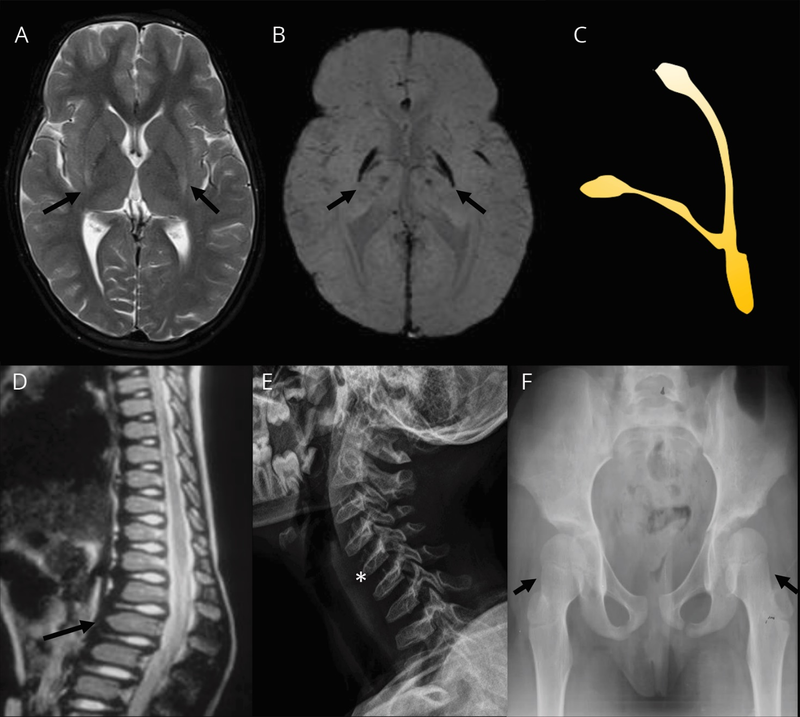
Imaging
Malik, et al.
© 2018 American Academy of Neurology
Notes:
Figure. Axial T2-weighted (A) showing posterior putamen hyperintensity and volume loss. SWI (B) and animation (C) showing blooming in globus pallidus in a wish bone pattern. Sagittal T2-weighted spine (C) and cervical radiograph (D) showing platyspondyly (asterisk) with beaking of vertebra (arrow). Pelvis radiograph (D) showing bilateral coxa valga
VIDEO LEGEND
Demonstrates Holme’s tremor in the left arm; classically characterized as a combination of rest and postural tremor of irregular and large amplitude usually affecting the proximal upper extremity. Postural and intention tremor is also present in right arm.

Slide 4
Wish bone pattern of iron accumulation: A characteristic imaging sign in GM1 gangliosidosis
Combination of putaminal finding and wish bone pattern of iron deposition is highly diagnostic of late onset /Type 3 GM1gangliosidosis (1,2) and helps differentiate from NBIA(Neurodegeneration with Brain Iron Accumulation).
Malik, et al.
© 2018 American Academy of Neurology
Notes:
References
1. Hajirnis O, Udwadia‐Hegde A. Chronic GM1 Gangliosidosis with Characteristic “Wish Bone Sign” on Brain MRI. Another Type of Neurodegeneration with Brain Iron Accumulation? Mov Disord Clin Pract. 2015 Sep 1;2(3):323–5.
2. Pillai SH, Sundaram S, Zafer SM, Rajan R. Expanding the phenotypic spectrum of type III GM1 gangliosidosis: Progressive dystonia with auditory startle. Neurol India. 2018 Mar 1;66(7):149.

