Slide 1
45-year-old man with increasing visual impairment
Teaching NeuroImages
Neurology
Resident and Fellow Section
© 2018 American Academy of Neurology

Slide 2
VIGNETTE
45-year-old man with increasing visual impairment
Non-specific lesion at the cavernous sinus on MRI
High focal uptake of the lesion on ⁶⁸Ga-DOTATATE PET/CT
Brain biopsy: non-caseating epithelioid granulomas and macrophages.
© 2018 American Academy of Neurology
Unterrainer et al.

Slide 3
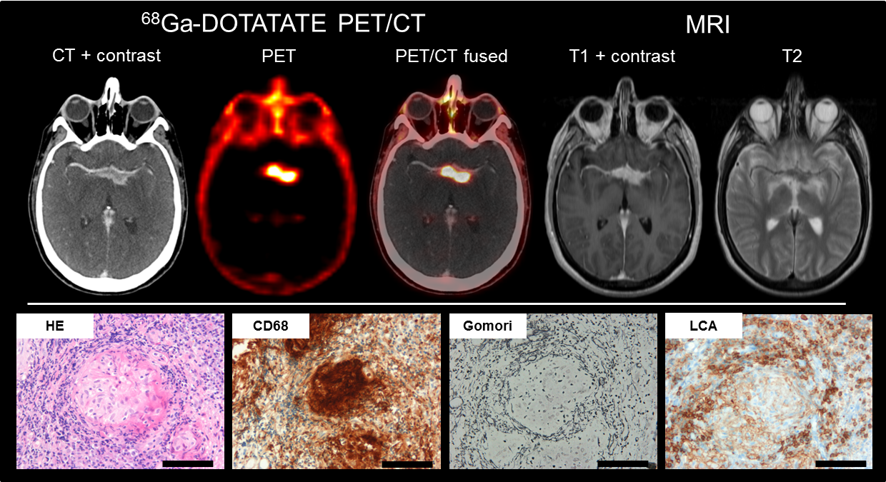
Imaging
© 2018 American Academy of Neurology
Unterrainer et al.
Notes:
MRI: contrast-enhancing lesion in the cavernous sinus with perifocal edema and contact to the chiasm and the blood vessels. ⁶⁸Ga-DOTATATE PET/CT: extraordinarily high ⁶⁸Ga-DOTATATE-uptake. HE staining: non-caseating epithelioid granulomas. CD68 staining: tightly packed epitheloid macrophages. Gomori staining: incipient perigranulomatous fibrosis surrounded by LCA-positive lymphocytes (magnification: 20x, bars: 100 µm).

Slide 4
Advanced imaging of neurosarcoidosis with ⁶⁸Ga-DOTATATE PET/CT
Initial diangosis of neurosarcoidosis
⁶⁸Ga-DOTATATE targets the somatostatin-receptor (SSR)
SSR is expressed by tumor cells in neuroendocrine tumors, but also by activated macrophages as present in neurosarcoidosis
Targeted radionuclide therapies using SSR-ligands labeled with beta-emitting isotopes might offer additional therapeutic options in patients with treatment-refractory neurosarcodosis
© 2018 American Academy of Neurology
Unterrainer et al.
Notes:
References:
Armani C, Catalani E, Balbarini A, Bagnoli P, Cervia D. Expression, pharmacology, and functional role of somatostatin receptor subtypes 1 and 2 in human macrophages. Journal of leukocyte biology 2007;81:845-855.
Lapa C, Kircher M, Hänscheid H, et al. Peptide receptor radionuclide therapy as a new tool in treatment-refractory sarcoidosis-initial experience in two patients. Theranostics 2018;8:644.

