Slide 1
A five-month old unresponsive male presenting with concern for non-accidental trauma
Teaching NeuroImages
Neurology
Resident & Fellow Section
© 2019 American Academy of Neurology

Slide 2
Vignette
5-month old male presented with R gaze preference and upper extremity shaking concerning for seizure activity
Patient intubated and neurological exam limited to withdrawal in all four extremities
Head CT and subsequent brain MRI demonstrated bilateral acute on chronic subdural hematomas, measuring up to 12mm on left and 4mm on right causing slight rightward midline shift
Intracranial injuries were non-operative at time of presentation but poor neurological exam persisted
Social work-up was concerning for non-accidental trauma
Hong et al.
© 2019 American Academy of Neurology

Slide 3
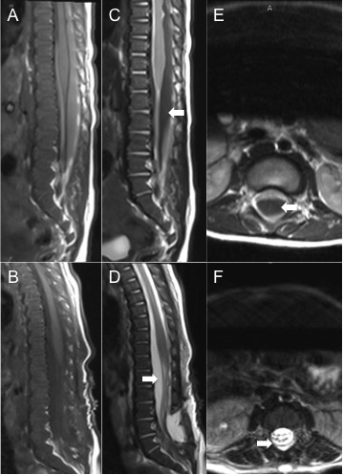
Imaging
Hong et al.
© 2019 American Academy of Neurology
Notes:
Sagittal T1-MRI (A) pre- (B) post-operatively, T2-MRI (C) pre- (D) post-operatively, and axial T2-MRI through L1-2 disc space (E) pre- (F) post-operatively demonstrating T2-hypointense subdural hemorrhage (arrows, panels C, E) causing thecal sac effacement with resolved compression and restoration of T2-hyperintense CSF signal (arrows, panels D, F) post-operatively.

Slide 4
A five-month old unresponsive male presenting with concern for non-accidental trauma
Spinal hematomas may be concurrent in severe intracranial injury in pediatric patients
Extensive spinal subdural hematomas may be evacuated neurosurgically via minimally invasive laminectomies and copious cephalad irrigation of the subdural space
Concomitant intracranial and spinal subdural hematomas may promote a pressure gradient from brain to spine necessitating evacuation of both compartments
Spinal imaging should be considered in suspected cases of pediatric non-accidental trauma with severe intracranial injury and/or poor neurological exam^{1,2}
Hong et al.
© 2019 American Academy of Neurology
Notes:
1. Choudhary AK, Bradford RK, Dias MS, Moore GJ, Boal DK. Spinal subdural hemorrhage in abusive head trauma: a retrospective study. Radiology. Jan 2012;262(1):216-223.
2. Gunda D, Cornwell BO, Dahmoush HM, Jazbeh S, Alleman AM. Pediatric Central Nervous System Imaging of Nonaccidental Trauma: Beyond Subdural Hematomas. Radiographics. Nov 23 2018:180084.

