Slide 1
A 48 year-old woman with seizures and headache.
Teaching NeuroImages
Neurology
Resident & Fellow Section
© 2019 American Academy of Neurology

Slide 2
Vignette
A 48-year-old woman with sensorineural hearing loss and diabetes presented with seizures and headache.
She was thin and short-statured.
Exam revealed encephalopathy, left homonymous hemianopia, and hemi-neglect.
Zuflacht, et al.
© 2019 American Academy of Neurology

Slide 3
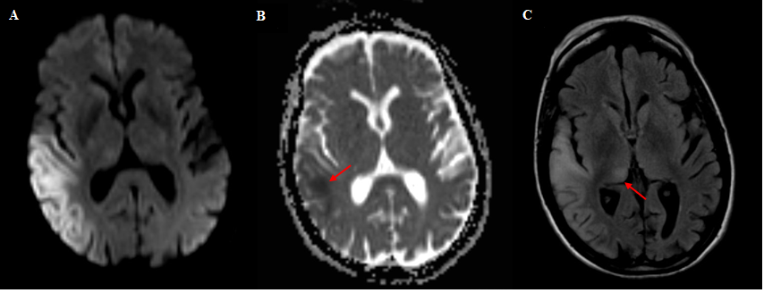
Imaging
Zuflacht, et al.
© 2019 American Academy of Neurology
Notes:
Figure 1. Brain MRI demonstrated a cortically-based region of slow diffusion (A) in the right parietal and right temporal lobes with a small area of darkness on ADC (B, arrow) which did not correlate fully with the extent of diffusion restriction. There was corresponding T2 FLAIR hyperintensity along with mild effacement of the associated sulci (C). In addition, there was abnormal T2 FLAIR signal in the right medial thalamus (C, red arrow).

Slide 4
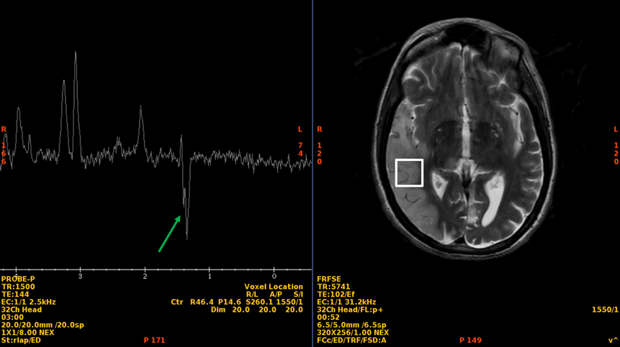
Imaging
Zuflacht, et al.
© 2019 American Academy of Neurology
Notes:
Figure 2. MR spectroscopy (A) within the region of slow diffusion (B) demonstrates an inverted doublet at 1.3 ppm (green arrow) consistent with a lactate peak and anaerobic metabolism.

Slide 5
A 48 year-old woman with seizures and headache.
Diagnosis: Mitochondrial encephalomyopathy, lactic acidosis, and stroke like episodes (MELAS).
Genetic testing showed m.3243A>G pathogenic variant of the MT-TL1 gene.
This mutation is found in more than 80% of patients with MELAS and always coexists with wild-type DNA.
Zuflacht, et al.
© 2019 American Academy of Neurology
Notes:
References
1. Ito, H., Mori, K., and Kagami, S. Neuroimaging of stroke-like episodes in MELAS. Brain Dev. 2011 Apr;33(4):283-8.
2. Goto, Y., Nonaka, I., and Horai, S. A mutation in the tRNA(Leu)(UUR) gene associated with the MELAS subgroup of mitochondrial encephalomyopathies. Nature. 1990 Dec 13;348(6302):651-3.

