Slide 1
A 32 months old male with progressive developmental regression
Teaching NeuroImages Neurology
Resident & Fellow Section
© 2019 American Academy of Neurology

Slide 2
Vignette
A 32 months old boy, born at term, presented with progressive developmental regression from 14 months of age.
On examination he had horizontal nystagmus, diminished gag reflex, hypertonicity and depressed reflexes.
His Arylsulphatase A enzyme activity was decreased.
He was homozygous for the c.465+1G gene, pathogenic variant in the ARSA gene, confirming MLD
Sonowal et al.
© 2019 American Academy of Neurology

Slide 3
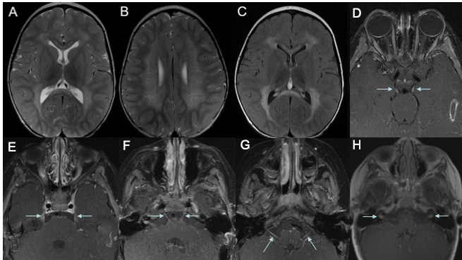
Imaging
Sonowal et al.
© 2019 American Academy of Neurology
Notes:
Axial T2 (Fig. A, B) and FLAIR (Fig. C) images showing symmetric confluent hyperintensities in a leopard like appearance throughout the periventricular white matter, centrum semiovale (sparing subcortical U fibers), genu and splenium of the corpus callosum. Axial contrast enhanced T1 images showing symmetric enhancement of the bilateral third cranial nerve (Fig. D, arrows), bilateral fifth cranial nerve (Fig. E, arrows), bilateral sixth cranial nerve (Fig. F, arrows) and bilateral seventh cranial nerve (Fig. G, arrows) and eighth cranial nerve (Fig. H, arrows).

Slide 4
A rare case of Metachromatic Leukodystrophy with multiple bilateral cranial nerve enhancement
In MLD there is accumulation of a metachromatic lipid material, galactosylceramide sulfatide, leading to the breakdown of the myelin sheath in both central and peripheral nervous systems, initially sparing the subcortical “U” fibers.
The typical radiographic appearance of MLD is a tigroid appearance and multiple bilateral symmetric cranial nerve enhancements.
The tigroid pattern is best seen as hypointensity on T2-weighted images on the background of abnormally T2 hyperintense white matter.
Sonowal et al.
© 2019 American Academy of Neurology
Notes:
1. Singh RK, Leshner RT, Kadom N, Vanderver AL. Isolated Cranial Nerve Enhancement in Metachromatic Leukodystrophy. Pediatr Neurol. 2009 May;40(5):380-2. PubMed Google Scholar.
2. Maia AC Jr, da Rocha AJ, da Silva CJ, Rosemberg S. Multiple cranial nerve enhancement: a new MR imaging finding in metachromatic leukodystrophy AJNR Am J Neuroradiol. 2007 Jun-Jul;28(6):999. PubMed Google Scholar.

