Slide 1
In different stages,
the characteristic imaging sign of ¹⁸F-FDG-PET in a LGI-1 AE patient
Teaching NeuroImages
Neurology
Resident & Fellow Section
© 2018 American Academy of Neurology

Slide 2
Vignette
A 50-year-old woman was admitted with frequent faciobrachial dystonic seizures (FBDS), complex partial seizures (CPS), generalized tonic-clonic seizures (GTCS), memory loss and psychological disturbance.
No focal deficit was found on neurological examinations, with the exception of memory loss. Laboratory tests showed mild hyponatremia. Serum and CSF leucine-rich glioma-inactivated 1 (LGI-1) antibodies were positively detected.
Interictal EEG revealed diffuse slow waves, especially in left temporal lobe region, and no epileptiform discharges were observed on ictal EEG.
The brain MRI following admission showed no abnormal intensity 43 days after the onset of her conditions, ¹⁸F-fluoro-2-deoxy-d-glucose PET (¹⁸F-FDG-PET) showed regional hypermetabolism both in the medial temporal lobe (MTL) and basal ganglia (BG) 55 days after the onset.
She responded well to immunotherapy and was subsequently discharged. However, she had a recurrence, with reemerging and aggravated FBDS after about 4 months.
The review ¹⁸F-FDG-PET revealed enlarged hypermetabolism in MTL and BG.
Her conditions improved again following treatment, and at the same time, ¹⁸F-FDG-PET showed reversible metabolic changes.
She rechecked brain MRI and showed hyperintensity in the left MTL, 217 days after the onset of her symptoms, and eventually evolved to hippocampus atrophy 384 days after onset.
Wei Shan, et al.
© 2018 American Academy of Neurology

Slide 3
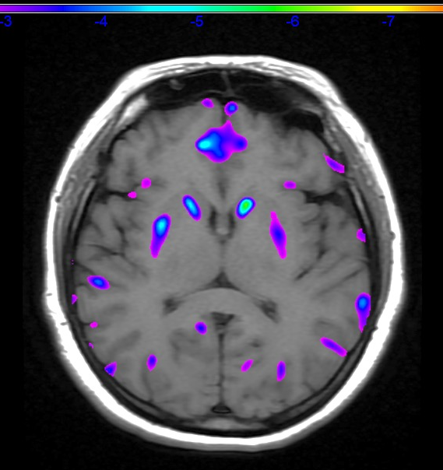
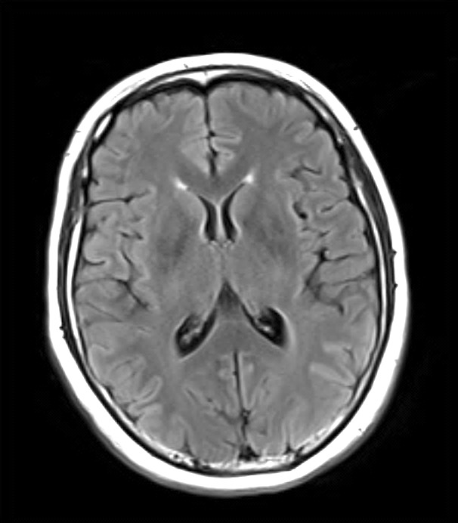
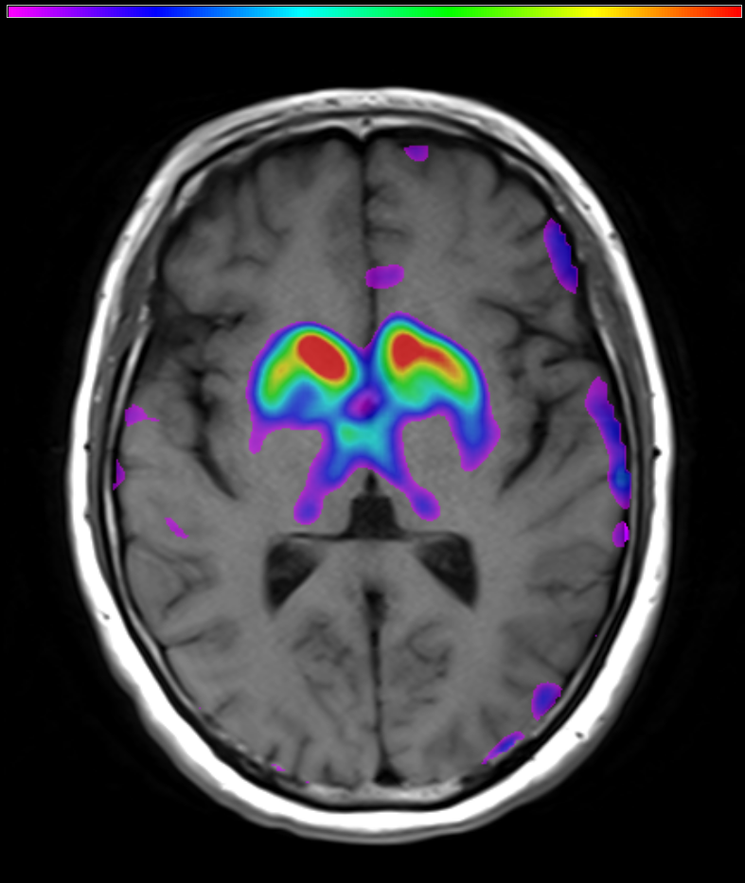
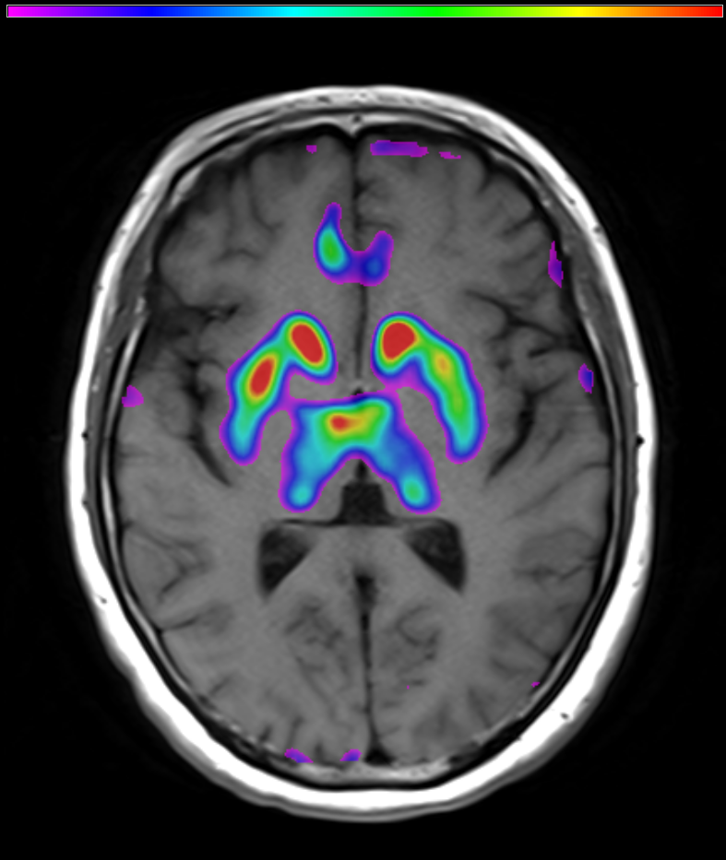
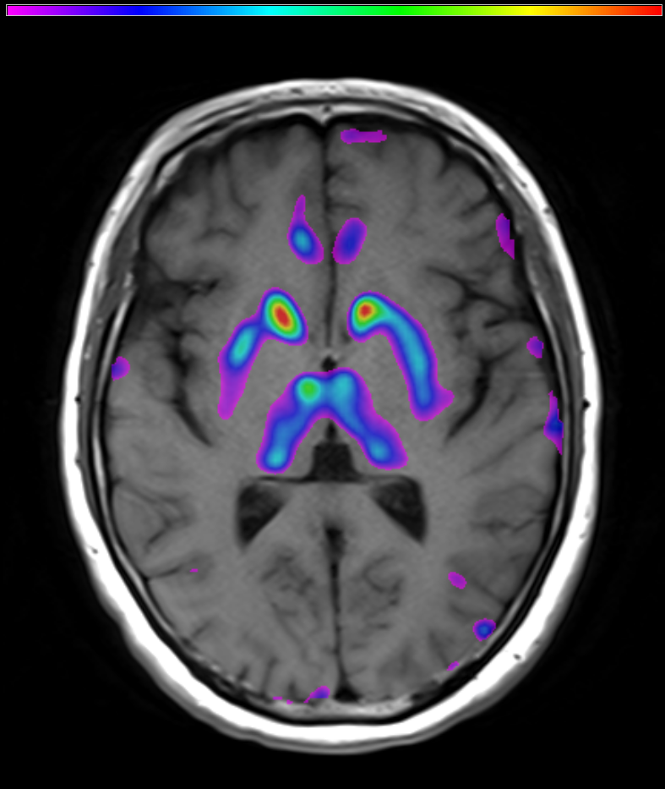
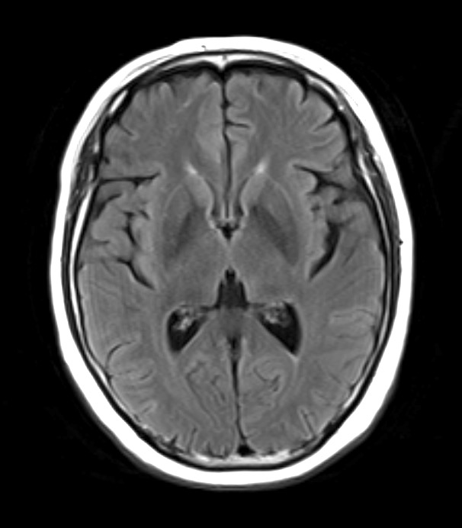
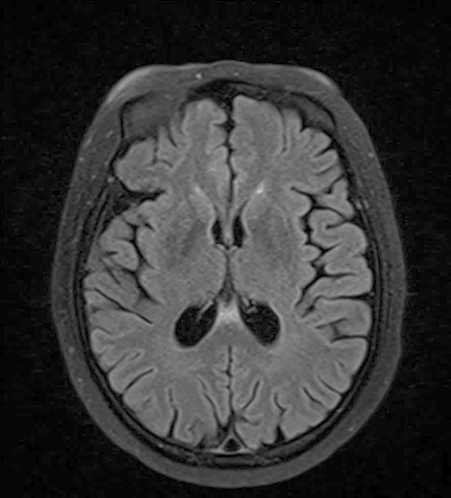
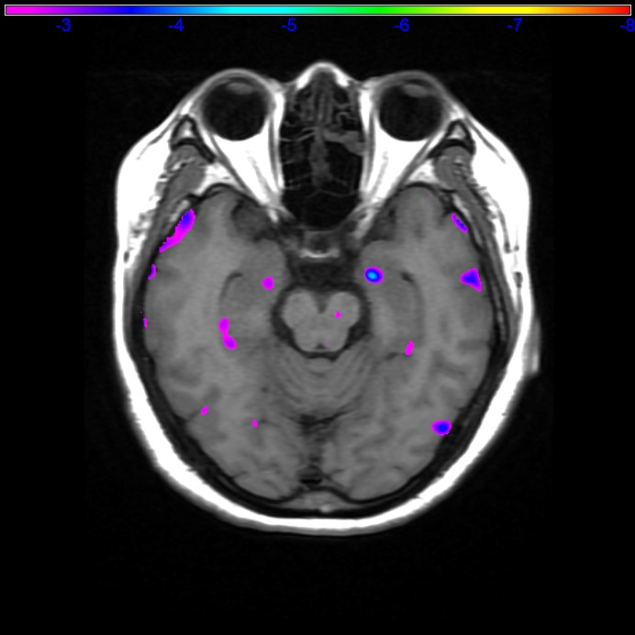
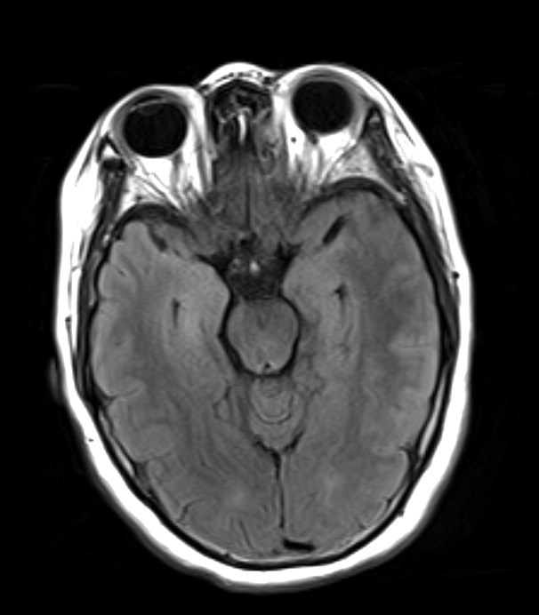
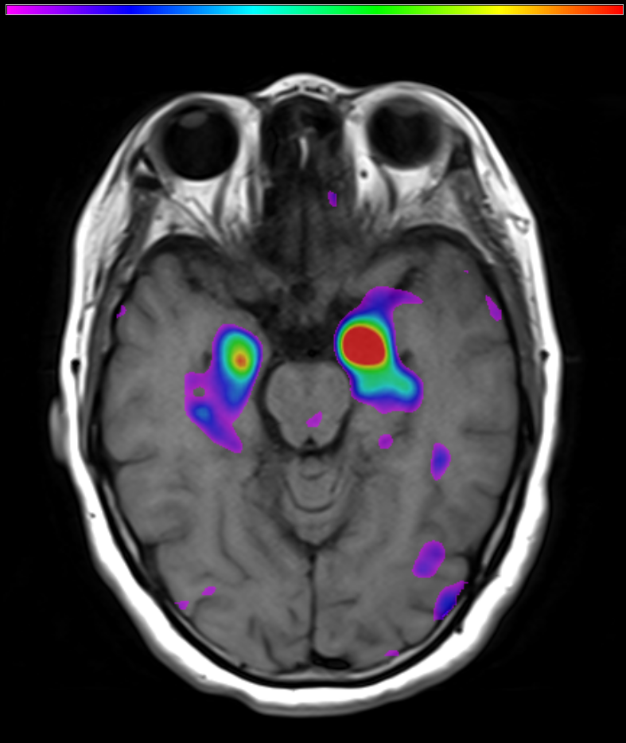
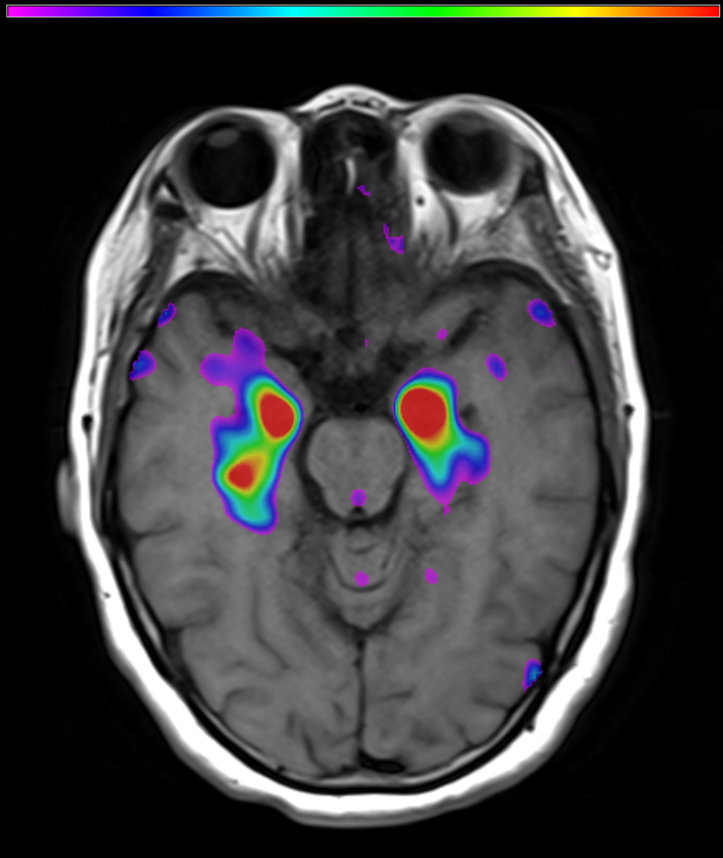
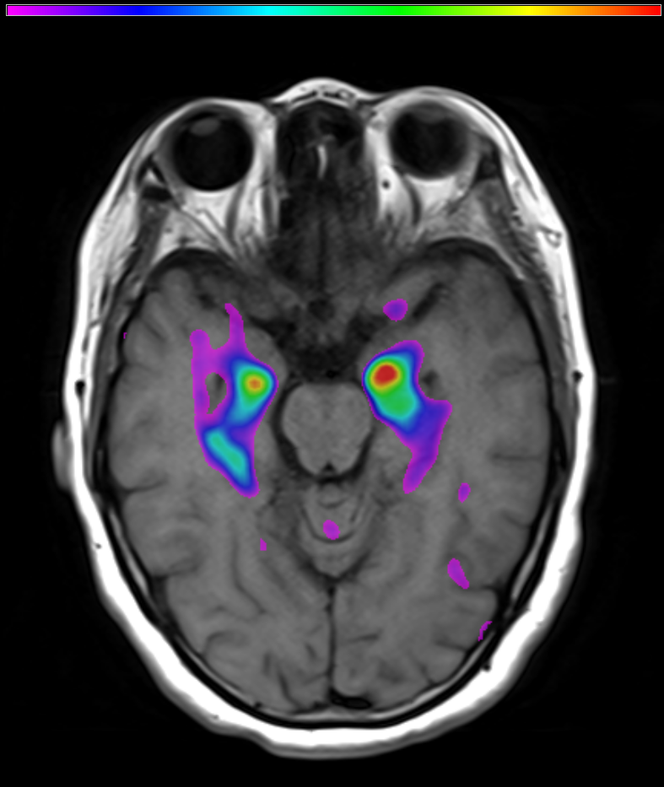
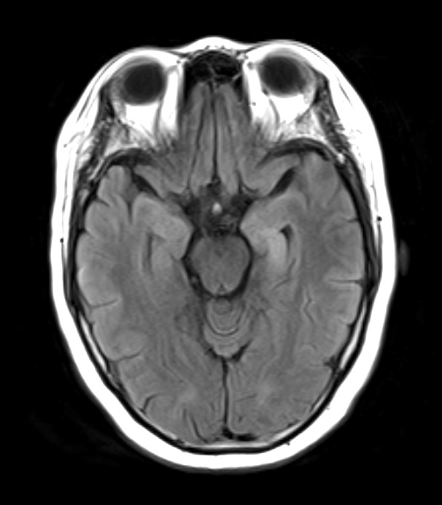
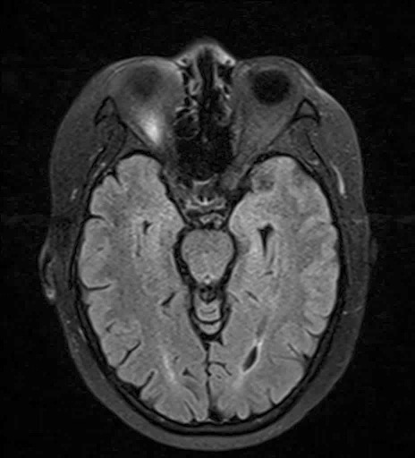
A
VPA 500mg bid
IVIG(0.4g/kg*d, 5 days)
IVMP(500mg/d, 3 days,
240mg/d, 3 days, 120mg/d, 3 days)
IVMP(500mg/d, 3 days, 240mg/d,
3 days, 120mg/d, 3 days)
Oral prednisone
IVMP(500mg/d, 3 days, 240mg/d,
3 days, 120mg/d, 3 days)
Oral prednisone
Day 0
Day 41
Day 55
Day 91
Day 192
Day 217/384
FBDS
On-set
ER
Neurological
Center
LGI-1 antibody titer 1:100/PET
Neurological
Center
PET Recheck
Neurological
Center
Relapse
LGI-1 antibody titer 1:100/PET
Neurological
Center
MRI Recheck
Preliminary diagnosis
Epilepsy
B
PET/SPM assay
MRI
PET/SPM assay
MRI
control
43 days
55 days
91 days
192 days
217 days
384 days
BG
MTL
Wei Shan, et al.
© 2018 American Academy of Neurology
Notes:
¹⁸F-FDG-PET/SPM follow up study for LGI-1 patient with FBDS
Sequence of events after the patient FBDS symptoms appeared.
(B) Represented MRI image and ¹⁸F-FDG-PET/SPM (P< 0.01) image in three different time stages from admission diagnosis, relapse, discharge, and review.

Slide 4
In different stages, the characteristic imaging sign of ¹⁸F-FDG-PET in a LGI-1 AE patient
In this case, we have 2 important discoveries, (1) ¹⁸F-FDG-PET imaging is earlier than MRI in the diagnosis of LGI1 AE.
(2) Basal ganglia and medial temporal lobe hypermetabolism are special higher.
Wei Shan, et al.
© 2018 American Academy of Neurology
Notes:
Reference:
1. Graus, Francesc, et al. "A clinical approach to diagnosis of autoimmune encephalitis." The Lancet Neurology 15.4 (2016): 391-404.
2. Tüzün, Erdem, and Josep Dalmau. "Limbic encephalitis and variants: classification, diagnosis and treatment." The neurologist13.5 (2007): 261-271.

